Slide 1
Global Illumination

Slide 2
Local Illumination
the GPU pipeline is designed for local illumination
  only the surface data at the visible point is needed to compute the lighting
    primitives can be generated, processed, and then discarded
many (most?) visual effects depend on points other than just the point being rendered
  using the GPU pipeline we can approximate some of these effects in a piecemeal fashion

Slide 3
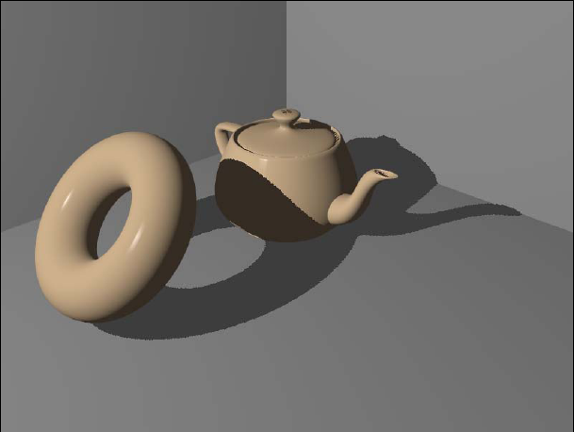
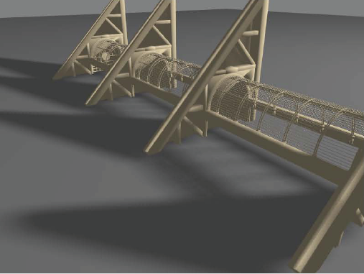
Shadows

Slide 4
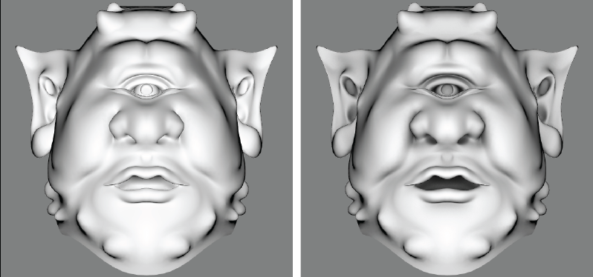
Ambient Occlusion

Slide 5
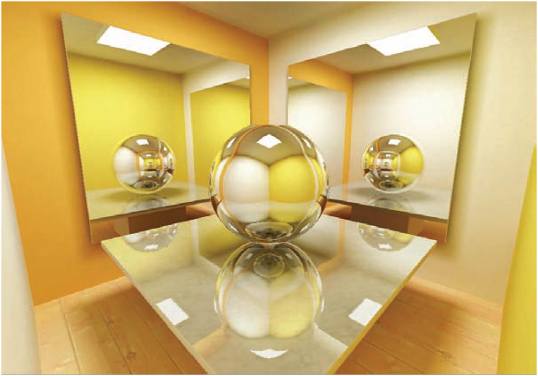
Reflections

Slide 6

Transmittance

Slide 7

Transmittance

Slide 8
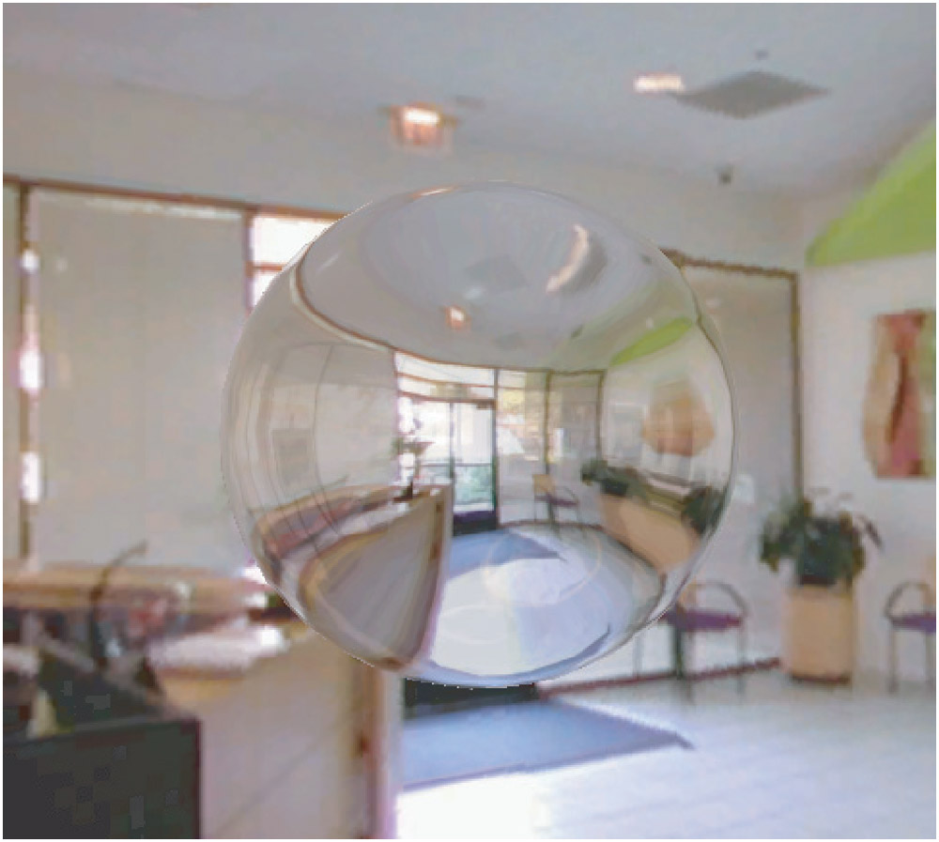
Refraction

Slide 9
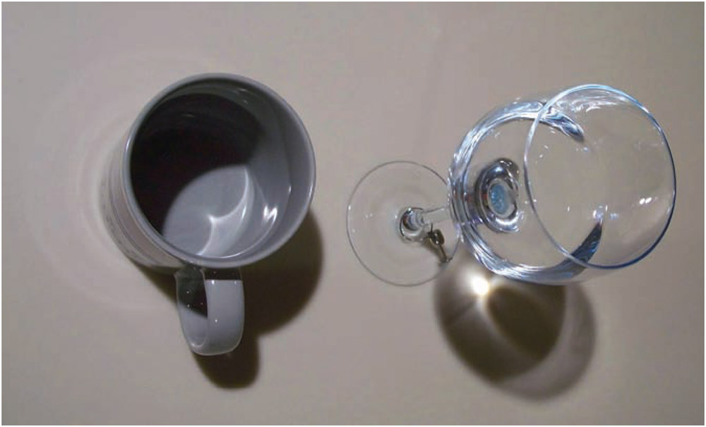
Caustics

Slide 10
Full Global Illumination
rendering equation (Kajiya, 1986)
emitted
radiance
from p in
direction v
BRDF for
light direction l
and view
direction v
integrate over
all possible l
in Ω
outgoing
radiance
from p in
direction v
hemisphere
of directions
above p
incoming radiance
at p from light
direction l
=
outgoing radiance
from some other
point in the
opposite direction –l

Slide 11
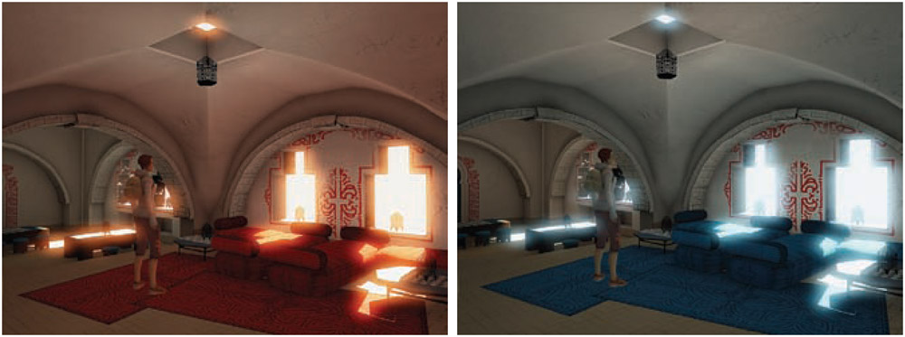
Radiosity

Slide 12
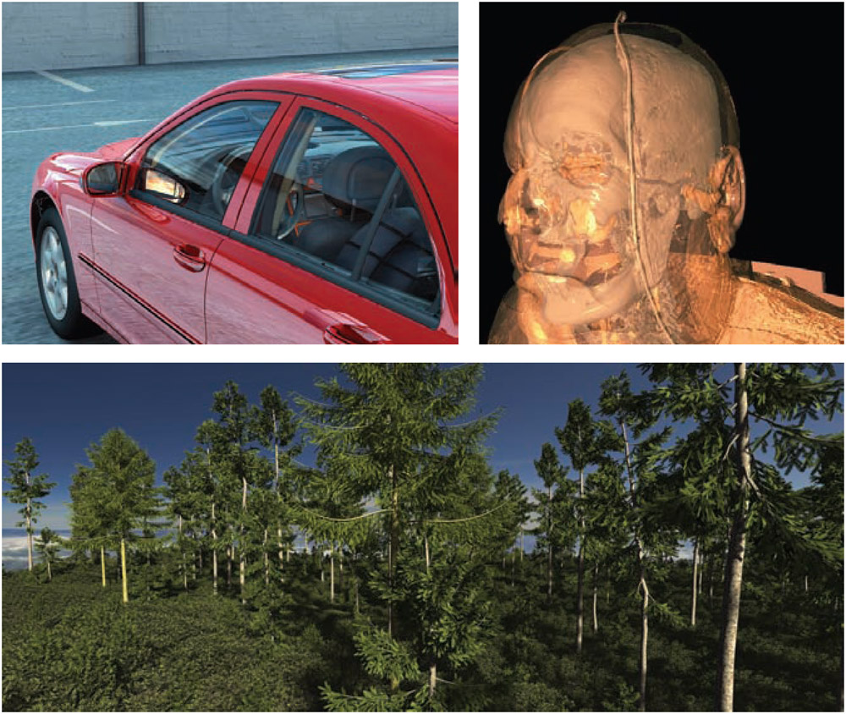
Ray Tracing

Slide 13
Ambient Occlusion

Slide 14
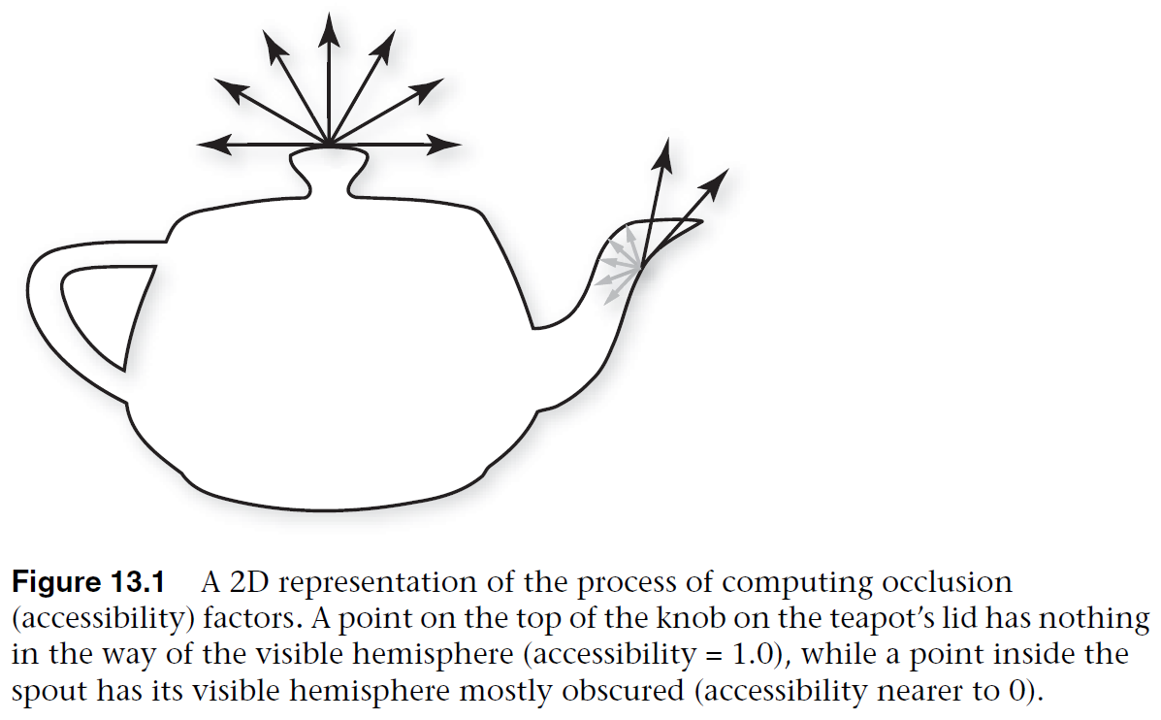
Ambient Occlusion
ambient occlusion is the shadowing of ambient light
  ambient light illuminates evenly from all directions

Slide 15
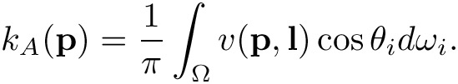
Ambient Occlusion
for each vertex on an object, precompute the ambient occlusion value
visbility of p
from direction l
hemisphere
of directions
above p
integrate over
all possible l
in Ω
if ray cast from p in direction l is blocked
otherwise

Slide 16
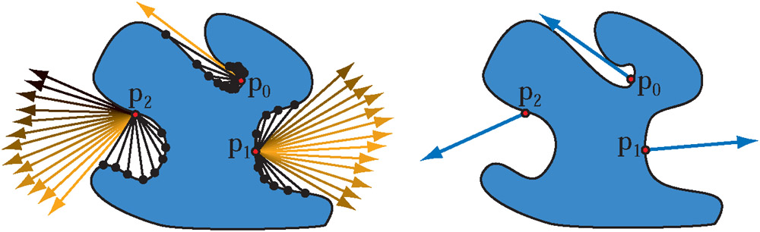
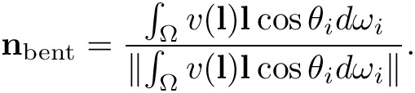
Ambient Occlusion

Slide 17
Ambient Occlusion
the ambient occlusion k_{A} is a vertex attribute
can be used to modify the ambient reflection coefficient in lighting calculations when using point or directional lights
alternatively, can modify the diffuse component of lighting calculations when using image-based lighting (environment mapping)

Slide 18
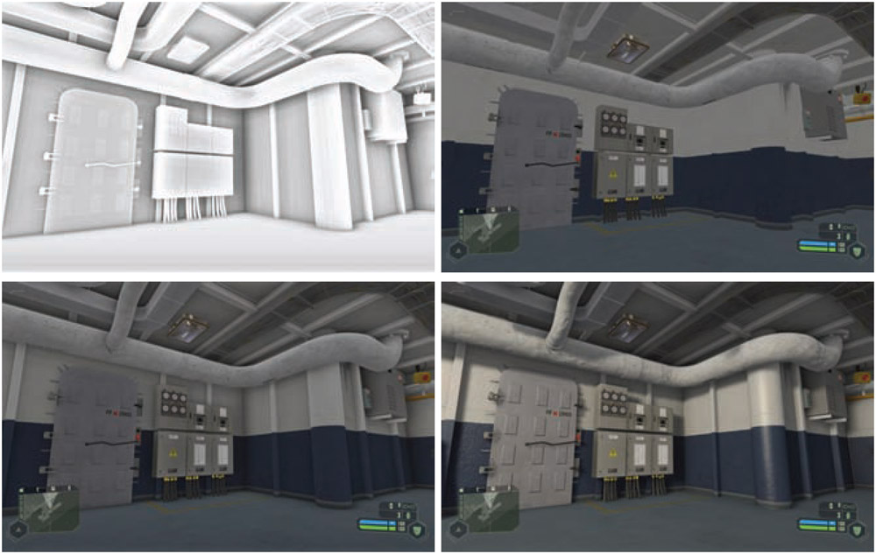
Ambient Occlusion

Slide 19
Ambient Occlusion
references
  Real-time Rendering, 3rd Edition, Chapter 9.2
  OpenGL Shading Language, 3rd Edition, Chapter 13.1
  GPU Gems 3, Chapter 12

Slide 20
Shadows

Slide 21
Shadows
useful or important for
  establishing spatial relationships between objects
  motion cues
  indicate shape
  establish mood
  enhance realism
better to have inaccurate shadows than none at all
  Wanger, Leonard, “The effect of shadow quality on the perception of spatial relationships in computer generated imagery,” Computer Graphics (1992 Symposium on Interactive 3D Graphics), vol. 25, no. 2, pp. 39–42, 1992

Slide 22
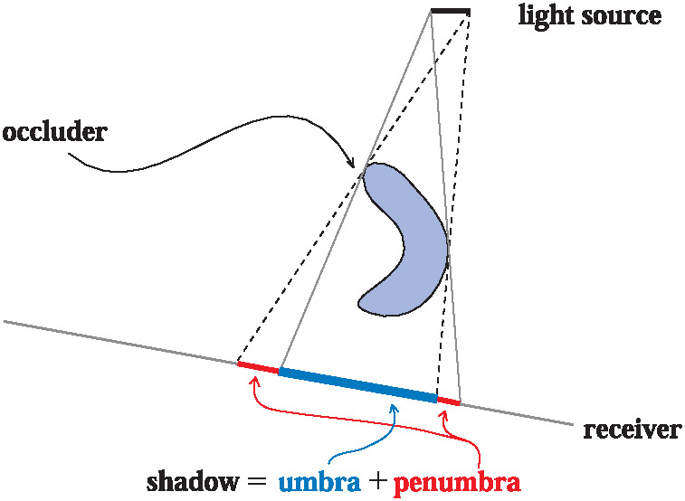
Shadows

Slide 23
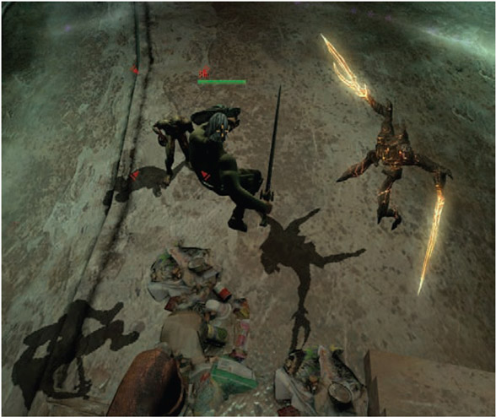
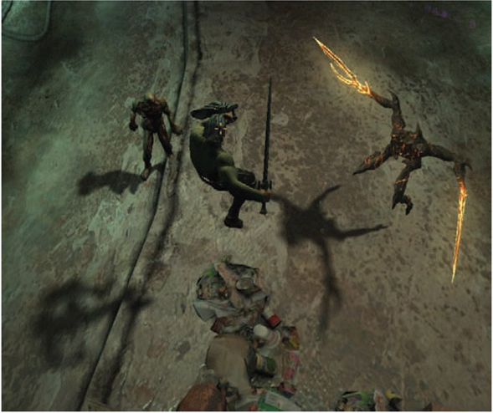
Shadows

Slide 24
Planar Shadows
shadows on a planar surface
idea: each occluder object is rendered twice; once normally and once as a shadow
  project the vertices of the occluder object onto the planar surface
    projection is done starting from the light location
  render the projected primitives using a shadow color

Slide 25
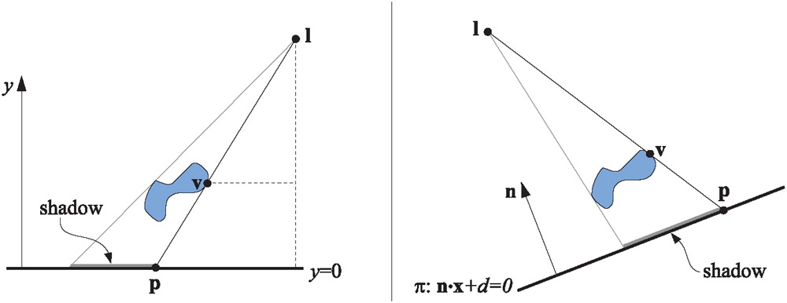
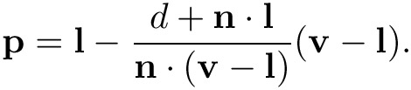
Planar Shadows

Slide 26
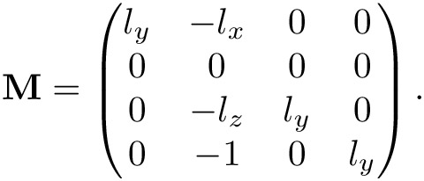
Planar Shadows

Slide 27
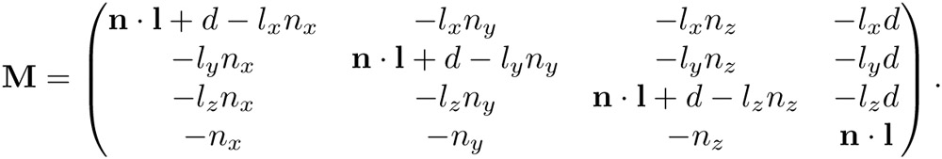
Planar Shadows

Slide 28
Planar Shadows
to render the shadow
  transform the occluder object using M
  render using a shadow color and no illumination
    produces an opaque shadow no penumbra
in practice the shadow needs to be drawn slightly above the shadow plane
  otherwise there will be hidden surface removal problems
alternatively
  render the plane
  disable the z-buffer and render the shadows
  enable the z-buffer and render the objects

Slide 29
Soft Shadows
soft shadows occur when lights have finite size
simple (but computationally expensive) method:
  represent the light source using many point lights distributed over the area of the light source
  render shadow for each point light into the accumulation buffer and average the result over all of the point lights

Slide 30
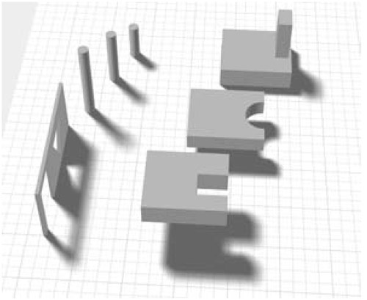
Soft Shadows

Slide 31
Shadow Maps
a two-pass algorithm
  first pass: scene is rendered from the point of view of the light source and saved into a texture (the shadow map)
    only the z-buffer (depth) values are stored
  second pass: scene is rendered normally but each fragment’s depth value is tested against the shadow map to determine if the fragment is in shadow

Slide 32
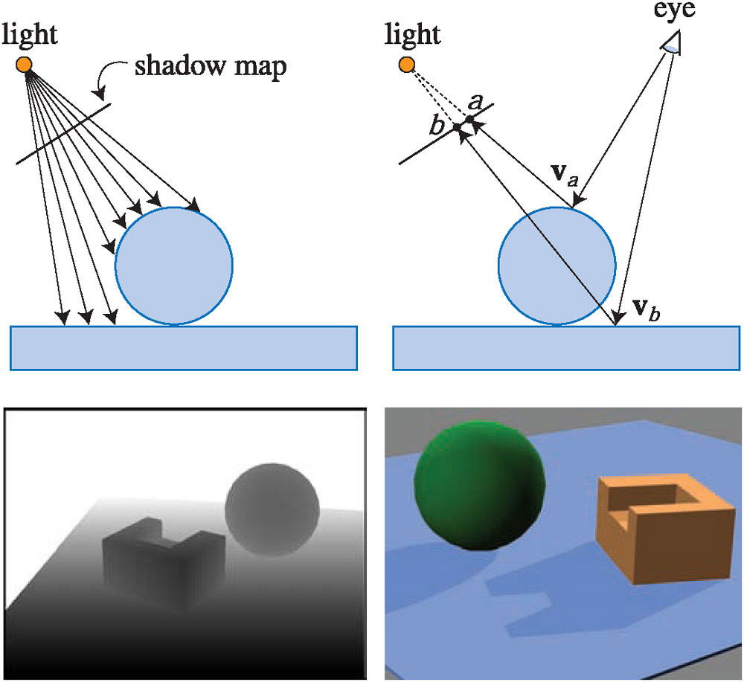
Shadow Maps

Slide 33
Shadow Maps
in the fragment shader
  position of each fragment is converted to coordinate system of the light and projected using the light source projection matrix
  result is biased to get valid texture coordinates to retrieve the shadow map depth value
  if the depth of the fragment is greater than the shadow map depth value the fragment must be in shadow
    render using only ambient light
  otherwise render using illumination
the key aspect is the conversion of the fragment’s 3D coordinates to shadow map coordinates

Slide 34
Shadow Maps
light view matrix
  converts world coordinates to light coordinates
light projection matrix
  converts light coordinates to homogeneous clip coordinates
    light view frustum is converted into a cube centered at the origin with side length = 2
(x,y) clip coordinates are almost texture coordinates for the shadow map
z clip coordinate is almost the depth value to compare with the shadow map value

Slide 35
Shadow Maps
given a point in object coordinates, the matrix S maps the point into shadow map coordinates
light projection matrix
light view matrix
model matrix (not the modelview matrix!)

