Slide 1
Procedural Textures

Slide 2
Noise in glman
glman automatically creates 2D and 3D textures (with default sizes 64x64 and 64x64x64) named
Noise2
Noise3
stores 4 octaves, 1 each in the R, G, B, A components

Slide 3
Noise in glman
Component | Term | Range | Limits
0 | nv.r | 0.5 ± 0.5 | 0.0 –1.0
1 | nv.g | 0.5 ± 0.25 | 0.25 –0.75
2 | nv.b | 0.5 ± 0.125 | 0.375 –0.625
3 | nv.a | 0.5 ± 0.0625 | 0.4375 –0.5625
 | sum | 2.0 ± 1.0 | 1.0 –3.0
 | sum – 1 | 1.0 ± 1.0 | 0.0 –2.0
 | (sum – 1) / 2 | 0.5 ± 0.5 | 0.0 –1.0
 | (sum – 2) | 0.5 ± 1.0 | -1.0 –1.0
Table 10.1

Slide 4
Clouds 1
vertex shader outputs
modelling coordinates of each vertex (scaled so that the values are suitable for use as texture coordinates)
light intensity (from ADS lighting or other)
fragment shader
retrieves a 3D noise texture value using the incoming modelling coordinate
computes a noise value from the retrieved texture value
blends a sky color with a cloud color using the noise value and modulates the incoming light intensity

Slide 5
Clouds 1
uniform sampler3D Noise3;
uniform vec4 uSkyColor;
uniform vec4 uCloudColor;
in vec4 vColor;
in vec3 vModelPosition;
out vec4 fFragColor;
void main(void)
{
vec4 nv = texture(Noise3, vModelPosition);
float cloudIntensity = (nv.r + nv.g + nv.b + nv.a - 1) / 2.0;
vec3 color = mix(uSkyColor.rgb, uCloudColor.rgb, cloudIntensity) * vColor.rgb;
fFragColor.rgb = color;
fFragColor.a = 1.;
}

Slide 6
Clouds 1

Slide 7
Clouds 2a
you can choose to emphasize the large scale structure by increasing the contribution of the first octave
float cloudIntensity = (3 * nv.r + nv.g + nv.b + nv.a - 2) / 2.0;

Slide 8
Clouds 2a

Slide 9
Clouds 2b
you can emphasize the effect by modifying the cloud intensity with a cosine function
float cloudIntensity = (3 * nv.r + nv.g + nv.b + nv.a - 2) / 2.0;
cloudIntensity = (1. + cos(3.1415 * cloudIntensity)) / 2.;

Slide 10
Clouds 2b

Slide 11
Turbulence
the term “turbulence” is used when discussing noise textures to mean absolute value noise
suppose you have noise functions f and g that both have range [-1, 1] ; then the noise function h = abs(f) + abs(g) is called a turbulence noise function
the absolute value function causes discontinuities in the gradient of the noise which produces a visual effect similar to turbulent flow

Slide 12
Turbulence
for glman noise, you subtract the middle of the range (0.5) from each of the components and take their absolute values
float turbulence(in vec4 nv)
{
return abs(nv.r - 0.5) +
abs(nv.g - 0.5) +
abs(nv.b - 0.5) +
abs(nv.a - 0.5);
}

Slide 13
Clouds 3
using turbulence instead of normal fbm noise

Slide 14
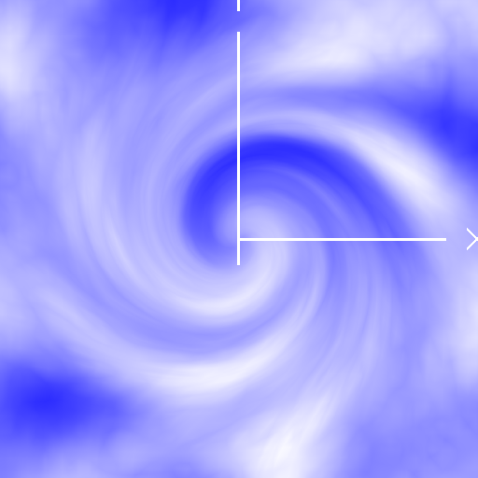
Clouds 4
vorticity can be emulated by rotating the texture coordinates by an amount that varies with the distance from the center of the vortex

Slide 15
Clouds 4
void main(void)
{
const float TWIST = 3.5;
const float MAX_RADIUS = 0.5;
float radius = length(vModelPosition.xy);
vec3 stp;
if (radius < MAX_RADIUS)
{
float dist = pow(MAX_RADIUS - radius, 3);
float angle = PI + TWIST * 2 * PI *
(MAX_RADIUS - dist) / MAX_RADIUS;
float c = cos(angle);
float s = sin(angle);
stp = vec3(dot(vec2(c, -s), vModelPosition.xy),
dot(vec2(s, c), vModelPosition.xy),
vModelPosition.z);
}

Slide 16
Clouds 4
else
{
stp = vModelPosition;
}
vec4 nv = texture(Noise3, stp);
float cloudIntensity = turbulence(vec4(nv.r*2,nv.gba));
vec3 color = mix(uSkyColor.rgb, uCloudColor.rgb,
cloudIntensity) * vColor.rgb * 1.5;
fFragColor.rgb = color;
fFragColor.a = 1.;
}

Slide 17
Clouds
techniques described here produce the illusion of clouds
there is a large body of literature describing the modeling of real clouds
see Chapter 9 of “Texturing and Modeling: A Procedural Approach, 3rd Edition”
a volume rendering approach

Slide 18
Marble
marble (sort of) has the appearance of alternating color veins
a marble effect can be achieved by using noise to modify a periodic function such as sin
the choice of function to modify can be used to change the relative thickness of the bands

Slide 19
Marble
uniform sampler3D Noise3;
uniform vec4 uMarbleColor;
uniform vec4 uVeinColor;
uniform float uNoiseScale;
uniform float uNoiseMag;
in vec4 vColor;
in vec3 vModelPosition;
out vec4 fFragColor;

Slide 20
Marble
void main(void)
{
vec4 nv = texture(Noise3,
vModelPosition * uNoiseScale);
float noise = clamp(turbulence(nv) * uNoiseMag,
0.0, 1.0);
float sineval = sin(vModelPosition.y * 6.0 +
noise * 12.0);
vec3 color = mix(uVeinColor.rgb, uMarbleColor.rgb,
sineval) * vColor.rgb;
fFragColor = vec4(color, 1.0);
}

Slide 21
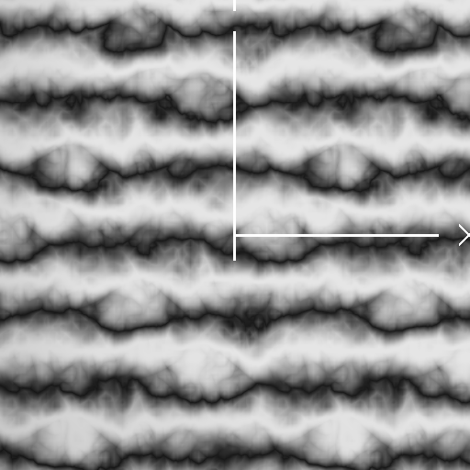
Marble
sin
abs(sin)

Slide 22
Marble

Slide 23
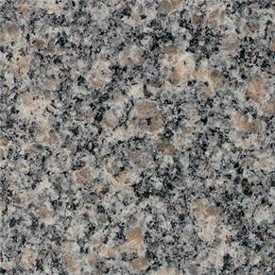
Granite
high frequency black and white patches with low frequency pink patches

Slide 24
Granite
to model the high frequency black and white patches we can use one or more of the high frequency noise components (shifted and scaled appropriately)
void main(void)
{
vec4 nv = texture(Noise3, vModelPosition * uNoiseScale);
float intensity = clamp((nv.a - 0.5 + 0.01) * 32.0, 0., 1.);
vec3 bw = vec3(intensity * vColor.rgb);
fFragColor = bw;
}

Slide 25
Granite

Slide 26
Granite
to model the low frequency patches of rose we add in the lower frequency components to generate a noise value and multiply it by a rose color
intensity = (nv.r + nv.g + nv.b + nv.a - 1.) / 2.;
vec3 rose = intensity * vec3(0.95, 0.6, 0.8);
fFragColor = rose;

Slide 27
Granite

Slide 28
Granite
this is not quite what we want
we want a small number of large islands of rose
only the “strongest” patches of rose color should remain with the rest of the texture becoming darker
two other primitive functions we can implement and use
bias
gain

Slide 29
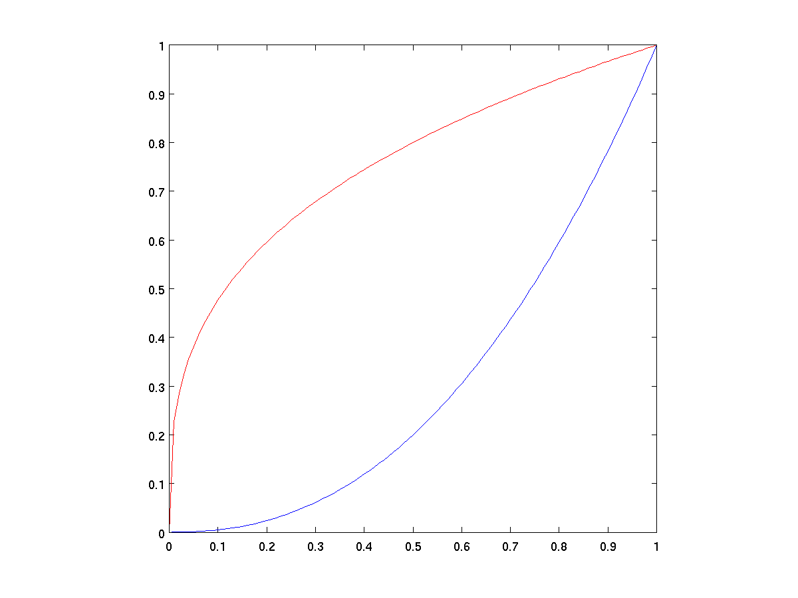
Bias
0 and 1 are mapped to themselves
all other values shifted
down if bias < 0.5
up if bias > 0.5
bias(0.8, x)
bias(0.2, x)

Slide 30
Bias
float bias(in float b, in float x)
{
return pow(x, log(b)/log(0.5));
}

Slide 31
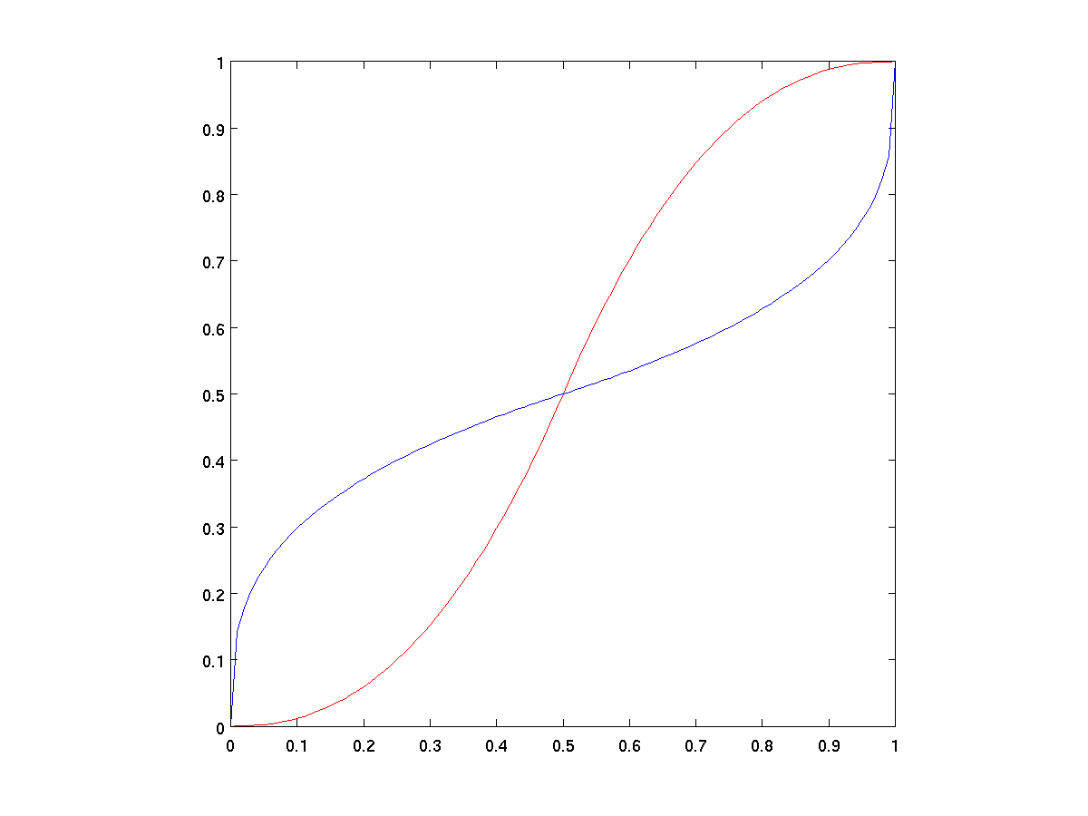
Gain
0, 0.5, and 1 mapped to themselves
above and below 0.5 the function consists of scaled down bias curves forming an S
gain(0.2, x)
gain(0.8, x)

Slide 32
Gain
float gain(in float g, in float x)
{
if (x < 0.5)
{
return bias(1 - g, 2 * x) / 2;
}
else
{
return 1.0 - bias(1 - g, 2 - 2 * x) / 2;
}
}

Slide 33
Granite
we want to bias the results strongly towards zero
intensity = (nv.r + nv.g + nv.b + nv.a - 1.) / 2.;
intensity = clamp(bias(0.005, intensity * 1.5), 0., 1.);
vec3 rose = intensity * vec3(0.95, 0.6, 0.8);
fFragColor = rose;

Slide 34
Granite

Slide 35
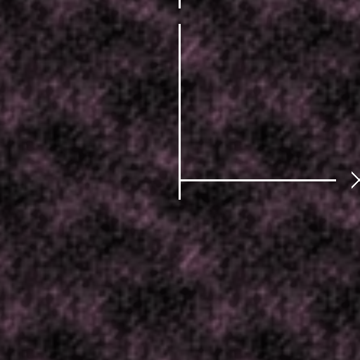
Granite
mixing the two results
vec3 color = mix(bw, rose, 0.8);
fFragColor = vec4(color, 1.);

