Slide 1
Procedural Textures

Slide 2
Primitives
glsl has some built-in functions that can be used to generate simple textures
returns 0.0 if x < a, 1.0 otherwise
float f = step(a, x);
f
1
0
a

Slide 3
Primitives
returns 0.0 if x < a, 1.0 if x > b, and performs smooth interpolation between a and b
float f = smoothstep(a, b, x);
f
1
0
a
b

Slide 4
Primitives
a pulse can be formed using two steps
  can also use smoothstep to generate a smooth pulse (p189)
float f = step(a, x) – step(b, x);
1
f
0
a
b

Slide 5
Primitives
clamp restricts a value to lie within a range
float f = clamp(x, a, b);
1
f
b
a
0
a
b

Slide 6
Primitives
mod is useful for generating periodic functions
for any function f(x) where 0 <= x < 1
f( mod(x, a) / a)
is periodic
works best if f(0) = f(1) and f’(0) = f’(1)

Slide 7
Primitives
consider the following fragment shader
in vec2 vST;
out vec4 fFragColor;
void main( )
{
const float N = 16;
const float F = 1.0 / N;
float x = mod(vST.s, F) / F;
float r = smoothstep(0.4, 0.6, x);
fFragColor = vec4( r, 1., 0., 1. );
}

Slide 8
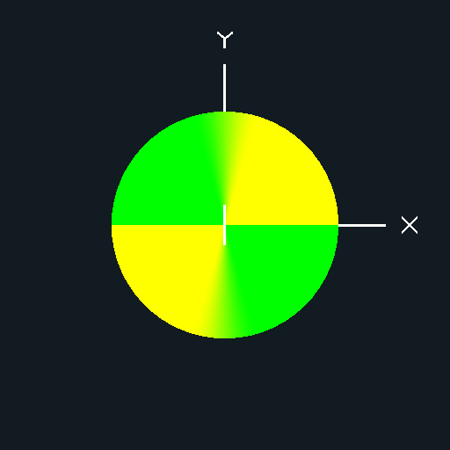
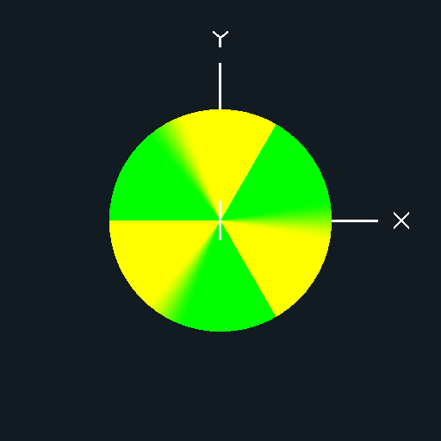
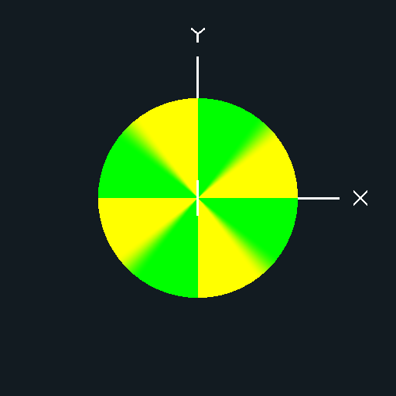
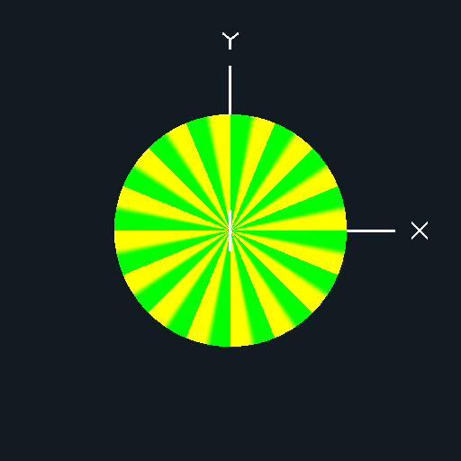
Primitives
N=2
N=3
N=4
N=16

Slide 9
Primitives
somewhat better using a smooth pulse
in vec2 vST;
out vec4 fFragColor;
void main( )
{
const float N = 16;
const float F = 1.0 / N;
float x = mod(vST.s, F) / F;
float r = smoothstep(0.0, 0.2, x) –
smoothstep(0.5, 0.7, x);
fFragColor = vec4( r, 1., 0., 1. );
}

Slide 10
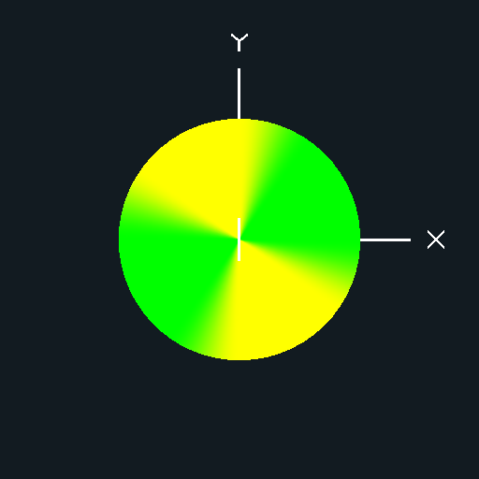
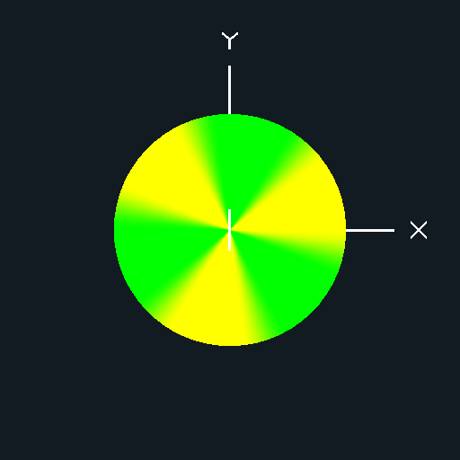
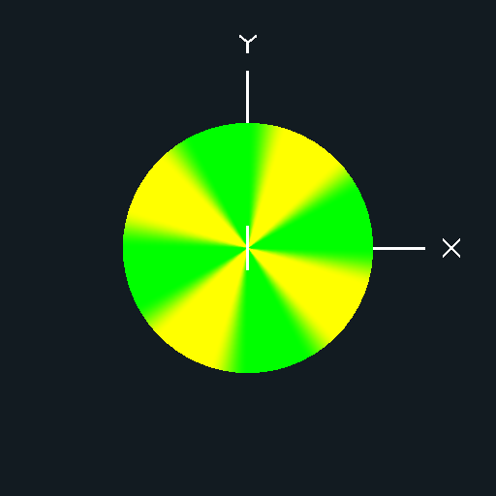
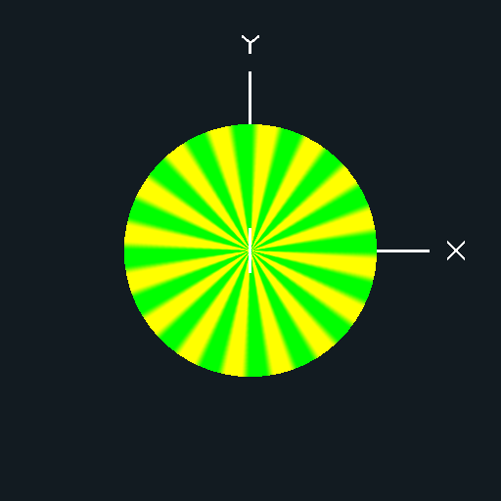
Primitives
N=2
N=3
N=4
N=16

Slide 11
Primitives
others
  sin
  cos
  abs
  mod(x, a) / a will produce a sawtooth pattern
splines are common primitives, but not supported directly in glsl

Slide 12
Irregular Textures
many natural textures are irregular and cannot easily be described using the previous simple primitive functions
  natural phenomenon (clouds, fire, smoke)
  natural materials (marble, wood, mountains)
  man-made materials (stucco, asphalt, cement)
  surface imperfections (rust, dirt, wear)
  pattern imperfections (wiggles, bumps, color variation)
  motion imperfections
in 1985 Ken Perlin described a method of procedural texture generation called “noise”

Slide 13
Noise Textures
noise textures are not true noise in the sense that they are not truly random
  a truly random function is not useful for most image generation purposes because we want repeatability
  i.e., the texture value for (s, t) should always be the same
    otherwise the texture will change everytime we render the object!
also, the texture values in a small neighborhood around (s,t) should be similar
  otherwise small changes to (s, t), such as what would occur when the camera or object moves, might produce dramatically different images

Slide 14
Noise Texture Properties
a noise function should have certain properties
  continuous function that appears random
  repeatable, i.e., the texture value for any (s, t) is constant
  has a well defined range, usually [0, 1] or [-1, 1]
  does not show obvious regular or periodic patterns
  isotropic (rotationally invariant)
  can be defined in 1, 2, 3 or higher dimensions

Slide 15
Lattice Noise Textures
many of the noise functions used in graphics are lattice based
  generate random points at regularly spaced intervals
  interpolate between the points using a continuous function
    usually a cubic or quintic spline
    see textbook p215-220

Slide 16
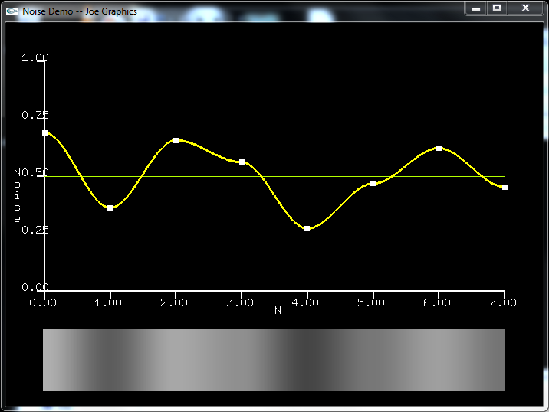
Value Noise Textures
“value” noise interpolates the lattice points and assumes that the gradient at each lattice point is zero (or has a “natural” value)

Slide 17
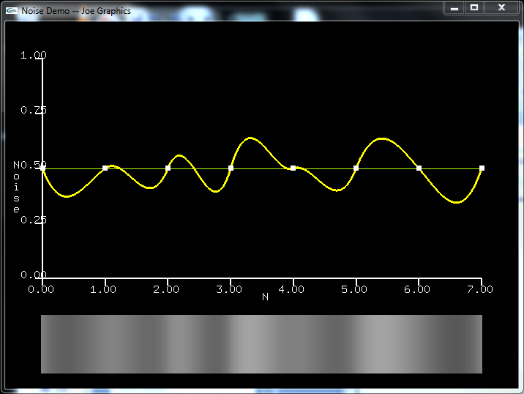
Gradient Noise Textures
“gradient” noise has a value of zero at each lattice point with a pseudorandom gradient

Slide 18
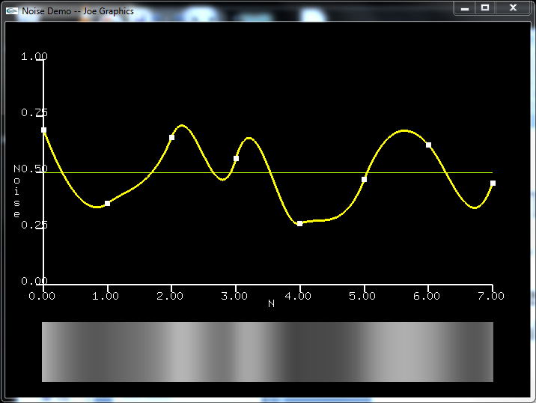
Value+Gradient Noise Textures
“value + gradient” noise interpolates each lattice point with a pseudorandom gradient

Slide 19

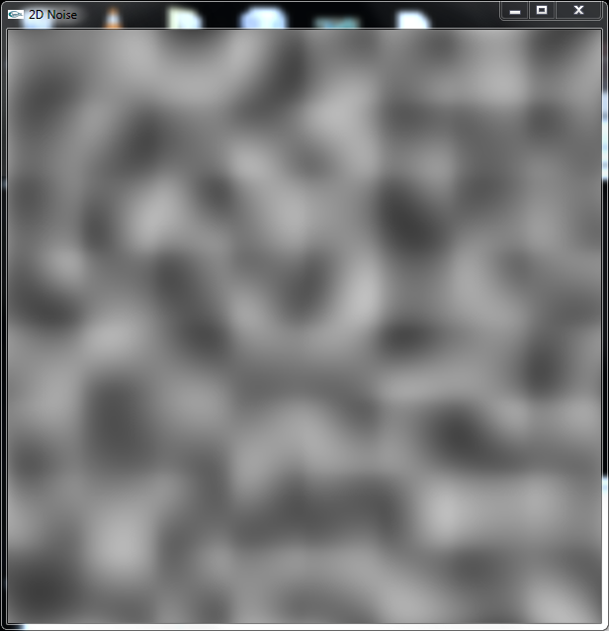
Value vs Gradient
value noise
gradient noise

Slide 20
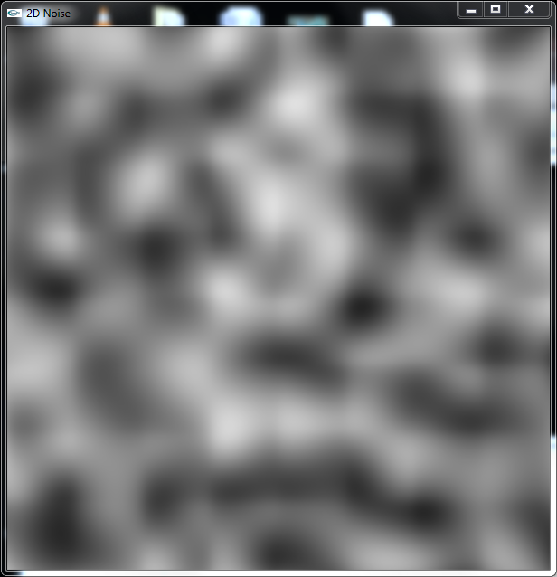
Gradient vs Value+Gradient
gradient noise
value+gradient noise

Slide 21
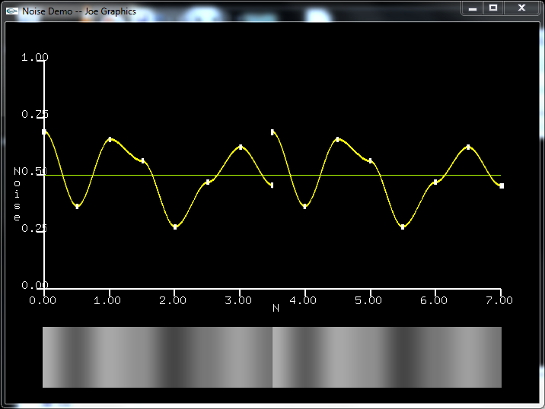
Noise Frequency
we can view our noise function f(x) as being one cycle of a periodic function
the function g(x) = f(2x) is a noise function with two cycles; i.e., g(x) has twice the frequency of f(x)
f(x)
g(x)

Slide 22
Noise Octaves
obviously g(x) is not a good noise function
  it is by construction periodic
  however, it will have more fine scale detail
  g(x) is called an octave of f(x)
    the ratio of their frequencies is 2:1
consider h(x) = f(x) + g(x)
  this might hide the obvious periodicity while providing the fine scale detail
  the magnitude might be too big though

Slide 23
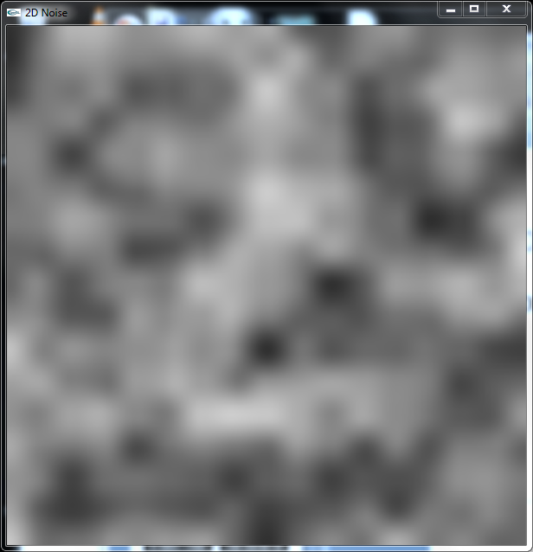
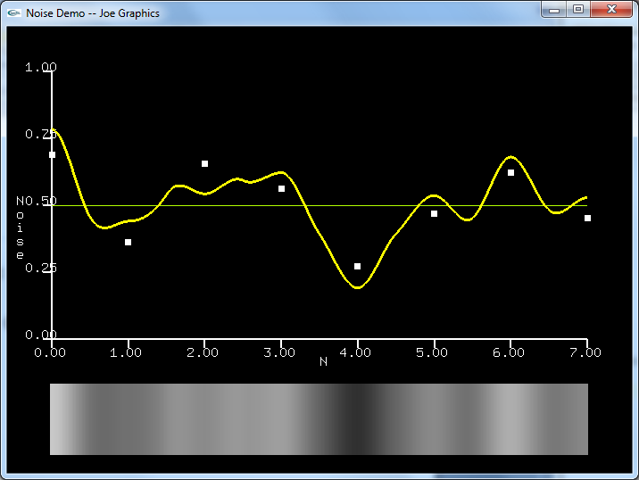
Noise Octaves
consider h(x) = f(x) + (½)g(x) = f(x) + (½)f(2x)
  this is called two octave 1/f noise or two octave fractional Brownian motion (FBM) noise

Slide 24
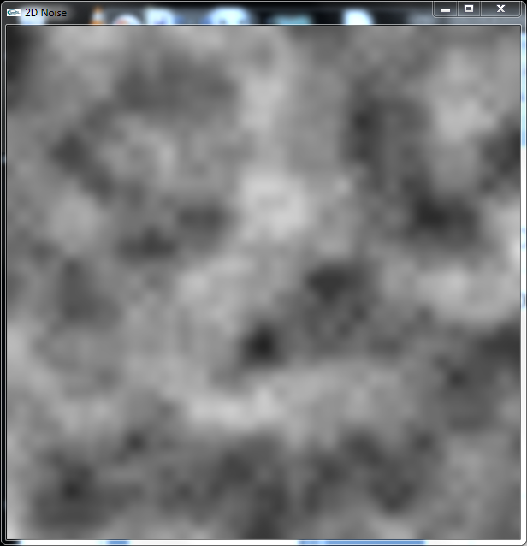
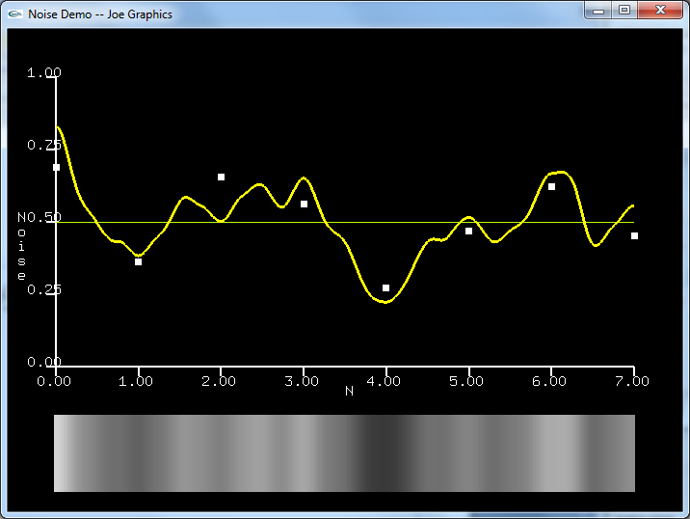
Noise Octaves
consider f(x) + (½)f(2x) + (½)(½) f(4x)
  three octave 1/f or FBM noise

Slide 25
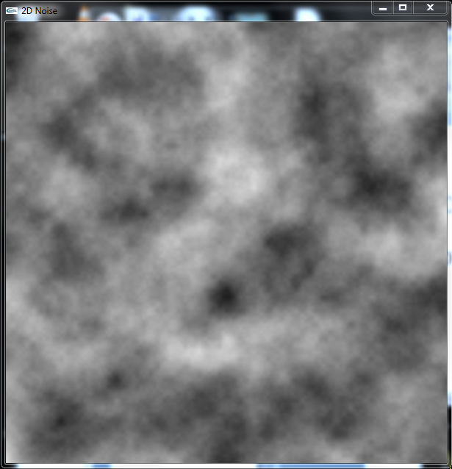
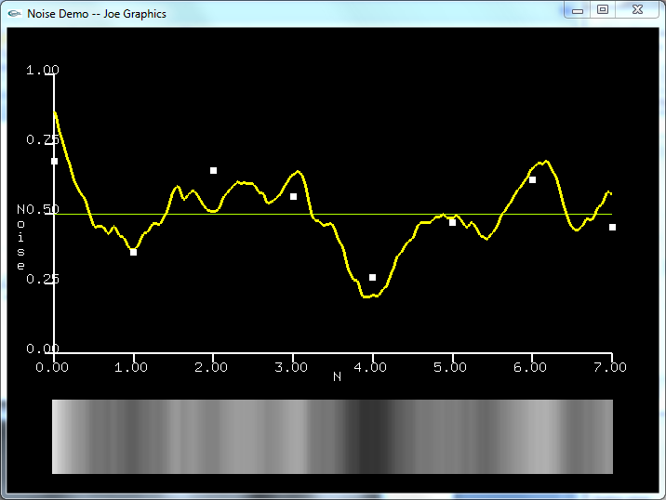
Noise Octaves
consider
  five octave 1/f or FBM noise

Slide 26
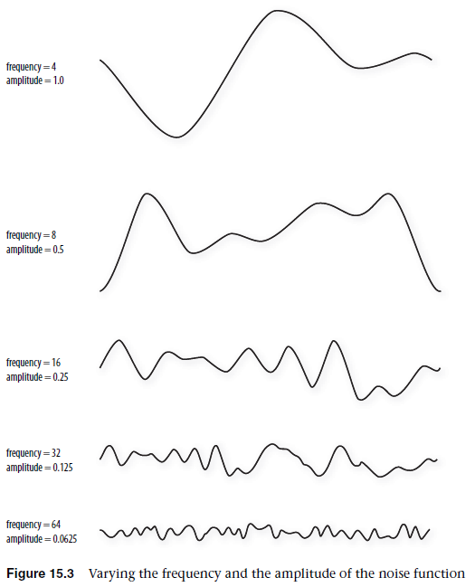
“OpenGL Shading Language, 3rd Edition”

Slide 27
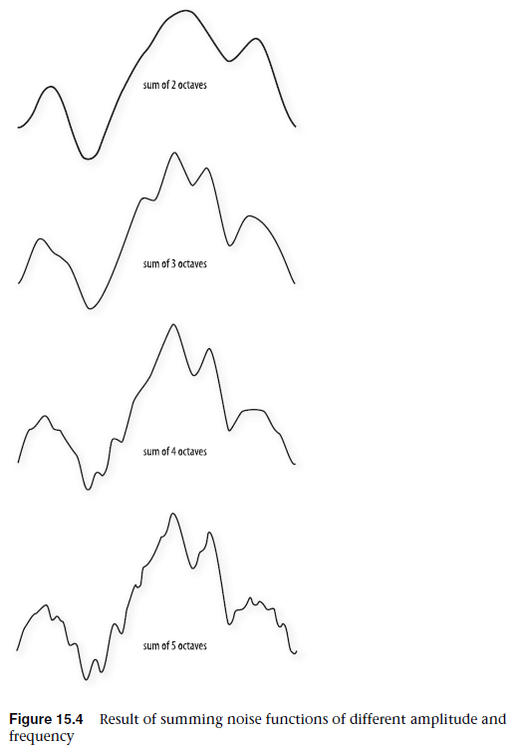
“OpenGL Shading Language, 3rd Edition”

Slide 28
noisegraph
noisegraph is a program distributed with glman that lets you experiment (a bit) with lattice noise textures

