Slide 1
Texture Mapping Applications 2

Slide 2
Parallax Mapping with Slope
parallax mapping assumes that the surface is a single plane
a better approximation
  surface is locally planar where the plane normal is given by the normal vector from the normal map

Slide 3
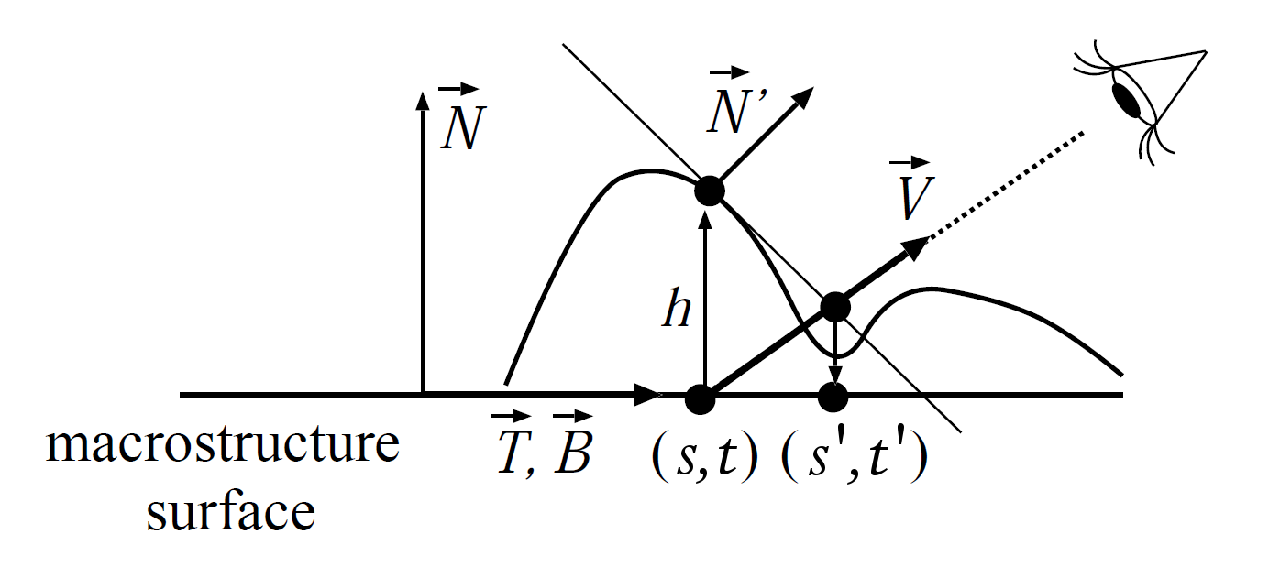
Parallax Mapping with Slope
point on approximating plane
L Szirmay-Kalos and T Umenhoffer, “Displacement mapping
on the GPU-State of the art”

Slide 4
Parallax Mapping with Slope
equation of “eye” ray
L Szirmay-Kalos and T Umenhoffer, “Displacement mapping
on the GPU-State of the art”

Slide 5
Parallax Mapping with Slope
intersection of ray and approximating plane
L Szirmay-Kalos and T Umenhoffer, “Displacement mapping
on the GPU-State of the art”

Slide 6
Parallax Mapping with Slope
solve for a then s’ and t’
tends to produce somewhat better results than ordinary parallax mapping

Slide 7
Parallax Mapping
the previous parallax mapping methods assume that the height field does not change rapidly
if the height field changes rapidly then the computed offset texture coordinate will likely be incorrect

Slide 8
Parallax Mapping
the problem that needs to be solved is “what is the height map intersection nearest to the viewer?”
  this is a root finding problem

Slide 9
Iterative Methods
because height maps typically do not have simple functional forms, the intersection of the eye ray with the height field has to be solved numerically (with an iterative root finding method)
iterative methods can be categorized as being unsafe or safe
  unsafe: an approximate intersection is found but not necessarily the one closest to the viewer
  safe: an approximate intersection is found and it is the one closest to the viewer

Slide 10
Iterated Parallax Mapping
the simplest unsafe iterative method is to simply iterate the estimate of the eye ray intersection point
  iteration is typically performed 3 or 4 times
start with a guess of the intersection point
substitute into eye ray equation

Slide 11
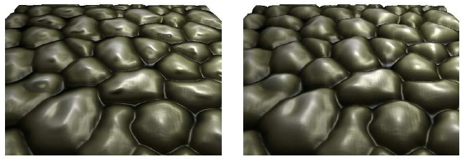
Iterated Parallax Mapping
solving for the updated approximation
iterate the above equation in a loop a few times to get the offset texture coordinates
parallax mapping with slope
iterated parallax mapping
“Displacement mapping on the GPU-State of the art”

Slide 12
Binary Search Parallax Mapping
start with two guesses A and B for the intersection point
  A has height below the height at the intersection point
  B has height above the height at the intersection point
  this can be done because the unbiased height map has height values in the range {0, 1}
look at the point M halfway between the two guesses
keep the interval [A,M] if M is above the height field, otherwise keep the interval [M,B]
repeat a fixed number of times

Slide 13
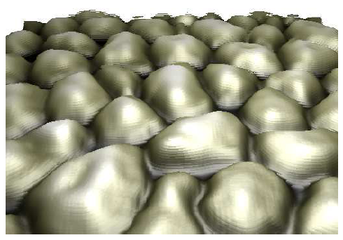
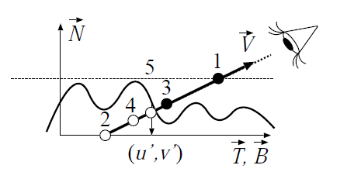
Binary Search Parallax Mapping
“Displacement mapping on the GPU-State of the art”

Slide 14
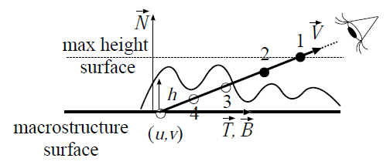
Ray Marching
ray marching is a quasi-safe method
  safe if step size is smaller than 1 texel
idea is very simple
  starting from the maximum height on the ray to the viewer
    take a fixed number of steps of constant size along the ray
    check if the point is below the height map surface
      if it is then there must be an intersection with the height map
“Displacement mapping on the GPU-State of the art”

Slide 15
Ray Marching
ray marching speed can be increased if we could avoid visiting points far from the height map surface
this is possible, but requires additional data structures computed as a preprocessing step
  dilation and erosion maps
  pyramidal displacement mapping
  sphere tracing
  cone stepping
  see “Displacement mapping on the GPU-State of the art” article for references

Slide 16
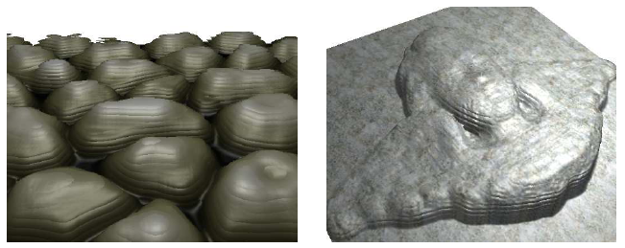
Ray Marching
used in a broad class of methods called relief mapping
  also known as steep parallax mapping and parallax occlusion mapping
can be slow if texture is large and the step size is small
tends to produce staircase artifacts
“Displacement mapping on the GPU-State of the art”

Slide 17
Vertex Shader Displacement Mapping
the vertex shader can be used to actually move the vertex positions using a height map
  simply move the vertex in the normal vector direction by an amount given by the height map
this only works if the object being displacement mapped is sufficiently tesselated
a significant advantage is that objects with curved surfaces can be displacement mapped in the vertex shader

Slide 18
Cube Mapping
textbook p200-205
a type of environment mapping
used to simulate the effect of an environment that surrounds an object or scene
used to create realtime reflections or refractions (typically for a single object)
basic idea
  a cube surrounds the environment
  the environment is projected onto the six inner surfaces of the cube
OpenGL and glsl provide support for cube mapping

Slide 19
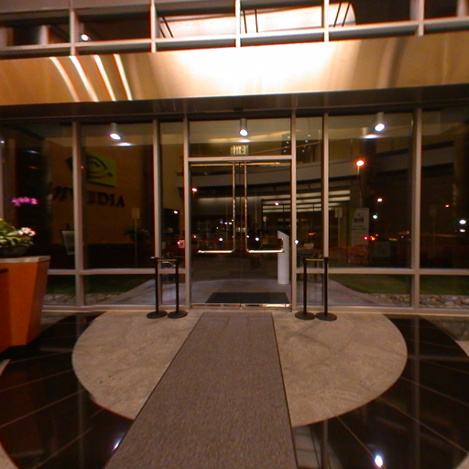
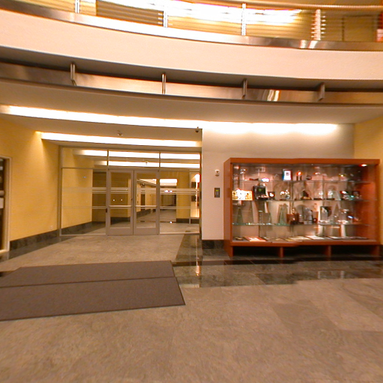
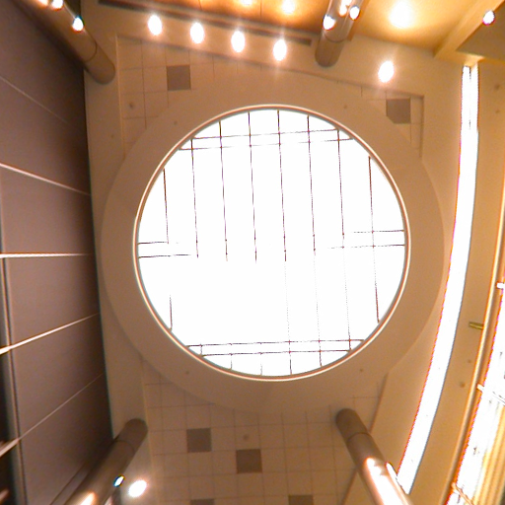

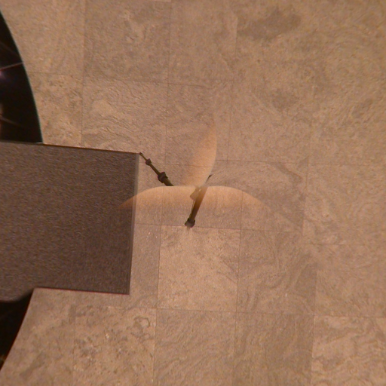
Cube Mapping

Slide 20
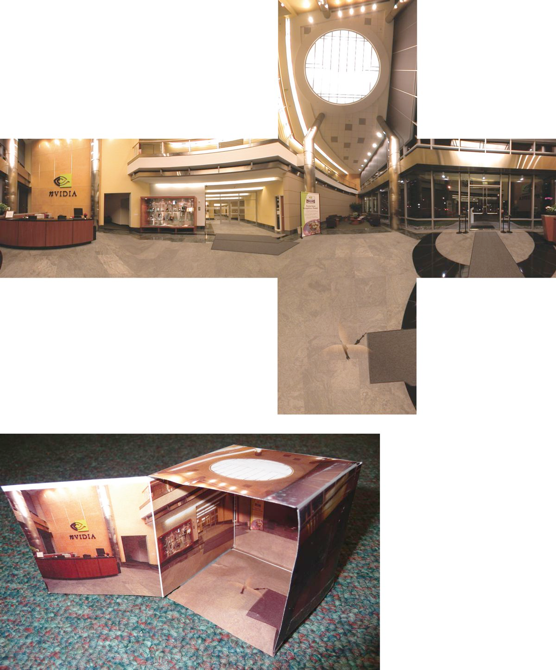
Cube Mapping

Slide 21
Cube Mapping

Slide 22
Cube Mapping
imagine a shiny (or transparent) object located at the center of the cube
for any point on the object we can easily find the reflection (or refraction) direction
  use glsl reflect (or refract)
using the reflection (or refraction) direction we can find which side of the cube is seen by the reflected (or refracted) ray
intersecting the ray with cube side yields a color texture value that can be applied to the object point
  yields realtime reflection (and refraction)

Slide 23
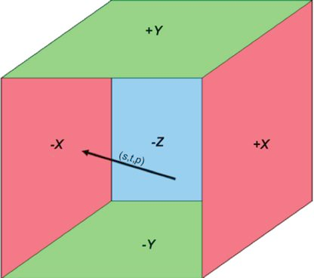
Cube Mapping
indexed using a three-dimensional texture coordinate
(s, t, p)
  this is just the reflection or refraction direction

Slide 24
Cube Mapping
find which of s, t, and p has the largest absolute value
  determines which side of the cube is hit by the ray (in this case the face labelled –x)

Slide 25
Cube Mapping
divide the other two coordinates (call them a and b) by v to obtain the texture coordinates
use s’ and t’ as the texture coordinates

Slide 26
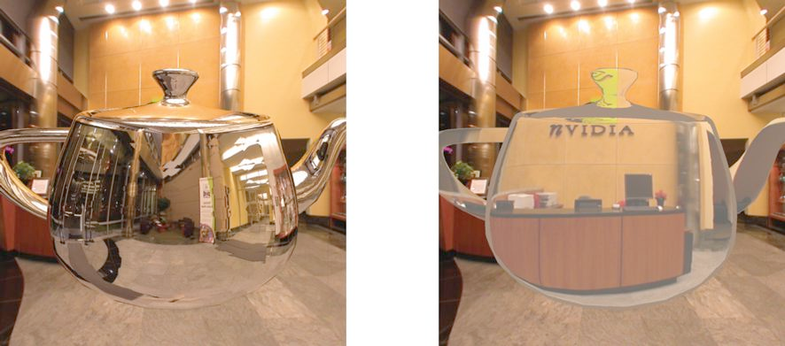
Cube Mapping
reflect.glib
refract.glib

Slide 27
Cube Mapping
cube maps can be updated in realtime to show changes in the environment
  idea: from a fixed location, render the scene with a camera facing in the six different directions directly into the six textures of the cube map

Slide 28
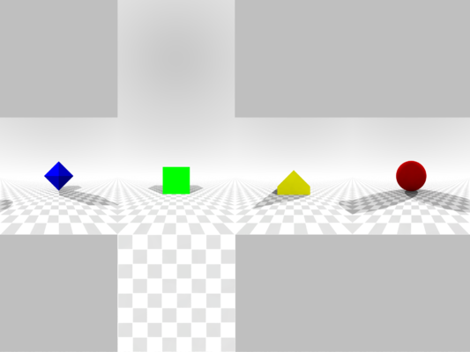
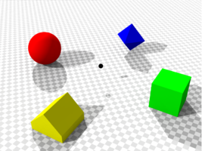
Cube Mapping

Slide 29
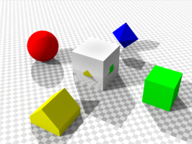
Cube Mapping

Slide 30
Cube Mapping
Wikipedia page on cube mapping describes some other uses of cube maps

Slide 31
Procedural Texture Mapping
textbook p187-200
a significant problem with image textures is that they have finite resolution
  leads to magnification problems
image textures can consume a large amount of memory
procedural texture mapping computes a texture value given a texture coordinate
  “infinite” resolution
  small memory footprint

Slide 32
Procedural Texture Mapping
disadvantages
  limited to textures that you can generate algorithmically
  probably slower than image texture lookup
  aliasing
  not necessarily platform independent
nothing to prevent you from using both image and procedural textures on the same object

Slide 33
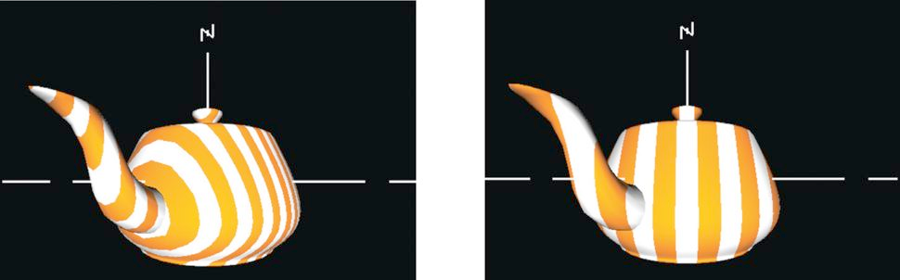
Textbook Examples
procedural stripes

Slide 34
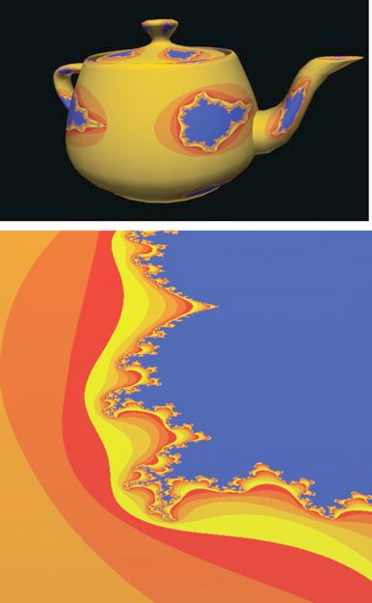
Textbook Examples
procedural fractals

Slide 35
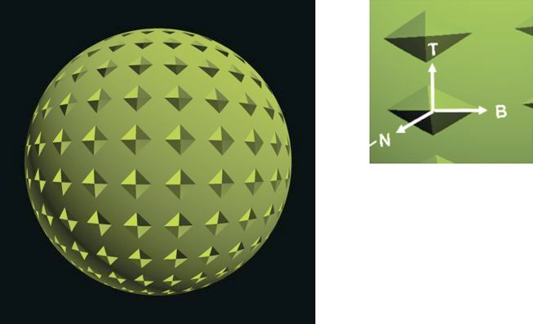
Textbook Examples
procedural bump map

Slide 36
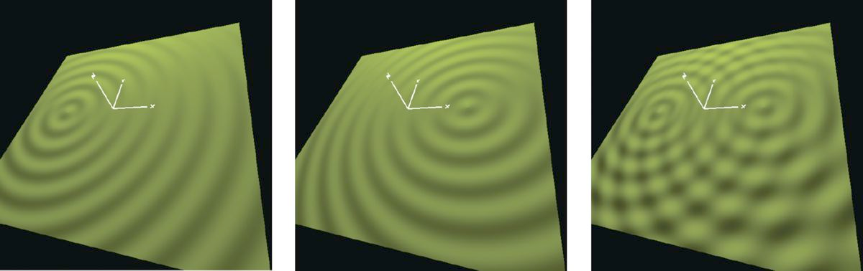
Textbook Examples
procedural bumpmap

Slide 37
Procedural Textures
Ken Perlin
Making Noise

