Slide 1
Texture Mapping Applications

Slide 2
Bump Mapping
a family of techniques for representing small-scale detail
better than ordinary texture mapping but usually less realistic than actual geometry
implemented in the fragment shader
idea: adjust shading parameters so that the viewer sees fine surface detail without actually changing the base geometry
use texture values to change the normal vector

Slide 3
Bump Mapping
bump map encodes the change in the normal vector direction
in which coordinate system?
world (or eye)
rotate the object and the surface appearance changes
object
works for rigid transformations
hard to reuse between different objects

Slide 4
Bump Mapping
modern bump mapping is usually done in surface-local coordinate space
each point has coordinates (0, 0, 0)
the unperturbed normal vector at the point has coordinates (0, 0, 1)
the tangent vector at the point has coordinates (1, 0, 0)
the bitangent vector at the point has coordinates (0, 1, 0)
need to store (or calculate) the tangent vector at each point

Slide 5
Bump Mapping

Slide 6
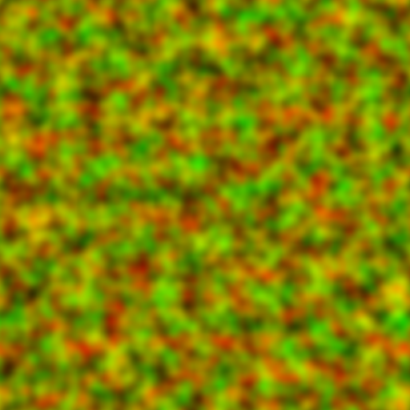
Bump Mapping
one kind of bump mapping perturbs the normal vector in the tangent and bitangent directions
one channel of the texture encodes the perturbation magnitude in the tangent direction
one channel of the texture encodes the perturbation magnitude in the bitangent direction

Slide 7
Bump Mapping
0______128______255
no perturbation
0______128______255
+’ve perturbation
0______128______255
-’ve perturbation

Slide 8
Bump Mapping
if the normal vector perturbation is defined in surface-local coordinates then we have to either:
transform light and view direction vectors into surface-local coordinates, or
transform the perturbed normal vector into whatever coordinate system the lighting is being performed

Slide 9
Bump Mapping
tangent vector in eye coordinates
bitangent vector in eye coordinates
normal vector in eye coordinates
the rotation matrix transforms vectors (but not points!) in surface-local coordinates to eye coordinates

Slide 10
Bump Mapping
the rotation matrix transforms vectors (but not points!) in eye coordinates to surface-local coordinates

Slide 11
Bump Mapping
in the vertex shader
compute view and light directions in eye coordinates
compute tangent, bitangent, and normal vectors in eye coordinates
form the matrix
compute view and light directions in surface-local coordinates as out variables

Slide 12
Bump Mapping: Vertex Shader
in vec4 aVertex;
in vec4 aNormal;
in vec4 aTangent;
uniform mat4 uModelViewProjectionMatrix;
uniform mat4 uModelViewMatrix;
uniform mat4 uNormalMatrix;
// light and viewer direction in local surface coords
out vec3 vLightDir;
out vec3 vViewDir;
// texture coords
out vec2 vST;
// light position in eye coordinates
const vec4 eyeLightPosition = vec4(10., 10., 10., 1.);

Slide 13
void main(void)
{
// view direction in eye coords
vec4 eyeVertex = uModelViewMatrix * aVertex / aVertex.w;
vec4 eyeViewDir = vec4(0., 0., 0., 1.) - eyeVertex;
// light direction in eye coords
vec4 eyeLightDir = eyeLightPosition - eyeVertex;
// n, t, b local surface coords
vec3 n = normalize(vec3(uNormalMatrix * aNormal));
vec3 t = normalize(vec3(uModelViewMatrix * vec4(aTangent.xyz, 0.)));
vec3 b = normalize(cross(t, n));
t = cross(n, b);
mat3 TBN = transpose(mat3(b, t, n));
// light and view direction in local surface coords
vLightDir = TBN * vec3(eyeLightDir);
vViewDir = TBN * vec3(eyeViewDir);
vST = aTexCoord0.st;
gl_Position = uModelViewProjectionMatrix * aVertex;
}

Slide 14
Bump Mapping
in the fragment shader
look up the perturbation in the texture
construct the perturbed normal vector in surface-local coordinates
compute the fragment color using the perturbed normal vector and the interpolated light and view directions

Slide 15
Bump Mapping: Fragment Shader
in vec3 vLightDir;
in vec3 vViewDir;
in vec2 vST;
uniform sampler2D uTexUnit;
out vec4 fFragColor;
// ADS lighting function here...
void main()
{
const float f = 0.1;
vec2 p = f * (vec2(texture2D(uTexUnit, vST)) - vec2(1.));
vec3 normal = normalize(vec3(p.x, p.y, 1.0));
fFragColor = vec4(ADSLightModel(normal, normalize(vViewDir),
normalize(vLightDir)), 1.);
}

Slide 16
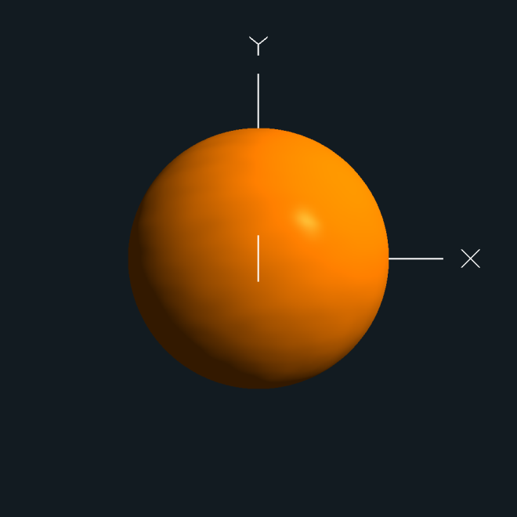
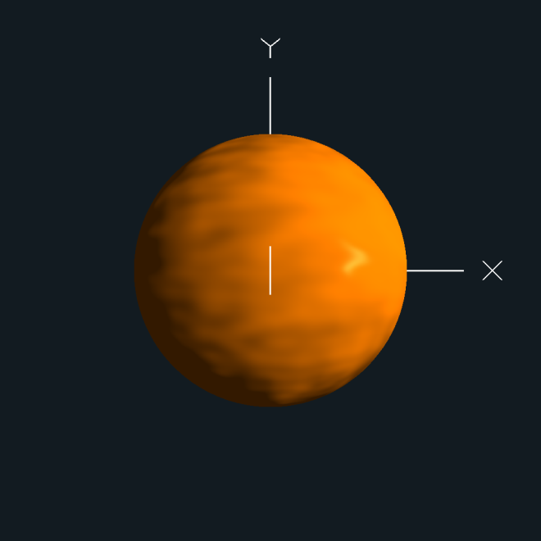
f=0
f=0.1
f=0.2
f=0.5

Slide 17
Normal Mapping
identical to bump mapping except that the texture stores all three components of the perturbed normal instead of the two perturbation components
now the preferred implementation of bump mapping on modern graphics cards where memory is plentiful
saves some computation in the fragment shader

Slide 18
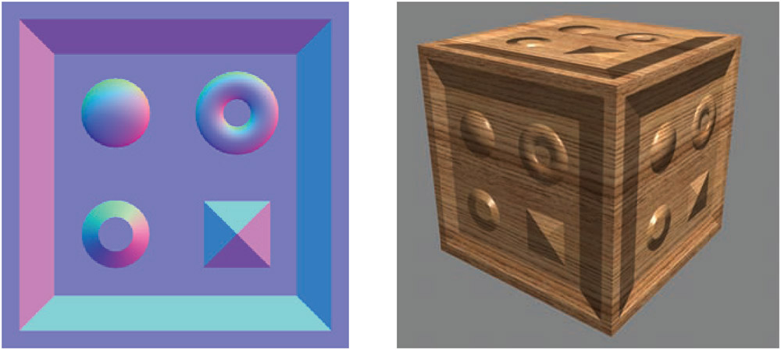
Normal Mapping
Red channel encodes x deviation; the more red the more the normal points to the
right. Green channel encodes y deviation and blue encodes z deviation.

Slide 19
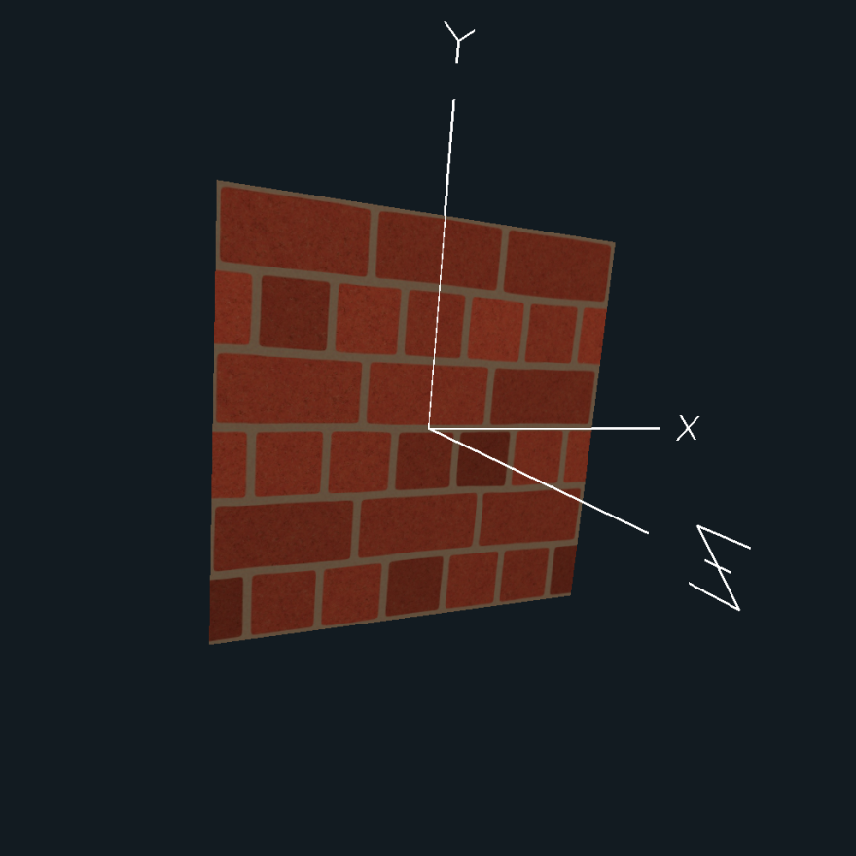
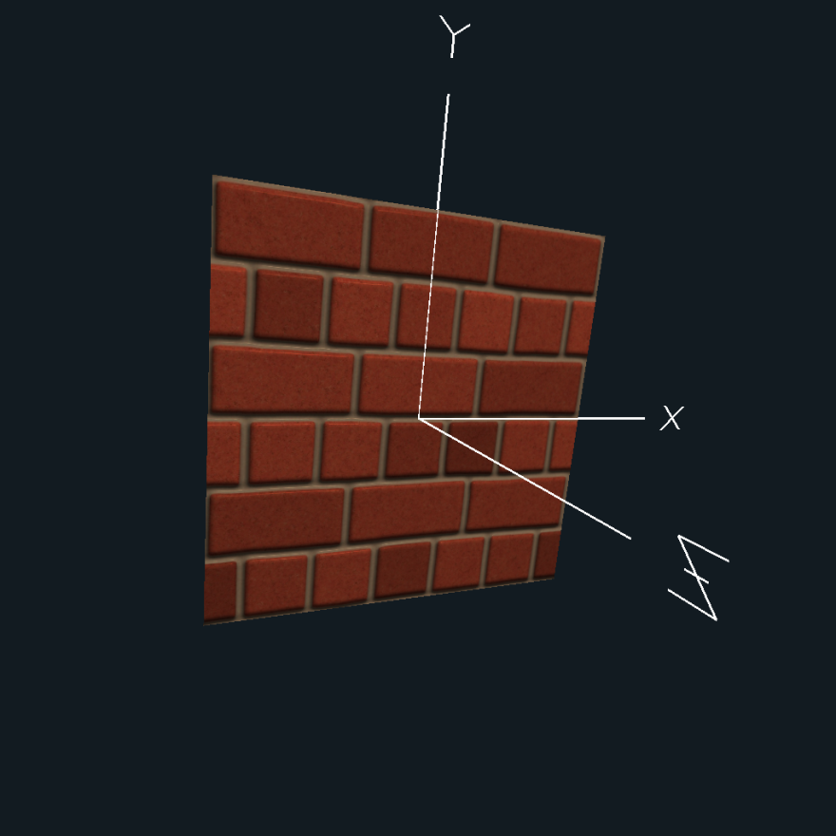
Parallax Mapping
applying a texture to a flat polygon produces a flat appearing surface, even if the texture is of a uneven surface
color texture
color + normal texture

Slide 20
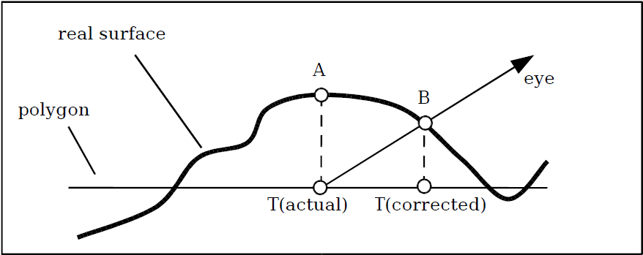
Parallax Mapping
ordinary texture mapping: get texel T(actual) corresponding to point A at the point we are shading
Terry Welsh, “Parallax Mapping with Offset Limiting: A PerPixel
Approximation of Uneven Surfaces”

Slide 21
Parallax Mapping
if we were to view the real surface we would see point B (get texel T(corrected))
Terry Welsh, “Parallax Mapping with Offset Limiting: A PerPixel
Approximation of Uneven Surfaces”

Slide 22
Parallax Mapping
if we used T(corrected) we could provide the illusion that the surface has changes in height
T(corrected)
Terry Welsh, “Parallax Mapping with Offset Limiting: A PerPixel
Approximation of Uneven Surfaces”

Slide 23
Parallax Mapping
notice that high points of the surface texture are shifted away from the eye (and vice versa for low points)
Terry Welsh, “Parallax Mapping with Offset Limiting: A PerPixel
Approximation of Uneven Surfaces”

Slide 24
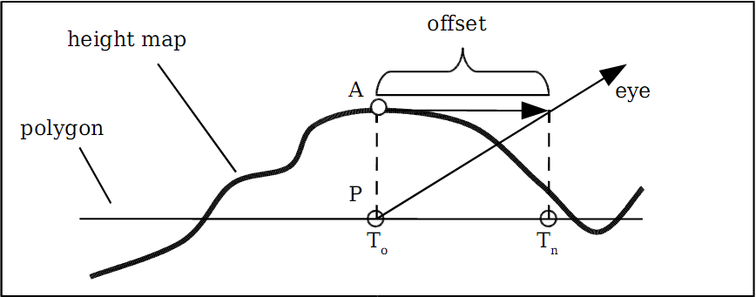
Parallax Mapping
we need a starting texture coordinate T₀, a height map, and a vector to the eye in surface local coordinates to compute the offset (in texture coordinates)
Terry Welsh, “Parallax Mapping with Offset Limiting: A PerPixel
Approximation of Uneven Surfaces”

Slide 25
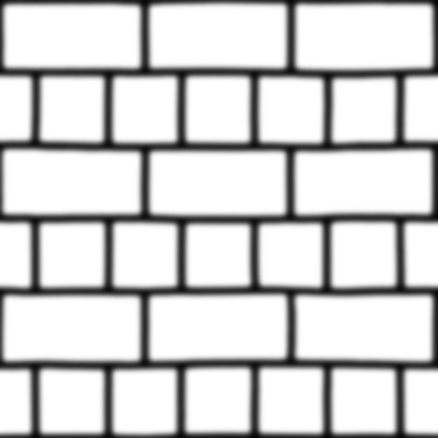
Parallax Mapping
height map stored as a one-component texture with height values in the range {0, 1}

Slide 26
Parallax Mapping
the unit vector from the point to the eye (the view direction) is needed in the same coordinate system as the texture if we are to compute an offset in texture coordinates
need surface-local coordinates (see bump mapping slides)

Slide 27
Parallax Mapping
the height map stores height values in the range {0, 1} because it is stored as a texture
you will want to scale the range (remember you are working in texture coordinates)
you will want to bias the range to make sure that the surface actually intersects the polygon
example:
texture covers a 3x3 m wall and we want to simulate changes in surface height of 1 cm
scale factor = s = 0.01 / 3 = 0.0033
bias = b = -0.5 * scale factor (usually works well)

Slide 28
Parallax Mapping
height (from height map)
scale factor
bias
scaled and biased height
offset texture coordinate
T_{n} is used to access all other textures
first two components of view direction vector
last component of view direction vector

Slide 29
Parallax Mapping
notice that the offset calculation is only an approximation
only correct if height at T_{n} is the same as height at T₀
Terry Welsh, “Parallax Mapping with Offset Limiting: A PerPixel
Approximation of Uneven Surfaces”

Slide 30
Parallax Mapping
at steep viewing angles, the approximation is reasonable and the texture offset values are small (because V_{z} is approximately 1)
at shallow viewing angles, the texture offset values approach infinity (because V_{z} is approximately 0) and the resulting image is usually a mess
need to limit the magnitude of the offset distance
any limit could be chosen, but Welch’s implementation limits the offset distance to h_{sb}

Slide 31
Parallax Mapping: Fragment Shader
in vec3 vLightDir; // light direction in surface-local coords
in vec3 vViewDir; // view direction in surface-local coords
in vec2 vST; // texture coords T0
uniform sampler2D uTexUnitNormal; // normal map
uniform sampler2D uTexUnitHeight; // height map
uniform sampler2D uTexUnitColor; // color map
out vec4 fFragColor;
// ADS lighting function here...

Slide 32
Parallax Mapping: Fragment Shader
void main()
{
vec3 viewDir = normalize(vViewDir);
float scale = 0.08;
float bias = -0.06;
float height = texture2D(uTexUnitHeight, vST).r;
float hsb = height * scale + bias;
vec2 SToffset = vST + hsb * viewDir.xy;
vec3 n = normalize(vec3(texture2D(uTexUnitNormal, SToffset)) - vec3(0.5));
vec3 tcolor = vec3(texture2D(uTexUnitColor, SToffset));
vec3 lcolor = ADSLightModel(n, viewDir, normalize(vLightDir));
fFragColor = vec4(lcolor * tcolor, 1.);
}

Slide 33
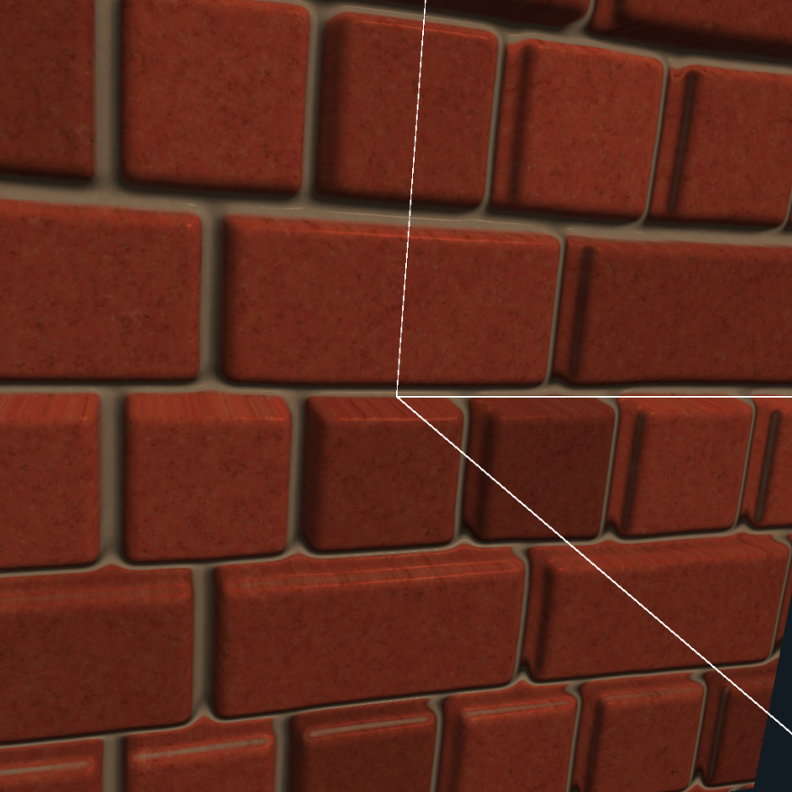
Parallax Mapping
color + normal texture
parallax + color + normal texture

