Slide 1
Texture Mapping

Slide 2
Texturing
process that modifies the appearance of each point on a surface using an image or function
any aspect of appearance can be modified
color, material properties, normal vector, location, …
multiple textures can be applied to the same surface
1* for color
1* for diffuse material properties
1* for specular material properties
1* for normal vector
etc

Slide 3
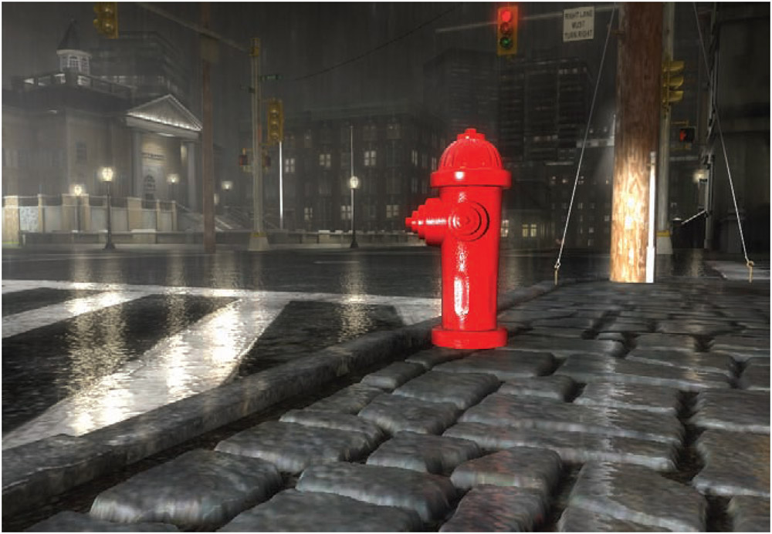
Texturing
color
color + bump
color + bump
color + bump + parallax

Slide 4
Texturing
http://i.imgur.com/NsYAx.jpg

Slide 5
Texture Pipeline
starts with a location, typically defined in the coordinate frame of the object

Slide 6
Texture Pipeline
projector function maps the object space location onto parameter space coordinates which are used to access the texture
e.g., (x, y, z) →(s, t) where 0 ≤ s, t ≤ 1

Slide 7
Texture Pipeline
corresponder function maps the parameters onto texture locations
e.g., (s, t) →(i, j) where i, j are texel indices

Slide 8
Texture Pipeline
texture locations are used retrieve or calculate values from the texture
e.g., texel (i, j) has color (r, g, b)

Slide 9
Texture Pipeline
value transform function transforms the texture value
e.g., normalize (r, g, b) and interpret the normalized texture value to be the normal vector at the object space location
called normal mapping

Slide 10
Texture Pipeline
transformed texture value is used to modify some property of the surface
e.g., compute lighting using the normal map value

Slide 11
Texture Pipeline

Slide 12
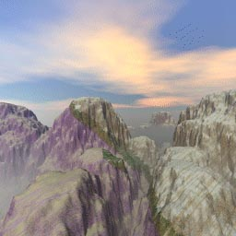
Texture coordinates
(0,1)
(1,1)
(u₁,v₁)
(u₂,v₂)
(0,0)
(1,0)
(u₀,v₀)
(u,v) in [0,1]

Slide 13
Projector Functions
projector function assigns a parameter space coordinate to a point on the object
usually the object points are given in object space (but this is not a requirement)
when the object is moved, the texture moves with it
common for object models to store the result of the projector function for each vertex
simple projector functions
spherical, cylindrical, box, planar

Slide 14
Projector Functions
spherical
cylindrical
planar
“natural”

Slide 15
Projector Functions
spherical
treat the point (x, y, z) as a vector and normalize to get (x’, y’, z’); then

Slide 16
Projector Functions
cylindrical
treat the point (x, y, z) as a vector and normalize to get (x’, y’, z’); then

Slide 17
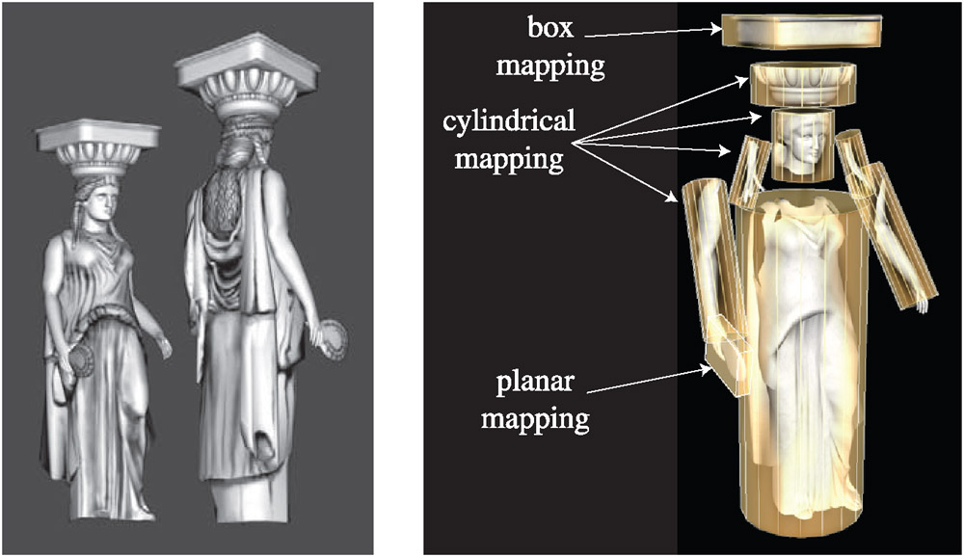
Projector Functions
complex objects will typically use many different projector functions over different parts of the object

Slide 18
Corresponder Functions
maps parameter space coordinates to texture space coordinates
parameter coordinates (s, t) in the range [0, 1) will map onto valid texture space coordinates
most common corresponder functions address the problem of what happens for values of (s, t) not in the range [0, 1)
more general functions are possible
e.g., OpenGL has a texture matrix that can be used to transform parameter coordinates (s, t, r, q)

Slide 19
Corresponder Functions
in OpenGL the “wrapping mode” determines what happens when (s, t) are not in the range [0, 1)
repeat
texture repeats across the surface (the integer part of coordinate is dropped)
clamp to edge
values outside the range [0, 1) are clamped to the range causing the edges of the texture to be repeated across the surface
clamp to border
values outside the range [0, 1) are mapped to a separately defined border color

Slide 20
Corresponder Functions
repeat
mirror
clamp to edge
clamp to border

Slide 21
Texture Values
texture values are typically in RGB or RGBA format
many possible different bit depths for the individual components
8 bit unsigned probably the most common for image textures
32 bit floats are available
your program does not have to interpret the components as colors

Slide 22
Image Textures
texture stored as an RGB or RGBA image
can be 1, 2, or 3 dimensions
problems you should have seen in previous graphics course
texture image size does not match screen size of object
magnification : object size is larger than texture image
texture appears blocky or blurry
minification: object size is smaller than texture image
aliasing occurs

Slide 23
Image Textures
magnification
48x48 texture image on 320x320 pixel square
nearest neighbor filtering
bilinear filtering
cubic filtering

Slide 24
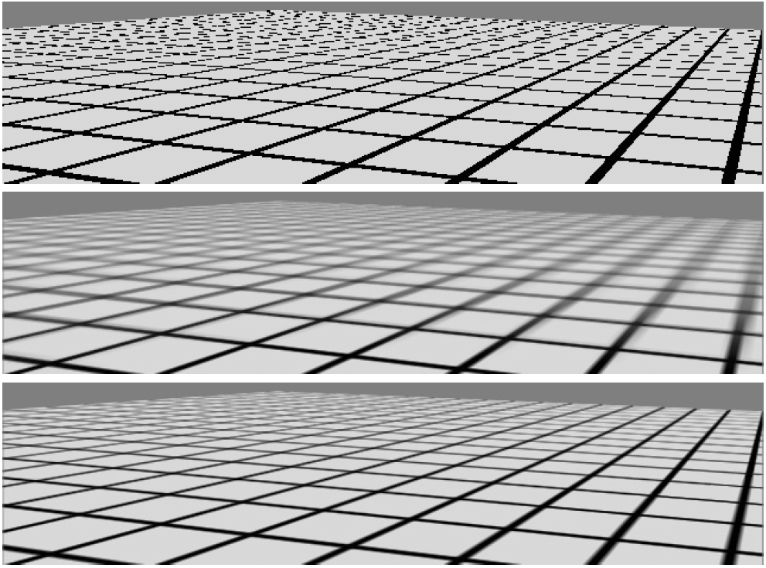
Image Textures
minification
many texels map onto the same pixel
nearest neighbor
mipmapping
summed area tables

Slide 25
Applying the Texture
once the final texture value has been computed, the value is used to modify the fragment color
OpenGL supports various “texture functions” that determine how the final fragment color is calculated
replace
modulate
decal
blend
functions are different if the texture is RGB or RGBA

Slide 26
Applying the Texture

Slide 27
Applying the Texture
replace
texture color replaces the fragment color
essentially removes all lighting effects
texture RGB
texture RGBA

Slide 28
Applying the Texture
modulate
texture and fragment colors are multiplied
combines texture and lighting effects, but attenuates specular highlights
texture RGB
texture RGBA

Slide 29
Applying the Texture
decal
similar to replace, except for RGBA textures where the the texture and fragment colors are blended based on the texture alpha value
like applying a decal (sticker) on top of a surface
texture RGB
texture RGBA

Slide 30
Applying the Texture
blend
texture and fragment colors are blended
commonly used for billboarding
C_{c} is a separately defined color called the “texture environment color”
texture RGB
texture RGBA

