Slide 1
Advanced Illumination Models
Chapter 7 of “Real-Time Rendering, 3rd Edition”

Slide 2
Fresnel Reflectance

Slide 3
Fresnel Reflectance
the surface of an object can be thought of as being an interface between air and the object material
the interaction of light at a planar interface is described by the Fresnel equations
when an incoming ray of light hits a surface part of the ray is reflected in the ideal reflection direction and part of the ray is refracted in the ideal refraction direction
the Fresnel equations describe the fraction that is reflected from the surface (i.e., the specular component)

Slide 4
Fresnel Reflectance
ideal reflection
direction
light direction
ideal refraction
direction
from Real-Time Rendering, 3rd Edition

Slide 5
Fresnel Reflectance
indices of
refraction
index of refraction = (speed of light in vacuum) / (speed of light in material)
from Real-Time Rendering, 3rd Edition

Slide 6
Fresnel Reflectance
Fresnel reflectance (a function of the angle of incidence θ_{i})
from Real-Time Rendering, 3rd Edition

Slide 7
Fresnel Reflectance
the Fresnel reflectance varies widely for different materials
roughly constant for silver colored metals
varies from about 0.05 to 1.0 for glass and plastic

Slide 8
Fresnel Reflectance
from Real-Time Rendering, 3rd Edition

Slide 9
Fresnel Reflectance
θ_{i} = 0° (light perpendicular to surface) R_{F} (0°) is the the characteristic specular color of the material
from Real-Time Rendering, 3rd Edition

Slide 10
Fresnel Reflectance
θ_{i} increases (light direction increasing glancing angle) R_{F} (θ_{i}) tends to increase and approaches 1 at θ_{i} = 90°
from Real-Time Rendering, 3rd Edition

Slide 11
Fresnel Reflectance
http://www.graphics.cornell.edu/~westin/misc/fresnel.html

Slide 12
Fresnel Reflectance
the Fresnel equations are somewhat complex for direct use in rendering
the Schlick approximation is easier to compute
depends only on R_{F} (0°)
where n is the index of refraction of the object material

Slide 13
Fresnel Reflectance
solid = Fresnel
dotted = Schlick
from Real-Time Rendering, 3rd Edition

Slide 14
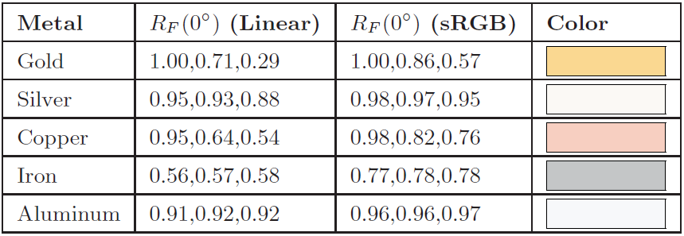
Fresnel Reflectance
Remember that these are specular colors!
from Real-Time Rendering, 3rd Edition

Slide 15
Microgeometry

Slide 16
Microgeometry
real surfaces are not perfectly smooth
the surface roughness affects how light is reflected
typically the imperfections in the surface are small
on a scale much smaller than the size of a pixel
large imperfections (bigger than a pixel) are modeled in the geometry of the object or using textures
the small imperfections are called “microgeometry”
the microgeometry cannot be observed directly
modeled statistically
would be too expensive to model even it could be seen

Slide 17
Microgeometry
reflected light
incident light
A somewhat rough surface with most
normal vectors pointing approximately
vertical.
A rougher surface with many normal
vectors pointing far away from vertical.
from Real-Time Rendering, 3rd Edition

Slide 18
Microgeometry
increasing microgeometry roughness causes blurring of the specular highlight
highlights are broader and less bright

Slide 19
Microgeometry
many surfaces have microgeometry that has no preference in the normal deviation direction
the microfacet direction is randomly distributed about the surface normal direction
“isotropic”
some surfaces have microgeometry where the normal deviation direction is stronger in certain directions
“anisotropic”
brushed metal
fabric

Slide 20
Microgeometry
Grooves in a vinyl record as an example of anisotropic microgeometry.
http://www.flickr.com/photos/roomiccube/3056752288/

Slide 21
Microgeometry
multiple surface normals
shadowing
blocking of incident light
masking
blocking of reflected light
interreflection
light reflected multiple times
retro-reflection
light reflected opposite to incident direction
mirror-like reflections at near glancing view and light directions

Slide 22
Microgeometry
occlusion
masking
interreflection

Slide 23
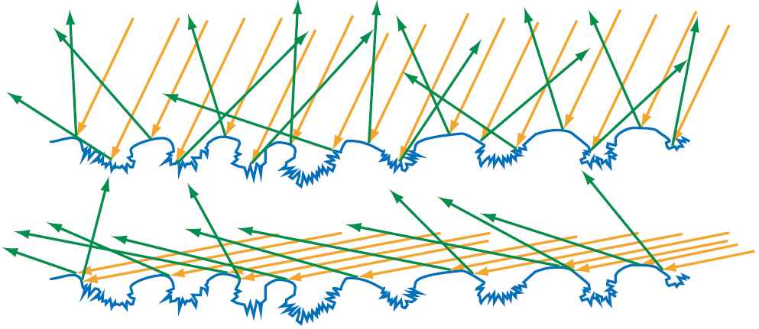
Microgeometry
incident light reflected from surface defects; appears optically rough
incident light reflected from smooth surfaces; appears optically shiny

Slide 24
Microgeometry
retro-reflection causes incident light to be reflected back towards the light source
Light and view directions are similar;
surface appears bright.
Light and view directions are very different;
surface appears dark.

Slide 25
Microfacet Theory
tries to model the first reflection of incident light for the specular component
does not model inter-reflections
typically uses the regular (Lambertian) diffuse term
shadowing and masking modeled using a geometric attenuation factor
value between 0 and 1
represents the amount of light remaining after shadowing and masking
surface is modeled as a collection of microfacets
small, flat Fresnel mirrors

Slide 26
Microfacet Theory
α_{h}
α_{h}
For a given incident light direction, only those microfacets oriented in the direction
halfway between the light and viewer direction contribute to the reflected specular
light. The amount of light reflected depends on the number of microfacets having
the correctly oriented normal vector.
The distribution of microfacet normal direction is called the “normal distribution
function” (NDF).

Slide 27
Microfacet Theory
normal distribution function
the fraction of microfacets that participate in the reflection of light from l to v
if the microfacet normals have no preferred deviation direction then NDF depends only the angle between n and h
n

Slide 28
Microfacet Theory
if the microfacet normals have no preferred deviation direction then NDF depends only the angle between n and h
n
θ_{h}

Slide 29
Microfacet Theory
shadowing and masking are modeled as a geometric attenuation factor that varies between 0 and 1
the most well-known is by Torrance and Sparrow

Slide 30
Microfacet Theory
the overall reflection function is given by
Fresnel reflectance
the average value of n•h overall all microfacets

Slide 31
Some Reflection Functions
Phong
Cook-Torrance
Kajiya (hair and fur)
Oren-Nayar (diffuse reflectors with retro-reflection)
Ashikhmin and colleagues
http://www.cs.utah.edu/~shirley/papers/facets.pdf

