Slide 1
Day 06
Vertex Shader for Ambient-Diffuse-Specular Lighting

Slide 2
Ambient Reflection
ambient light reflected by an object depends on the incident light intensity and the material ambient reflection coefficient
ambient_{r,g,b} = light_{r,g,b} * ambreflcoeff_{r,g,b}

Slide 3
Ambient Reflection
uniforms
// light intensity (assuming white light)
uniform float uI;
// ambient reflection coefficients
uniform vec4 uAmb;

Slide 4
Ambient Reflection
code
// ambient intensity
vec3 ambient = uI * vec3(uAmb);

Slide 5
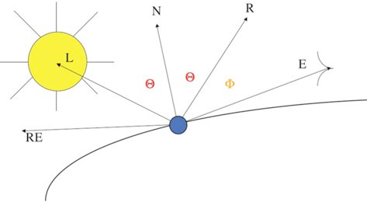
Diffuse Reflection
diffuse light reflected by an object depends on the incident light intensity, the angle between the normal vector and light direction, and the material diffuse reflection coefficient
diffuse_{r,g,b} = light_{r,g,b} * cos(θ) * diffreflcoeff_{r,g,b}

Slide 6
Diffuse Reflection
attributes
// vertex location
in vec4 aVertex;
// normal direction at aVertex
in vec3 aNormal;

Slide 7
Diffuse Reflection
uniforms
uniform mat4 uModelViewMatrix;
uniform mat4 uNormalMatrix;
// diffuse reflection coefficients
uniform vec4 uDiff;
// light location in eye coordinates
uniform float uX;
uniform float uY;
uniform float uZ;

Slide 8
Diffuse Reflection
code
// surface normal in eye coordinates
vec3 eyeNormal = normalize(vec3(uNormalMatrix * aNormal));
// vertex position in eye coordinates
vec4 vPosition4 = uModelViewMatrix * aVertex;
vec3 vPosition3 = vPosition4.xyz / vPosition4.w;
// vector to light source
vec3 lightPosition = vec3(uX, uY, uZ);
vec3 lightDir = normalize(lightPosition - vPosition3);
// dot product gives us diffuse intensity
float diff = max(0.0, dot(eyeNormal, lightDir));
// multiply intensity by diffuse color and light intensity
vec3 diffuse = uI * diff * vec3(uDiff);

Slide 9
Specular Reflection
specular light reflected by an object depends on the incident light intensity, the angle between the reflection and viewing directions, the material specular reflection coefficient, and the specular exponent (shininess)
specular_{r,g,b} = light_{r,g,b} * cos^{f}(Φ) * specreflcoeff_{r,g,b}

Slide 10
Specular Reflection
uniforms
// specular reflection coefficients
uniform vec4 uSpecular;
// specular exponent
uniform float uShininess;

Slide 11
Specular Reflection
code
// reflection direction
vec3 refl = reflect(-lightDir, eyeNormal);
// viewer direction
vec3 view = normalize(-vPosition3);
// cosine of angle between reflection and viewer directions
float cosPhi = max(0.0, dot(view, refl));
// specular intensity
float spec = pow(cosPhi, uShininess);
// specular color
vec3 specular = uI * spec * vec3(uSpecular);

Slide 12
Total Reflection
just the sum of the ambient, diffuse, and specular components
total_{r,g,b} = ambient_{r,g,b} + diffuse_{r,g,b} + specular_{r,g,b}

Slide 13
Total Reflection
out
// total
out vec4 vColor;

Slide 14
Total Reflection
code
// total color
vColor.rgb = clamp(ambient + diffuse + spec, 0.0, 1.0);
vColor.a = 1.0;
// don’t forget to transform the geometry
gl_Position = uModelViewProjectionMatrix * aVertex;

Slide 15
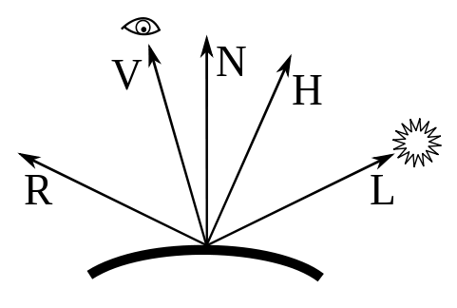
Halfway Vector
instead of computing the reflection direction you can use the halfway vector (the vector halfway between V and L)
H = V + L (then normalize H)
specular_{r,g,b} = light_{r,g,b} * cos^{f}(Φ) * specreflcoeff_{r,g,b}
Φ

Slide 16
Emitted Light
fixed pipeline OpenGL also has an emission term in the lighting calculation
just a constant color added to the total
// total color
vColor.rgb = clamp(ambient + diffuse + spec + emission, 0.0, 1.0);
vColor.a = 1.0;

Slide 17
Attenuation
for point light sources the intensity of the light source can be made to fall off with distance
multiply the source intensity by a falloff function where r is the distance between the light source and the vertex/fragment and s_{c}, s_{l}, and s_{q} are constants

Slide 18
Attenuation
an alternative falloff function used in games

Slide 19
Attenuation
Pixar

Slide 20
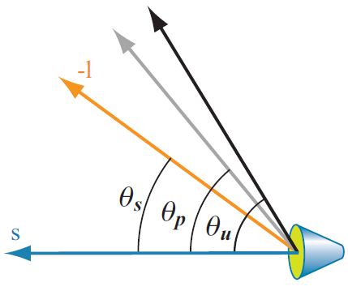
Spotlights
θ_{s} angle between source direction s and direction to vertex/fragment –l
θ_{p} penumbra angle (angle where the intensity starts to decrease)
θ_{u} umbra angle (angle where the intensity goes to zero)
Real-Time Rendering, 3rd Edition

Slide 21
Spotlights
OpenGL spotlight function
two zones:
spotlight zone where the light intensity varies
outside where the light intensity is zero

Slide 22
Spotlights
DirectX spotlight function
three zones:
inner zone where the light intensity is constant
spotlight zone where the light intensity varies
outside where the light intensity is zero

