Slide 1
Day 05
Shader Basics

Slide 2
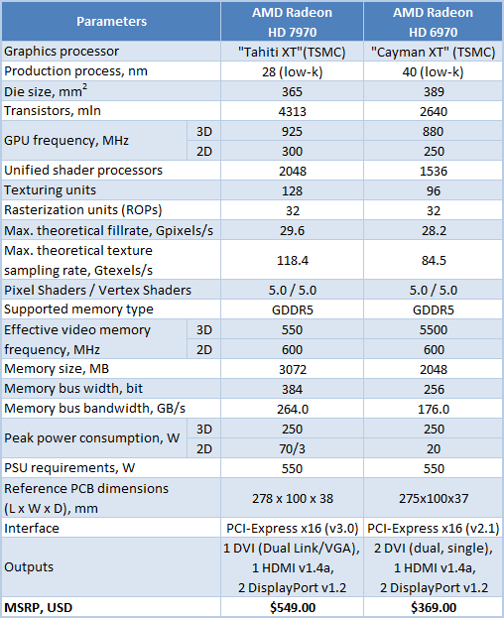
http://www.xbitlabs.com/articles/graphics/display/radeon-hd-7970_2.html#sect0

Slide 3
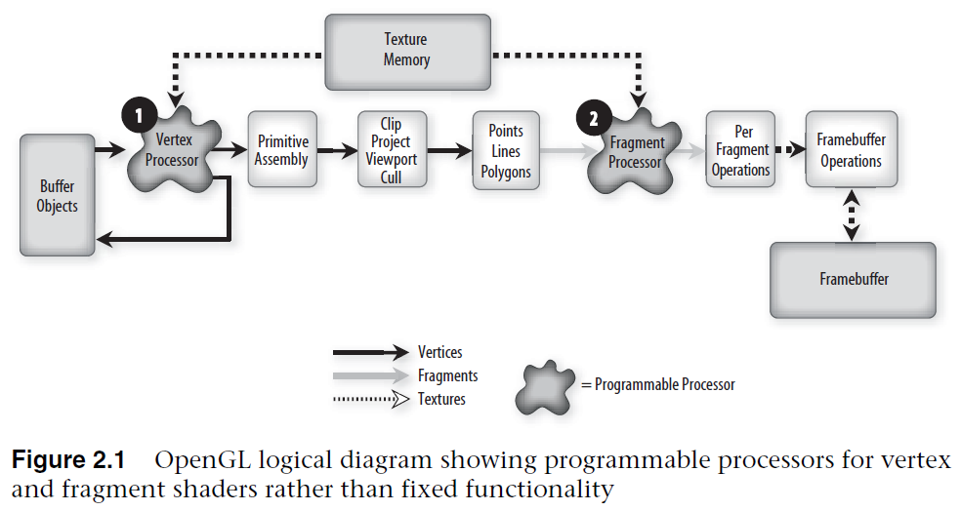
OpenGL Shading Language, 3rd Edition

Slide 4
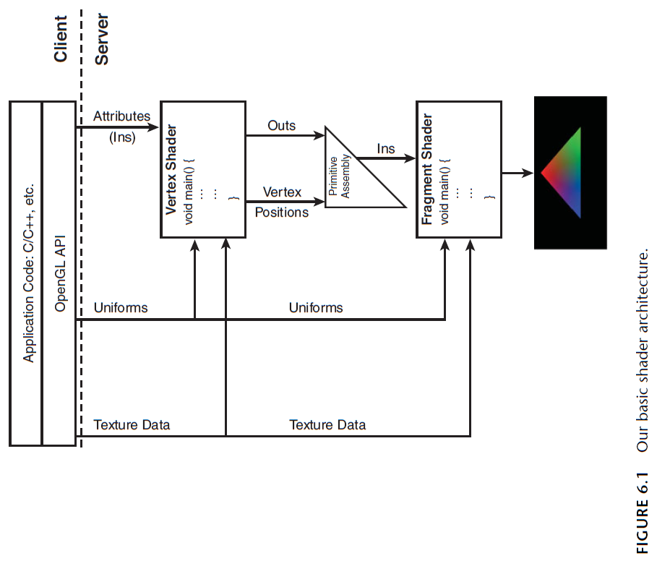
OpenGL SuperBible, 5th Edition

Slide 5
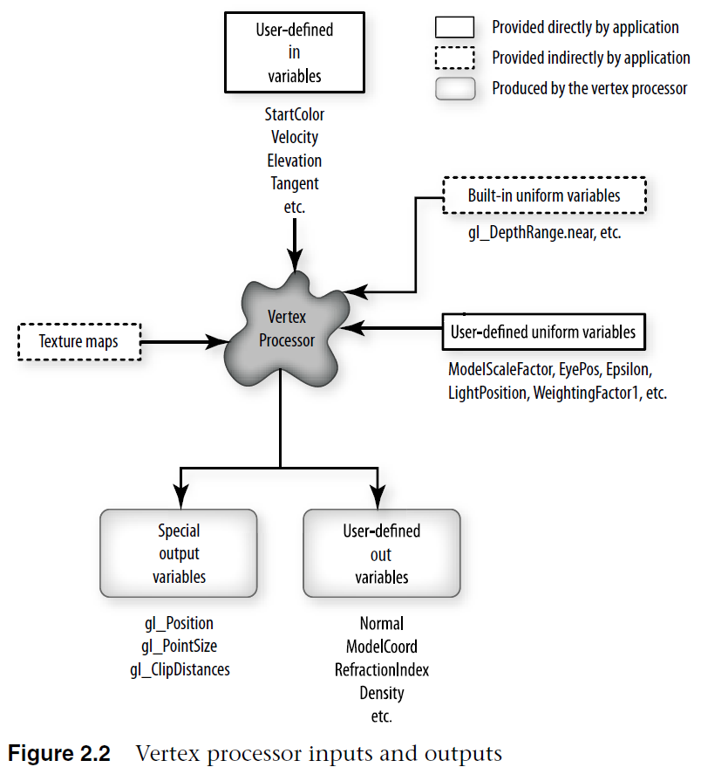
OpenGL Shading Language, 3rd Edition

Slide 6
Vertex Shader
a vertex shader can specify a completely general sequence of operations to be applied to each vertex and its associated data
accepts inputs from the application and generates outputs that are consumed by the rest of the graphics pipeline
the vertex shader is applied to each inbound vertex and must generate an outbound vertex

Slide 7
Vertex Shader
typical operations
vertex transformation
normal transformation and normalization
texture coordinate generation
texture coordinate transformation
lighting
color material application

Slide 8
Vertex Shader
does not replace graphics operations that require knowledge of several vertices at a time
perspective divide
primitive assembly
frustum and user clipping
frontface/backface culling
polygon mode
polygon offset

Slide 9
Vertex Shader
inputs
attributes
attributes are in variables
variable that has a value when it is passed into the shader and cannot be changed by the shader
per vertex data
vertex coordinates, normal vector, color
user-defined attributes are allowed
uniforms
a global variable set outside of the shader that is constant (uniform) for the entire primitive
tend to change infrequently (at most once per primitive)
both built-in and user-defined uniform variables
texture data

Slide 10
Vertex Shader
outputs
vertex shaders are designed to transform and light a single vertex
must compute the homogeneous position of the coordinate in clip space and store the result in the special output variable gl_Position
global variables output by the vertex shader are called out variables
write-only variable in the shader where it is defined
i.e., an out variable has no initial value when it is created and it is assumed that the shader will assign a value to the variable

Slide 11
Simple Vertex Shader
#version 330
in vec4 aVertex; // vertex position attribute
in vec4 aColor; // vertex color attribute
out vec4 vColor; // output color computed for aVertex
void main()
{
vColor = aColor;
gl_Position = aVertex;
}

Slide 12
Simple Vertex Shader
#version 330
in vec4 aVertex; // vertex position attribute
in vec4 aColor; // vertex color attribute
out vec4 vColor; // output color computed for aVertex
void main()
{
vColor = aColor;
gl_Position = aVertex;
}
minimum version of GLSL required to compile this shader

Slide 13
Simple Vertex Shader
#version 330
in vec4 aVertex; // vertex position attribute
in vec4 aColor; // vertex color attribute
out vec4 vColor; // output color computed for aVertex
void main()
{
vColor = aColor;
gl_Position = aVertex;
}
homogeneous coordinates of incoming vertex

Slide 14
Simple Vertex Shader
#version 330
in vec4 aVertex; // vertex position attribute
in vec4 aColor; // vertex color attribute
out vec4 vColor; // output color computed for aVertex
void main()
{
vColor = aColor;
gl_Position = aVertex;
}
RGBA color of incoming vertex

Slide 15
Simple Vertex Shader
#version 330
in vec4 aVertex; // vertex position attribute
in vec4 aColor; // vertex color attribute
out vec4 vColor; // output color computed for aVertex
void main()
{
vColor = aColor;
gl_Position = aVertex;
}
outgoing RGBA color computed for aVertex

Slide 16
Simple Vertex Shader
#version 330
in vec4 aVertex; // vertex position attribute
in vec4 aColor; // vertex color attribute
out vec4 vColor; // output color computed for aVertex
void main()
{
vColor = aColor;
gl_Position = aVertex;
}
entry point for the shader

Slide 17
Simple Vertex Shader
#version 330
in vec4 aVertex; // vertex position attribute
in vec4 aColor; // vertex color attribute
out vec4 vColor; // output color computed for aVertex
void main()
{
vColor = aColor;
gl_Position = aVertex;
}
just pass the incoming color through to the output

Slide 18
Simple Vertex Shader
#version 330
in vec4 aVertex; // vertex position attribute
in vec4 aColor; // vertex color attribute
out vec4 vColor; // output color computed for aVertex
void main()
{
vColor = aColor;
gl_Position = aVertex;
}
no transformation of the vertex
*vertex shader must assign to gl_Position

Slide 19
Simple Vertex Shader
#version 330
in vec4 aVertex; // vertex position attribute
in vec4 aColor; // vertex color attribute
out vec4 vColor; // output color computed for aVertex
void main()
{
vColor = aColor;
gl_Position = aVertex;
}
read only

Slide 20
Simple Vertex Shader
#version 330
in vec4 aVertex; // vertex position attribute
in vec4 aColor; // vertex color attribute
out vec4 vColor; // output color computed for aVertex
void main()
{
vColor = aColor;
gl_Position = aVertex;
}
value must be assigned by the shader

Slide 21
Naming Convention
Variable Prefix | Stage that Wrote It | Example
a | attribute (from application) | aColor
u | uniform (from application) | uModelViewMatrix
v | vertex shader | vColor
f | fragment shader | fFragColor

Slide 22
Fragment Shader
suppose we use the previous vertex shader to process three vertices of a triangle
graphics pipeline assembles the vertices into a triangle, clips the triangle to the viewing frustum, and rasterizes the triangle
by default, each out variable of the vertex shader is interpolated using perspective-correct interpolation to compute an interpolated value for each fragment
the fragment shader can use these interpolated values as in variables

Slide 23
Simple Fragment Shader
#version 330
in vec4 vColor; // interpolated color for the fragment
out vec4 fFragColor; // output fragment color
void main()
{
fFragColor = vColor;
}

Slide 24
Simple Fragment Shader
#version 330
in vec4 vColor; // interpolated color for the fragment
out vec4 fFragColor; // outgoing fragment color
void main()
{
fFragColor = vColor;
}
RGBA color of incoming fragment

Slide 25
Simple Fragment Shader
#version 330
in vec4 vColor; // interpolated color for the fragment
out vec4 fFragColor; // outgoing fragment color
void main()
{
fFragColor = vColor;
}
RGBA color of outgoing fragment

Slide 26
Simple Fragment Shader
#version 330
in vec4 vColor; // interpolated color for the fragment
out vec4 fFragColor; // outgoing fragment color
void main()
{
fFragColor = vColor;
}
shader entry point

Slide 27
Simple Fragment Shader
#version 330
in vec4 vColor; // interpolated color for the fragment
out vec4 fFragColor; // outgoing fragment color
void main()
{
fFragColor = vColor;
}
out variable must be assigned; here we
just pass through the interpolated color

Slide 28
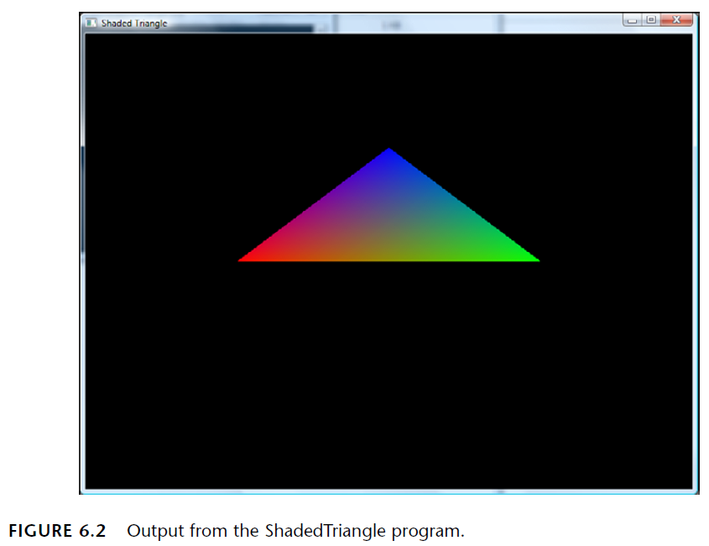
Shader Output
OpenGL SuperBible, 5th Edition

Slide 29
Extending the Vertex Shader
the previous vertex shader applies no modelling or viewing transformations to the incoming vertex
typically, you want to transform the incoming vertex position by the modelview-projection matrix
the modelview-projection matrix is a uniform in variable

Slide 30
Simple Vertex Shader
#version 330
in vec4 aVertex; // vertex position attribute
in vec4 aColor; // vertex color attribute
uniform mat4 uModelViewProjectionMatrix;
out vec4 vColor; // output color computed for aVertex
void main()
{
vColor = aColor;
gl_Position = uModelViewProjectionMatrix * aVertex;
}

Slide 31
Simple Vertex Shader
#version 330
in vec4 aVertex; // vertex position attribute
in vec4 aColor; // vertex color attribute
uniform mat4 uModelViewProjectionMatrix;
out vec4 vColor; // output color computed for aVertex
void main()
{
vColor = aColor;
gl_Position = uModelViewProjectionMatrix * aVertex;
}
homogeneous modelview-projection matrix

Slide 32
Simple Vertex Shader
#version 330
in vec4 aVertex; // vertex position attribute
in vec4 aColor; // vertex color attribute
uniform mat4 uModelViewMatrix; // modelview matrix
out vec4 vColor; // output color computed for aVertex
void main()
{
vColor = aColor;
gl_Position = uModelViewMatrix * aVertex;
}
transform incoming vertex by modelview matrix

Slide 33
glman Uniform Variables
glman makes several uniform variable matrices available to your shaders
uModelViewMatrix
uProjectionMatrix
uModelViewProjectionMatrix
uNormalMatrix
uModelViewMatrixInverse

