Slide 1
Day 03
Viewing and Perspective Transformations

Slide 2
Transformation of Normal Vectors
the normal vector is the vector that is perpendicular to a surface at some point on the surface
  i.e., we can think of the surface as being locally planar at the point and the normal vector is the normal vector to the plane

Slide 3
Transformation of Normal Vectors
a point q is on the plane if and only if
written as matrix multiplication

Slide 4
Transformation of Normal Vectors
if the surface is transformed by some invertible affine transformation T then the plane is also transformed by T
  we require the normal to the transformed plane
  notice that
  therefore

Slide 5
Transformation of Normal Vectors
what happens if T is
  a translation?
  a uniform scale?
  a rotation?
  not invertible?

Slide 6
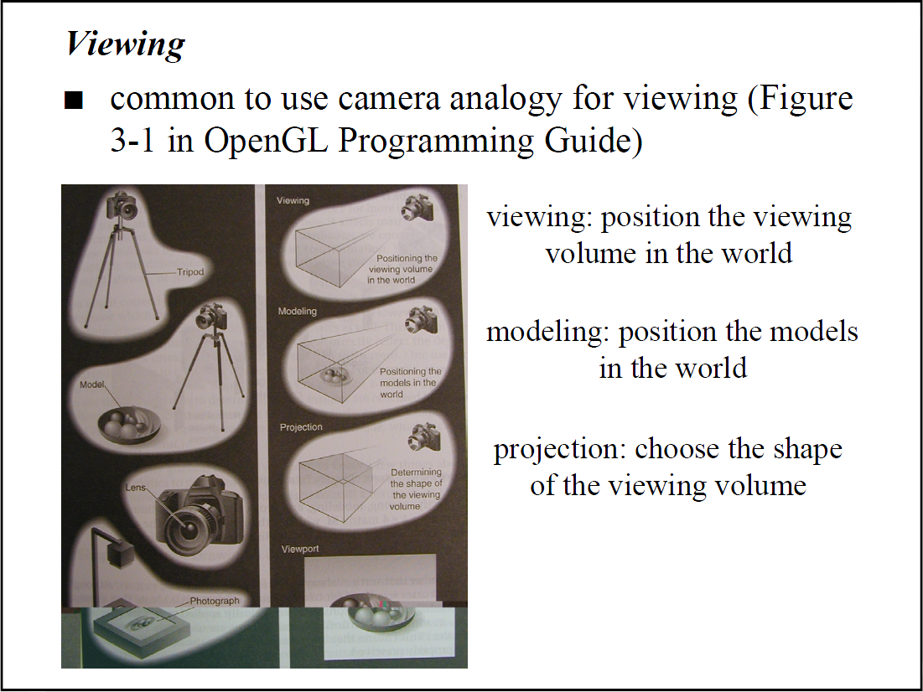

Slide 7
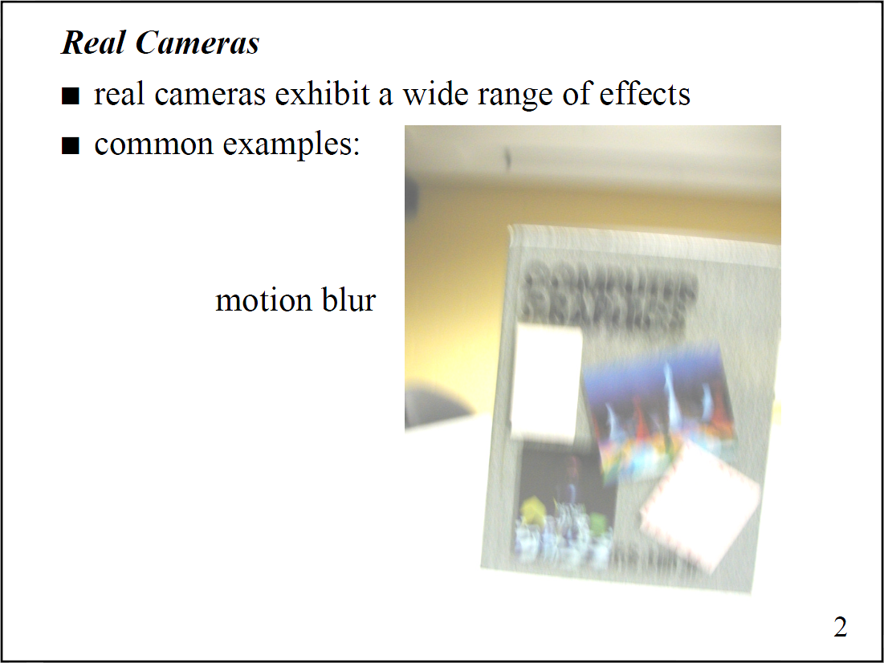

Slide 8
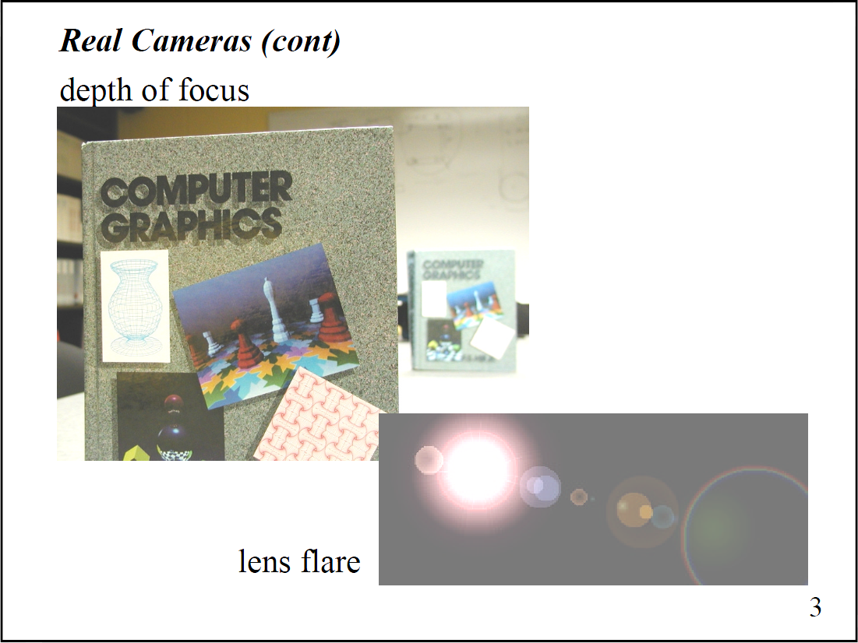

Slide 9
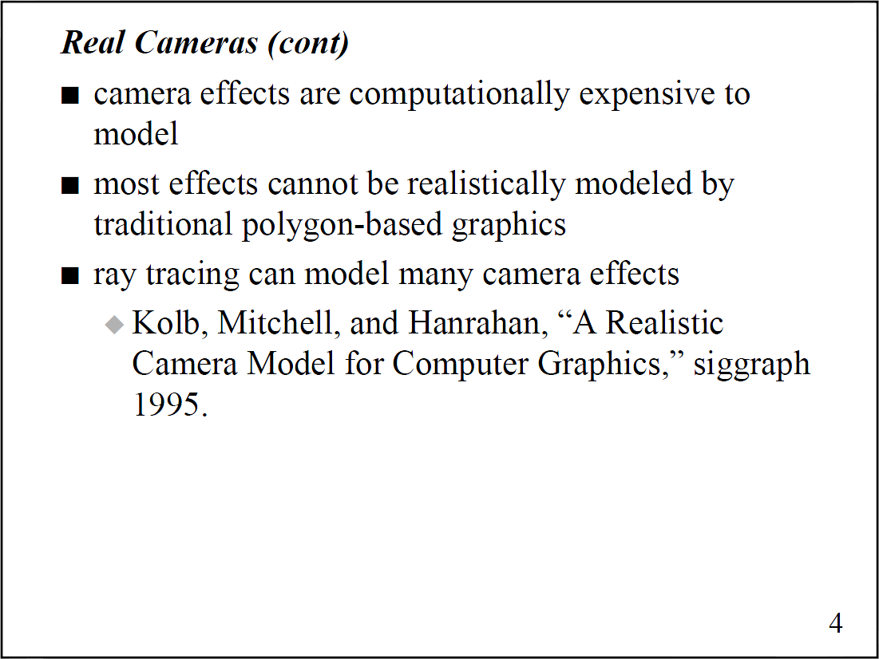

Slide 10
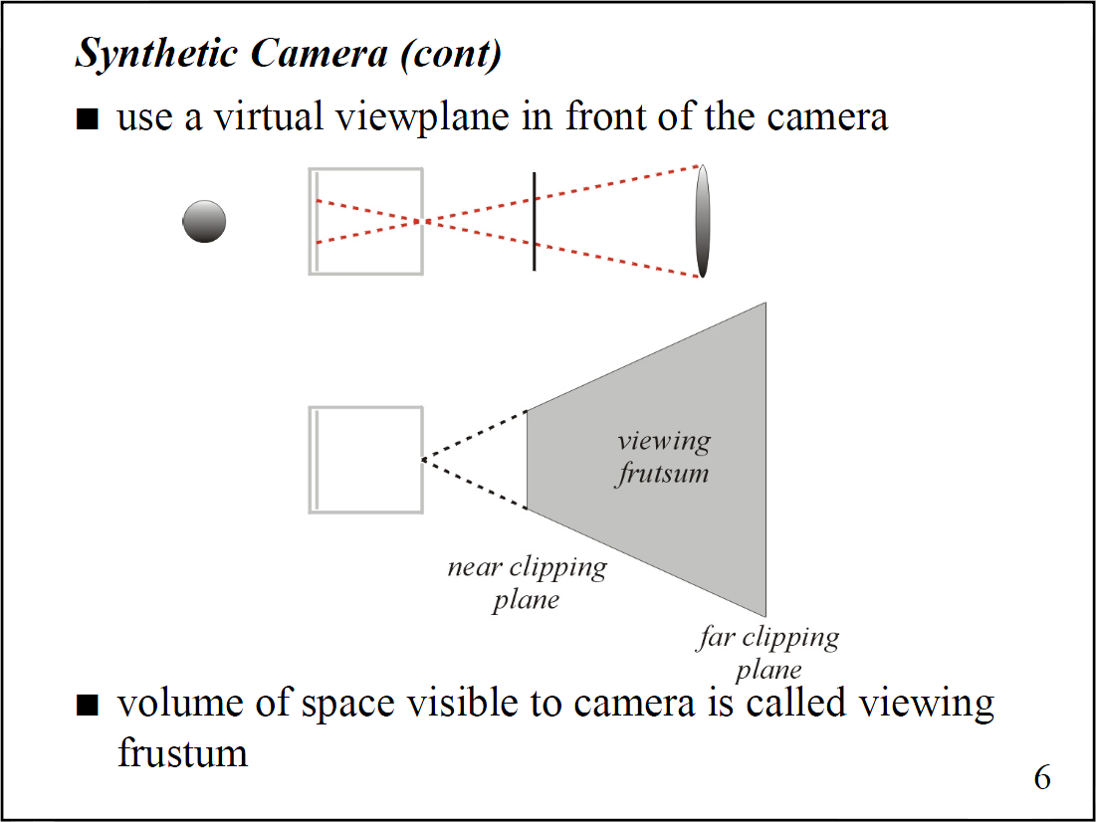

Slide 11
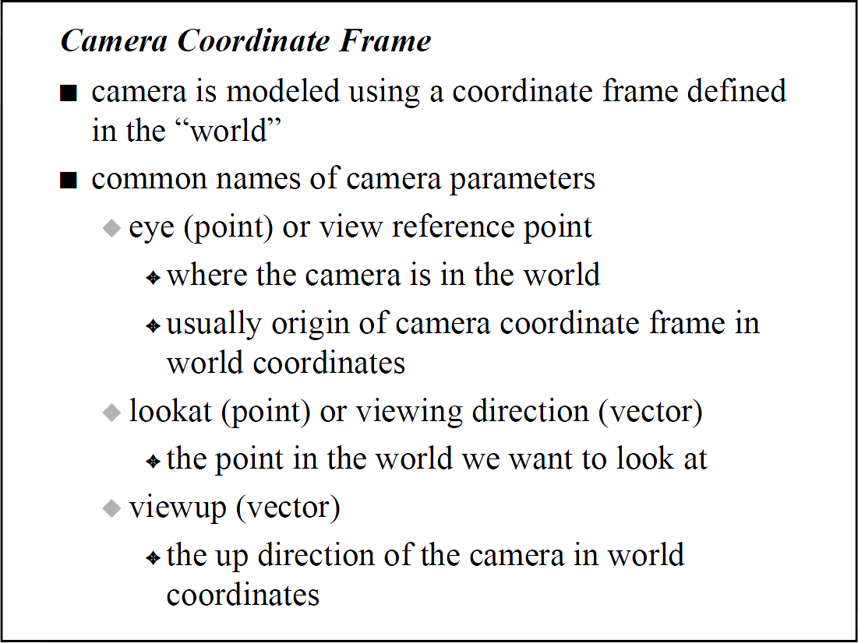

Slide 12
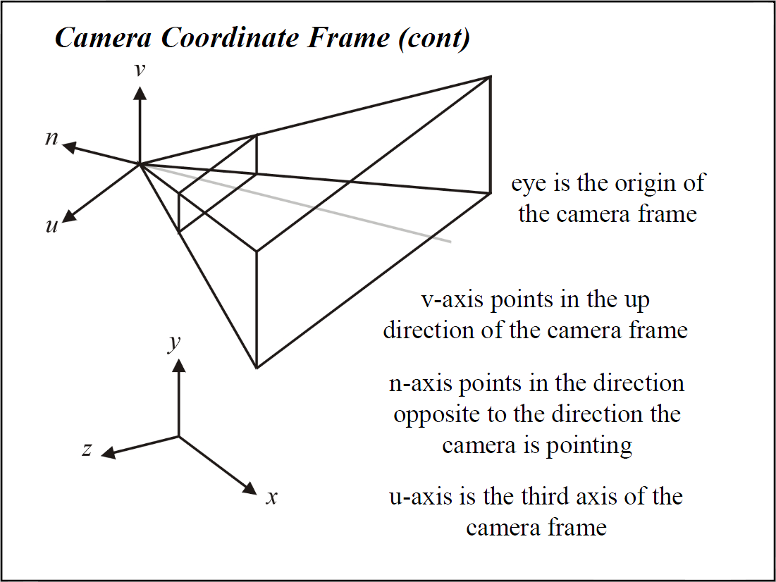

Slide 13
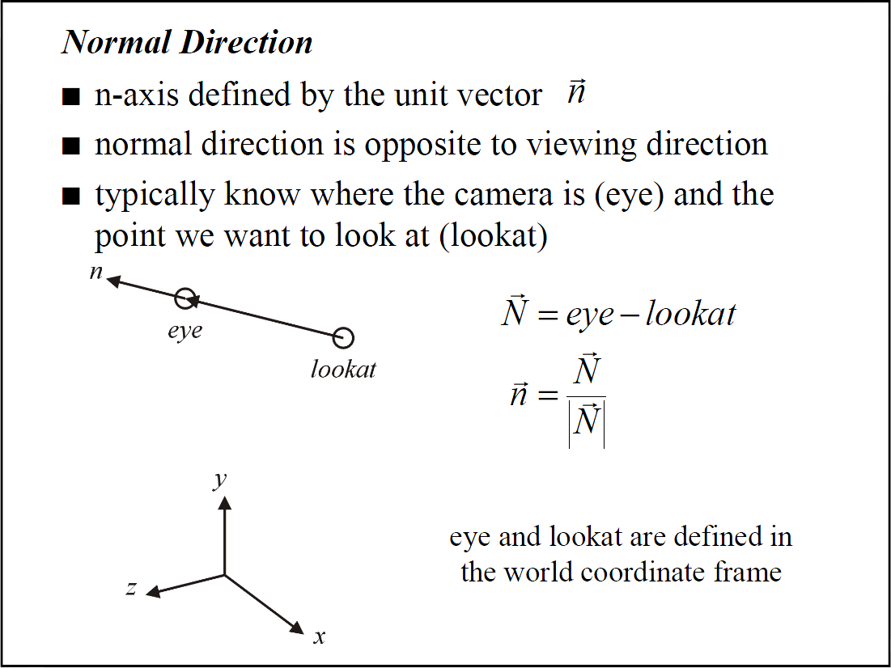

Slide 14
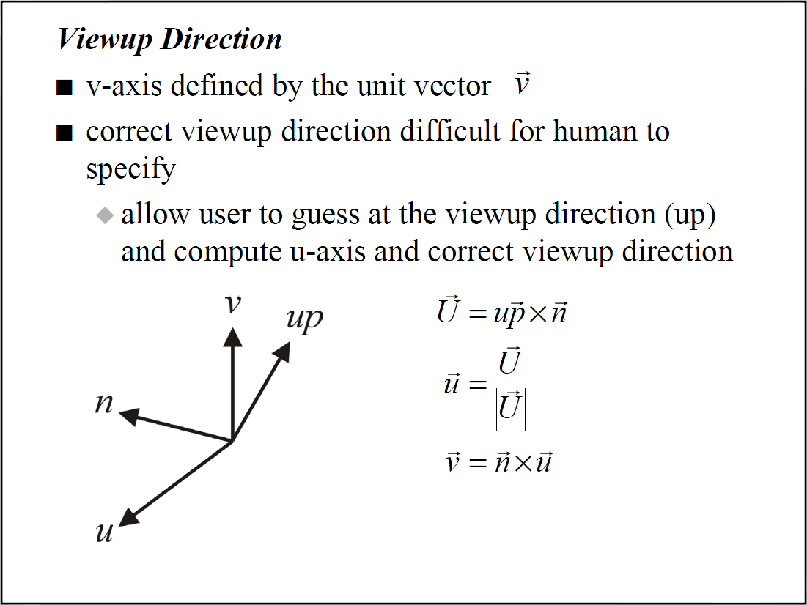

Slide 15
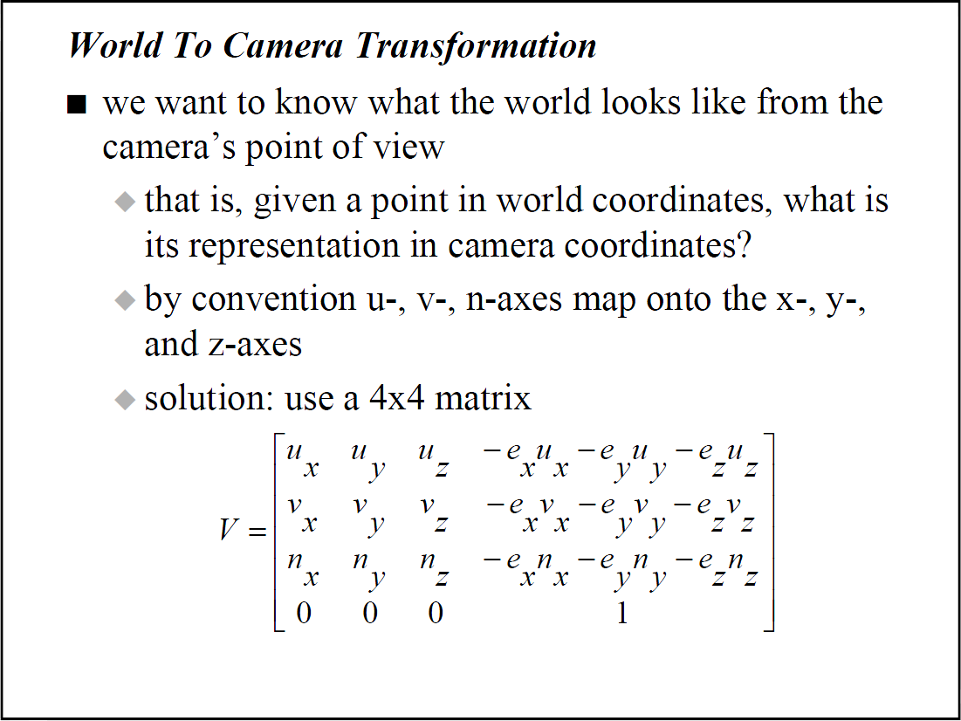

Slide 16
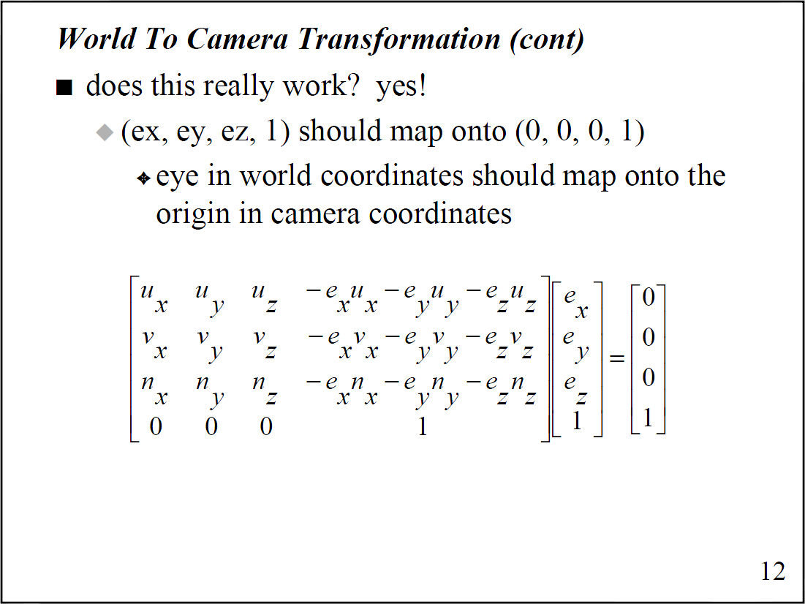

Slide 17
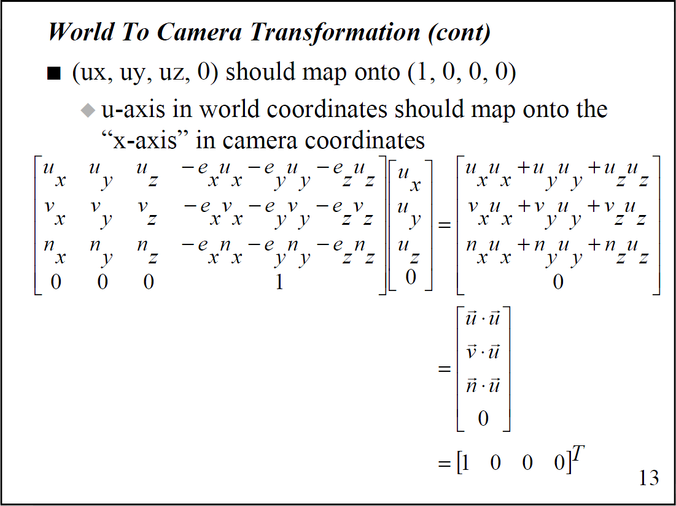

Slide 18
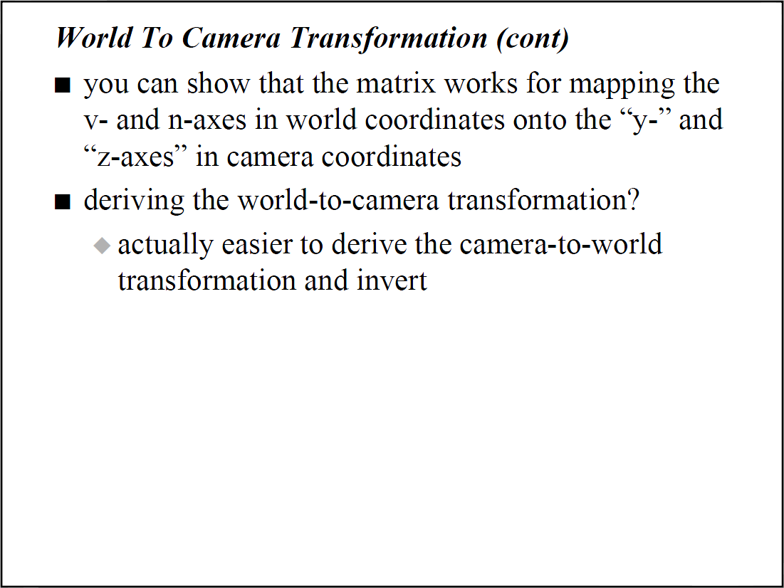

Slide 19
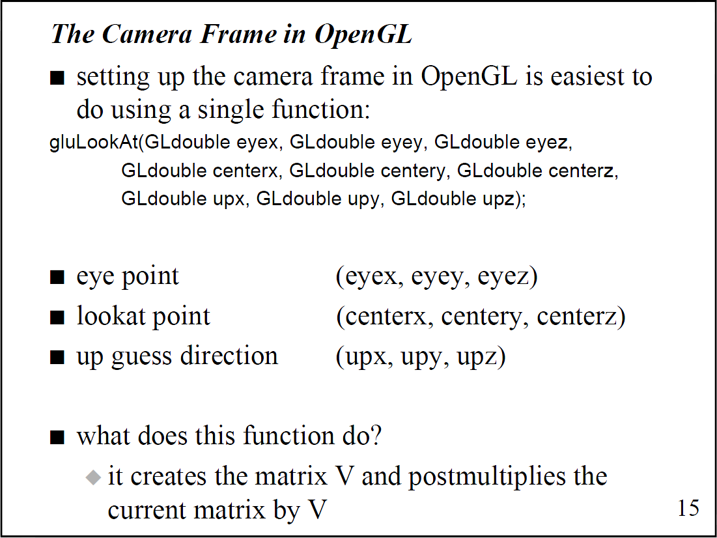

Slide 20
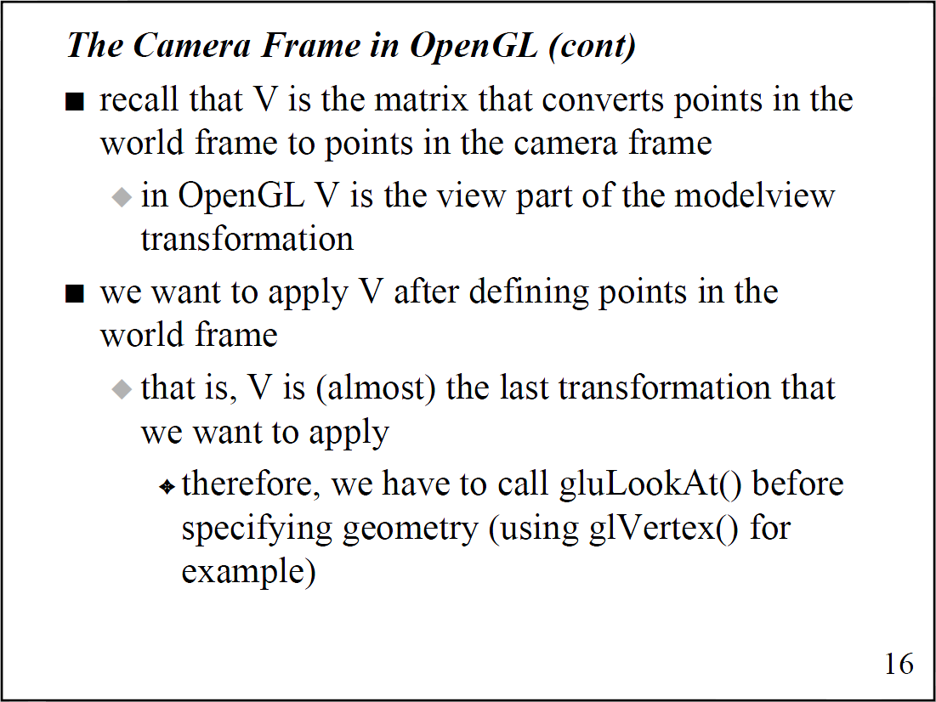

Slide 21
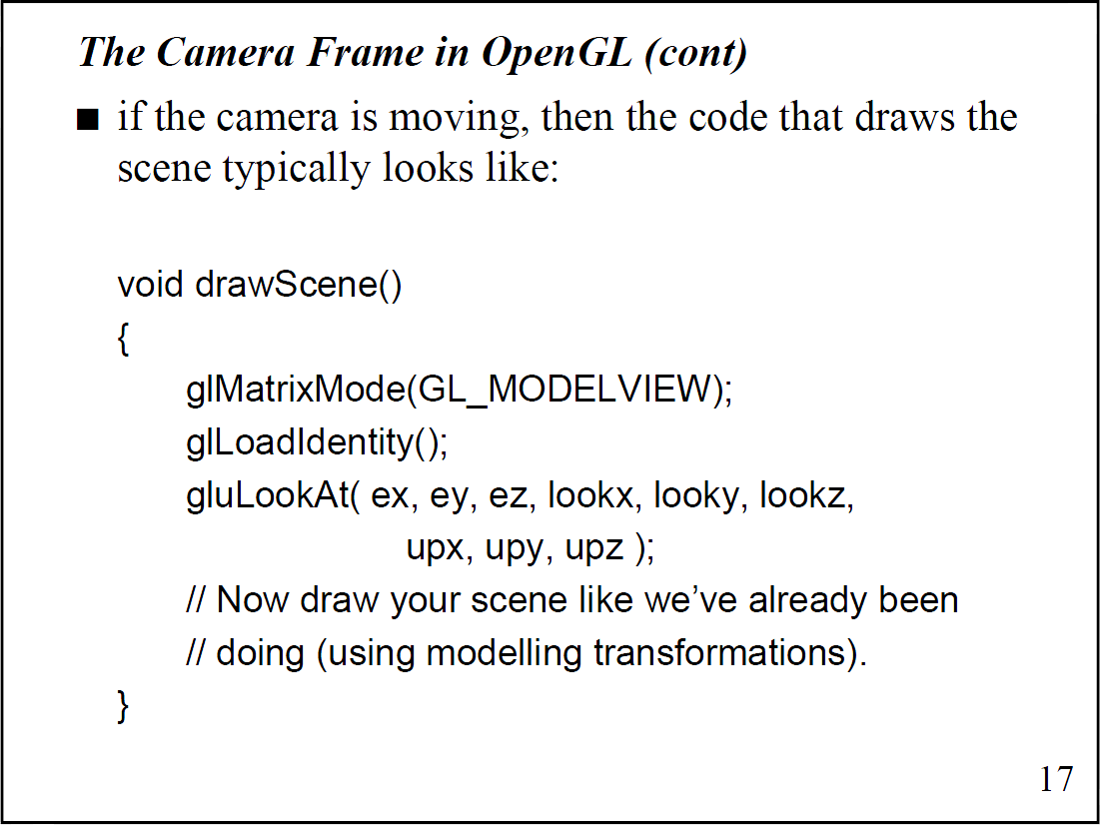

Slide 22
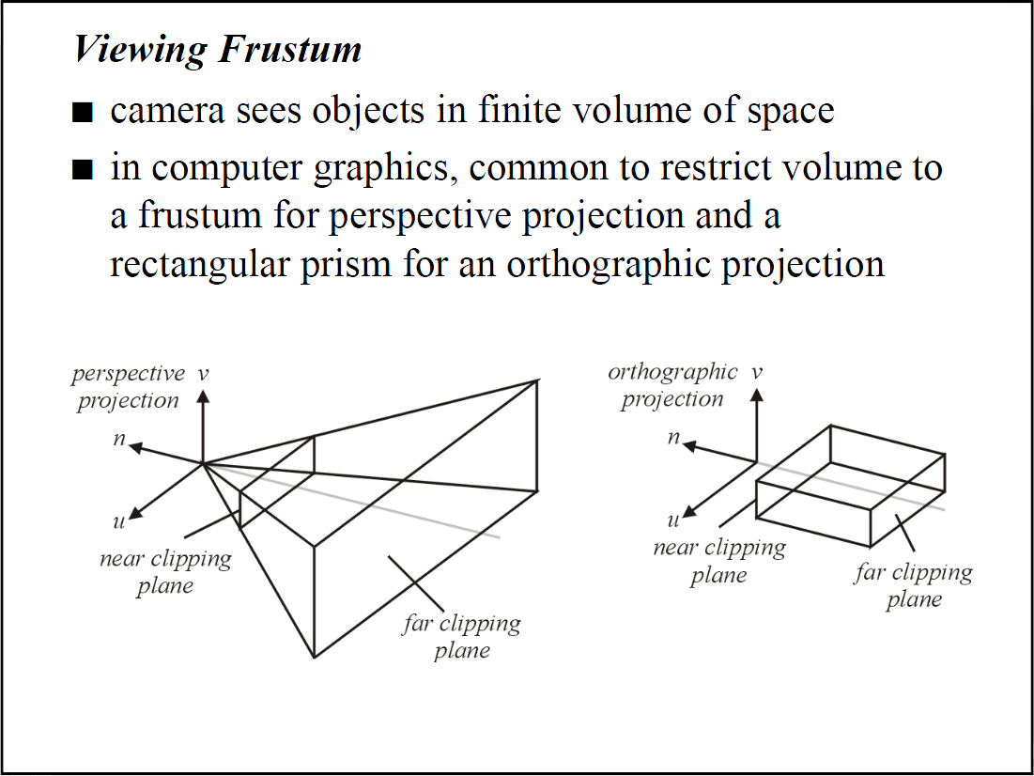

Slide 23
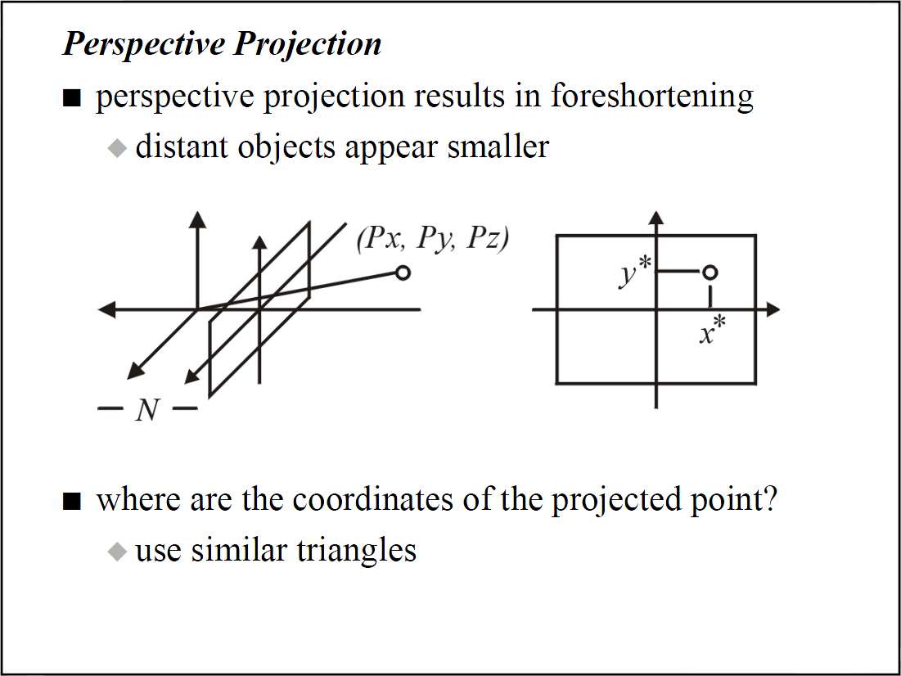

Slide 24
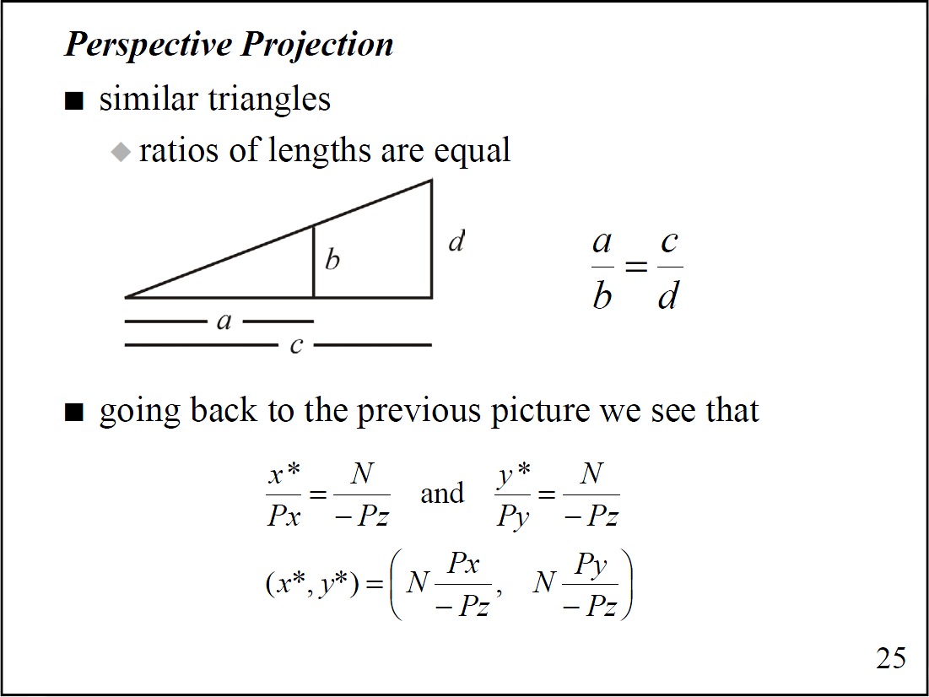

Slide 25
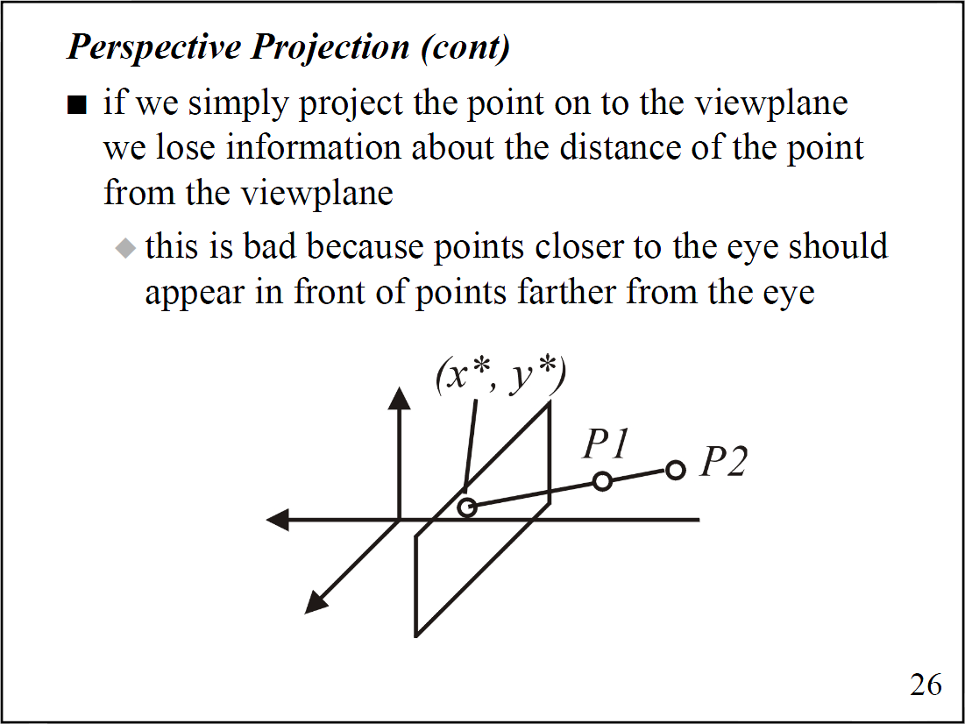

Slide 26
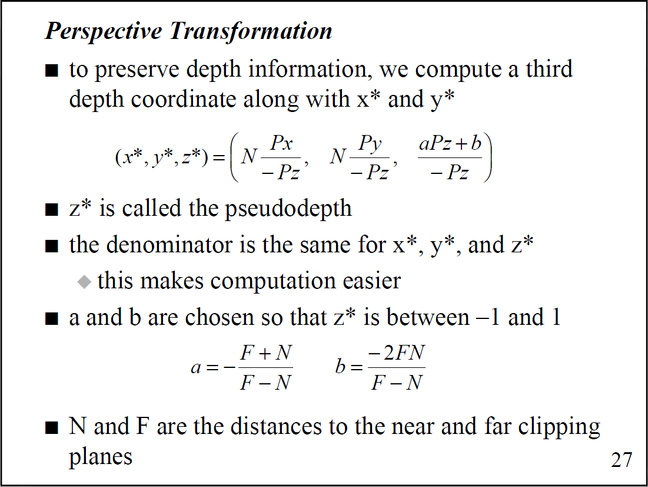

Slide 27
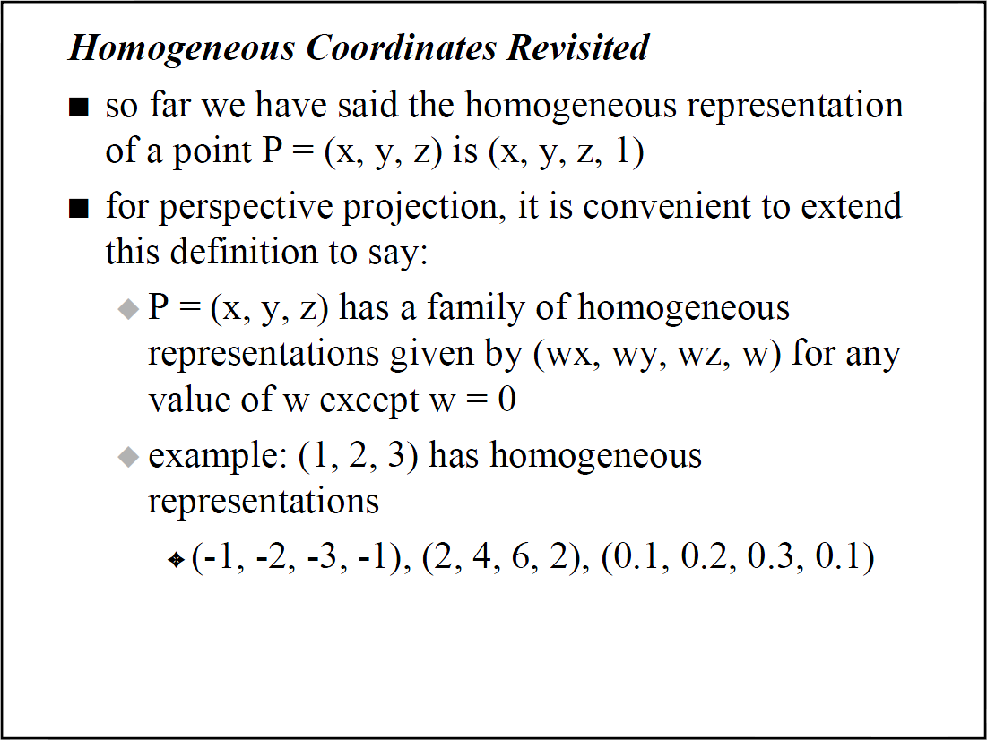

Slide 28
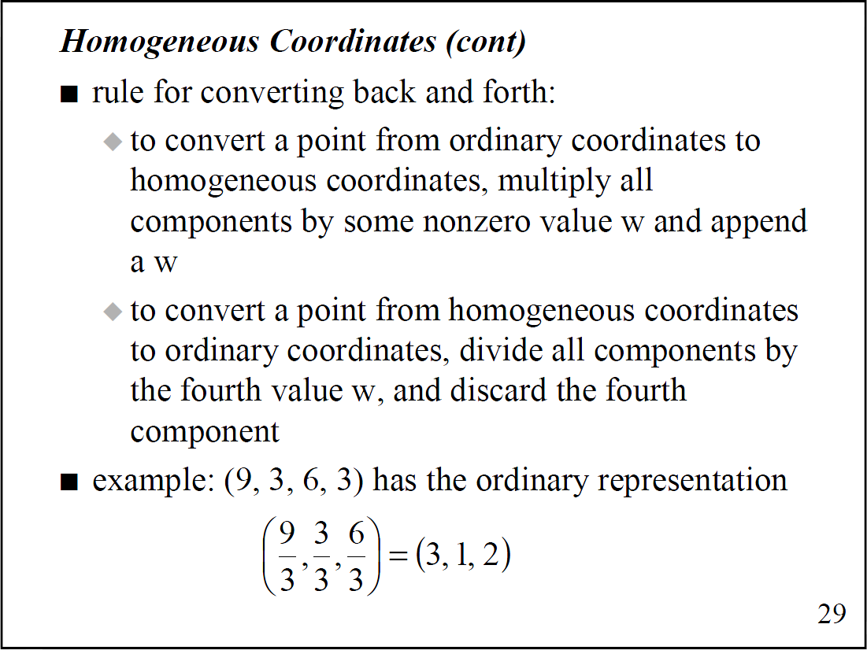

Slide 29
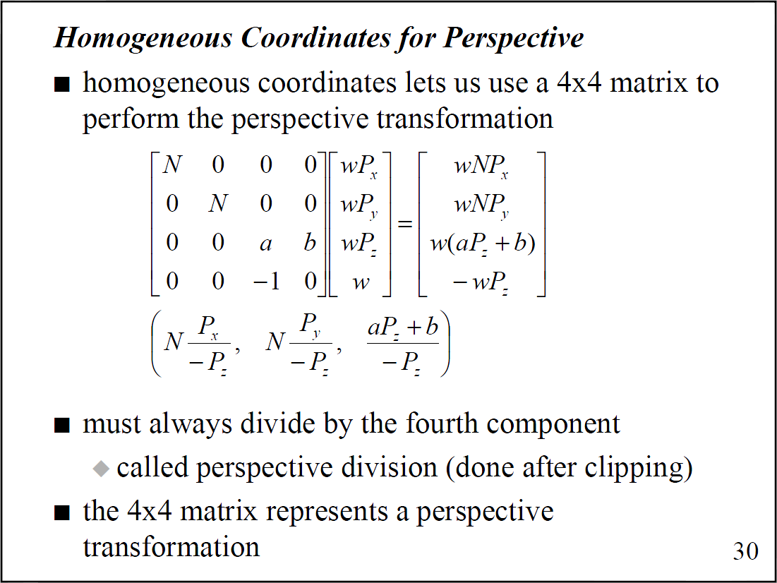

Slide 30
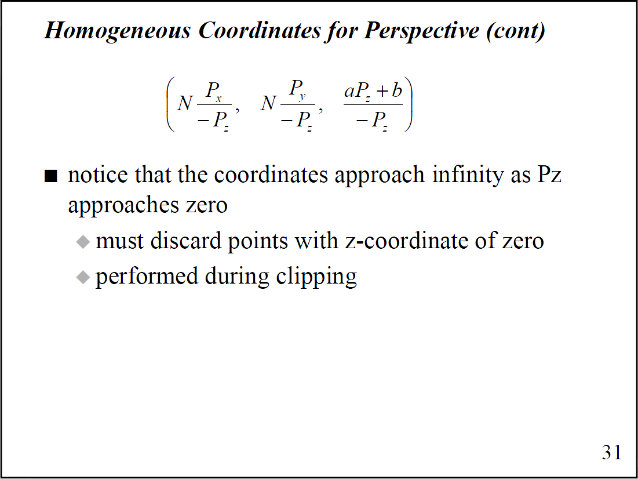

Slide 31
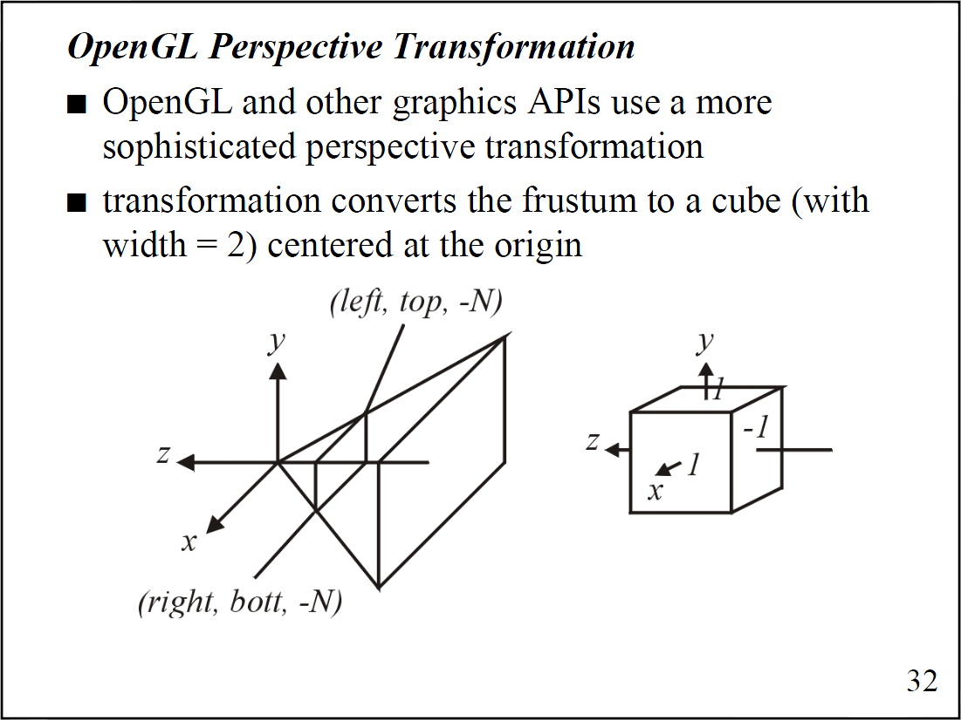

Slide 32
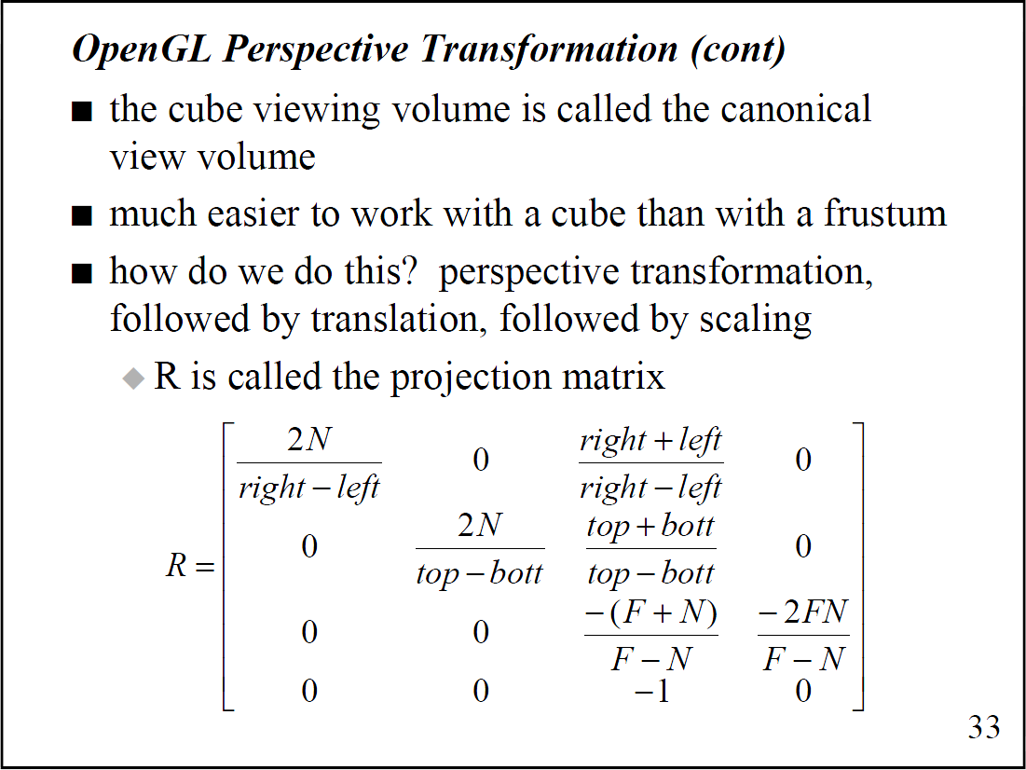

Slide 33
