Slide 1
Ariadne A Secure On-Demand Routing Protocol for Ad Hoc Networks
Speaker: Christof Hammer
Course: High Performance Computer Networks, Fall 2o1o
CSE-Department York University, Toronto

Slide 2
Duration & Questions
This presentation will last about 30 minutes
Please keep all your questions until the end of the presentation

Slide 3
Content
Ad hoc networks
On-Demand Routing
What Ariadne does
Short review of DSR
TESLA
Assumptions
Security & Keys
Attacker and Attacking-Models
Route Discovery
Route Maintenance
Performance of Ariadne
Conclusions
Q & A

Slide 4
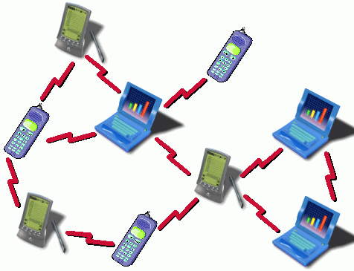
Ad hoc networks
Ad hoc networks
are groups of wireless mobile devices (nodes)
nodes cooperate by forwarding packets
have no need for central management
setup and deployment is easy and quick
nodes are not homogeneous
Ad hoc routing Protocols
can handle the requested (high) mobility
don‘t send periodic routing messages
have not as much overhead as wired routing protocols
but do not concern the aspect of security

Slide 5
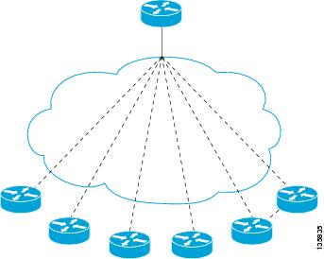
On-Demand Routing
On-Demand routing is also refered to as reactive routing
A route request is only issued if there‘s need
A node starts a discovery iff it has to send data to the destination and doesn‘t know a valid route to the target
This method has (much) less overhead than proactive protocols (e.g. Boder Gateway Protocol)
Routing overhead is almost completly eliminated in network areas which do not change often

Slide 6
What Ariadne does
Ariadne authenticates routing messages using one of three possibilities :
Shared secrets between node pairs
Shared secrets between communication nodes in combination with broadcast authentication (TESLA) (focus of the presentation)
Digital signature method
Ariadne builds upon the DSR-protocol
Prevents malicious injection or altering of routing data
Routing loop
Black Hole
Detours

Slide 7
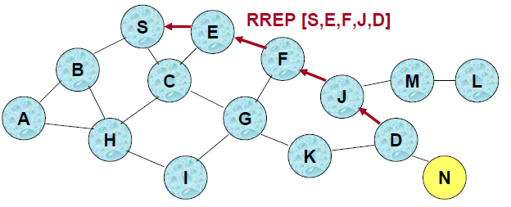
Short review of DSR
DSR belongs to the on demand protocols
Route discovery
Is triggered iff a node need to send data to a destination for which no route exists
A special ROUTE-REQUEST packet is sent.
This packet builds the actual path
Route maintenance
Detects borken links on a route
Generates ROUTE-ERROR messages
Removes the defect links from the path cache

Slide 8
TESLA
TESLA = Time Efficient Stream Loss-tolerant Authentication
TESLA is a broadcast authentication protocol
Ariadne uses TESLA to authenticate the DSR routing packets
Efficient: It adds only a single message authentication code (MAC) to a message
An asymmetric primitive is required to prevent others from forging Message Authentication Codes
TESLA archives asymmetry through clock synchronization (not strict) and delayed key disclosure (keys are sent after the message) rather than complex mathematical computations (e.g. RSA)
TESLA generates a one-way key chain by repeatedly computing a one way hash function H

Slide 9
TESLA

Slide 10
TESLA
Each sender splits time into slots (t) (e.g. 200 ms)
After that it chooses a random initial key
Now a one-way key chain is generated
The keys are used in reverse order of their generation
The sender discloses the key (i) based on the time interval (t), and the disclosure time of the first key (T₀)
The sender attaches MAC to each packet
Computed over the packet‘s contents
Sender determines time interval and uses corresponding key
With each packet the sender also sends the most recent discloseable one-way-key

Slide 11
TESLA

Slide 12
TESLA
All Receivers know the key disclosing schedule
Checks that the key used to compute the MAC is still secret by determining that the sender could not have made it public yet
As long as key is secret, the receiver buffers the packet
When the key is made public, receiver checks it‘s correctness and authenticates the buffered packets

Slide 13
Assumptions
Each node must be able to estimate the end-to-end transmission time to any other node in the Network
Physical attacks or attacks on the medium (e.g. jamming) are disregarded
All nodes have loosely synchronized clock
Resources of network nodes are very different, so Ariadne assumes always constrained recourses.
Each node has a TESLA one way key chain and each node know an authentic key of the TESLA one-way key chain of each other node

Slide 14
Security & Keys
Three authentication mechanism possibilities:
Pair wise secret keys
TESLA (shared keys between all source-destination pairs)
Digital signatures
Shared secret keys
Key distribution center
Bootstrapping from a Public Key Infrastructure
Pre-loading at initialization
Initial TESLA keys
Embed at initialization
Assume PKI and embed Certifications Authority’s public key at each node
Notes:
Pair wise secret keys (requires n(n+1)/2 keys)
Digital signatures (requires powerful nodes)

Slide 15
Attacker and Attacking-Models
Active attacker
Injects packets and eavesdrops
Characterized based on the number of controlled nodes in the network
Passive attacker is not considered in the presentation
Routing disruption attacks
Causes legitimate data packets to be routed dysfunctional (e.g., routing loop, black hole, detour)
Resource consumption attacks
Consumes valuable network resources or node resources (e.g., injecting data packets, injecting control packets)

Slide 16
ROUTE REQUEST Packet
ROUTE REQUEST packet contains eight fields:
ROUTE REQUEST: label
initiator: address of the sender
target: address of the recipient
id: unique identifier
time interval: TESLA time interval of the (pessimistic) arrival time
hash chain: sequence of MAC hashes
node list: sequence of nodes on the path
MAC list: MACs of the message using TESLA keys
request | initiator | target | id | time interval | hash chain | node list | MAC list

Slide 17
Route Discovery
Assume sender and receiver share secret (non-TESLA) keys for message authentication
Target authenticates ROUTE REQUESTS
Initiator includes a MAC computed with end-to-end key (e.g. K_{AB})
Target verifies authenticity and freshness using shared key
Data authentication using TESLA keys
Each hop authenticates new information in the REQUEST
Target buffers REPLY until intermediate nodes release TESLA keys
TESLA security condition is verified at the target
Target includes a MAC in the REPLY
Attacker can remove a node from node list in a REQUEST but the One-way hash functions verify that no hop was omitted

Slide 18
Route Discovery (cont.)
Upon receiving ROUTE REQUEST, a node:
Processes the request only if it is new
Processes the request only if the time interval is valid (not too far in the future, but not for an already disclosed TESLA key)
Modifies the request and rebroadcasts it
Appends its address to the node list, replaces the hash chain with H[its nodeid, prev. hash chain]
Appends MAC of entire REQUEST to MAC list using K_{Ai} where i is the index for the time interval specified in the REQUEST

Slide 19
Route Discovery (cont.)

Slide 20
Route Discovery (cont.)
Assume all nodes know an authentic key of the TESLA one-way key chain of every other node
Securing ROUTE REQUEST
Target can authenticate the sender (using their shared key)
Initiator can authenticate each entry using intermediate TESLA keys
No node can remove any other node in the REQUEST or REPLY

Slide 21
Route Reply
When the target receives the route request:
Checks the validity of the REQUEST (determining that the keys from the time interval have not been disclosed yet and that hash chain is correct)
Returns ROUTE REPLY containing eight fields
ROUTE REPLY, target, initiator, time interval, node list, MAC list
target MAC: MAC computed over above fields with key shared between target and initiator (e.g. K_{BA)}
Key list: disclosable MAC keys of nodes along the path

Slide 22
Route Reply (cont.)

Slide 23
Route Reply (cont.)
Node forwarding ROUTE REPLY
Waits until it can disclose TESLA key from specified interval
Appends that key to the key list
This waiting does delay the return of the ROUTE REPLY but does not consume extra computational power
When initiator receives ROUTE REPLY
Verifies each key in the key list is valid
Verifies that the target MAC is valid
Verifies that each MAC in the MAC list is valid using the TESLA keys

Slide 24
Route Maintenance
Node forwarding a packet to the next hop returns a ROUTE ERROR to the original sender
ROUTE ERROR contains six fields
ROUTE ERROR: label
sending address: node encountering error
receiving address: intended next hop
time interval: pessimistic arrival time of error at destination
error MAC: MAC of the preceding fields of the error (computed using sender’s TESLA key)
recent TESLA key: most recent disclosable TESLA key

Slide 25
Route Maintenance
Prevent unauthorized nodes from sending errors, we require errors to be authenticated by the sender
Errors are propagated as regular data packets
Intermediate nodes remove routes that use the bad link
Sending node continues to send data packets along the route until error is validated
Generates additional errors, which are all cleaned up when the error is finally validated

Slide 26
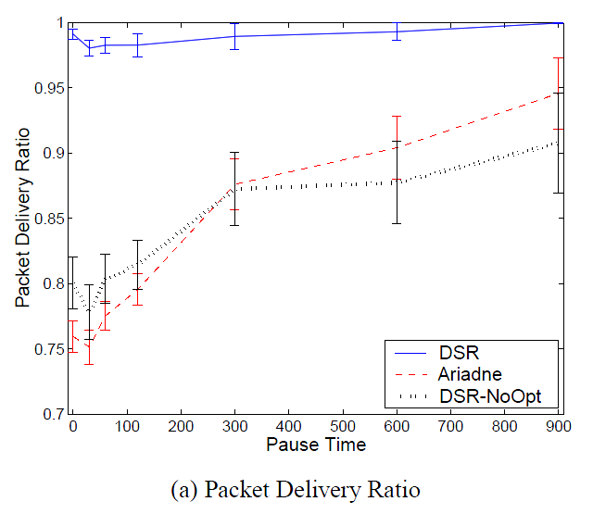
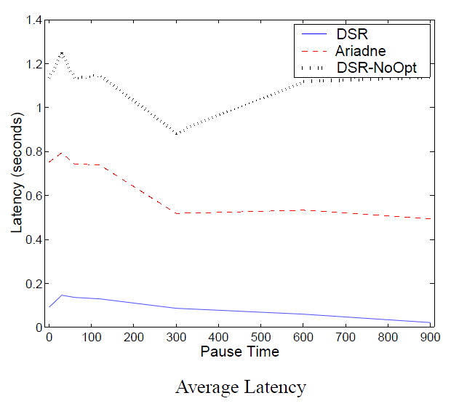
Performance

Slide 27
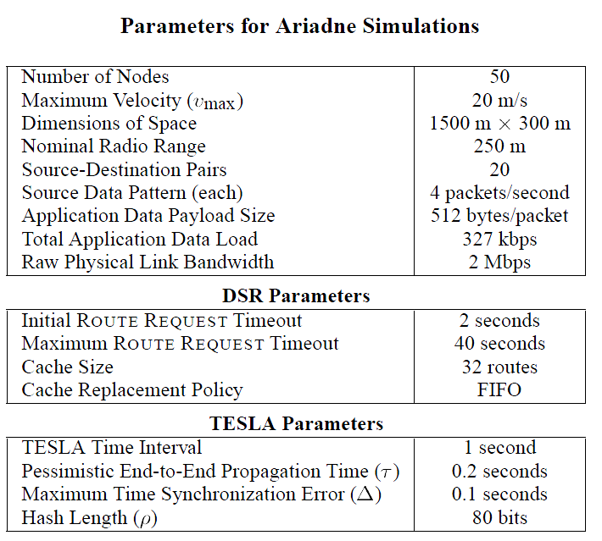
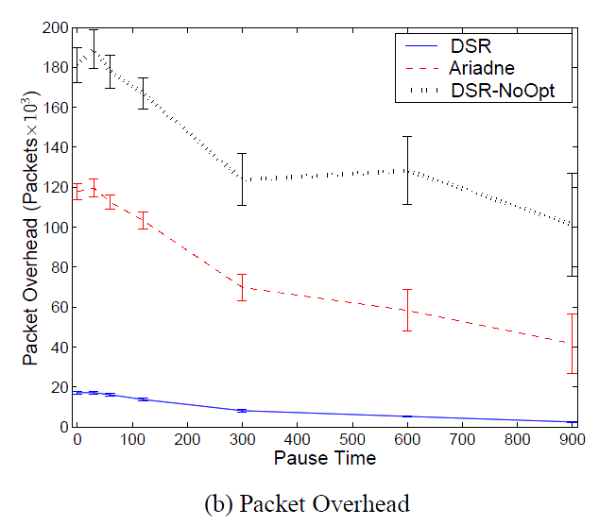
Performance (cont.)

Slide 28
Conclusions
Ariadne is a secure ad hoc routing protocol
Operates on-demand
Efficient and general security mechanisms
The authors of the paper restricted the scenarios very much
Ariadne was implemented on a non optimized version of DSR
About 26% more overhead than non optimized DSR
Slower route discovery with TESLA
Delays due to delayed key disclosure
Ariadne has less throughput
Due to slower route discovery
Key exchange is complicated
In the ad hoc environment especially, this is most likely not feasible

Slide 29
Thank you for listening.
Are there any Questions?

