Slide 1
Transmission Control Protocol (TCP)
EECS 3214
1

Slide 2
TCP Services
Transmission Control Protocol (RFC 793)
  connection oriented, reliable communication
  over reliable and unreliable (inter)networks
  If the underlying network is unreliable (IP)
    segments may get lost
    segments may arrive out of order
Connection establishment and termination
Flow control
Reliable delivery
Congestion control
2
Notes:
Now look at TCP (RFC 793), at the service it provides to the TS user and then at the internal protocol details. TCP is designed to provide reliable communication between pairs of processes (TCP users) across a variety of reliable and unreliable networks and internets. TCP provides two useful facilities for labeling data: push and urgent:
• Data stream push: Ordinarily, TCP decides when sufficient data have accumulated to form a segment for transmission. The TCP user can require TCP to transmit all outstanding data up to and including that labeled with a push flag. On the receiving end, TCP will deliver these data to the user in the same manner. A user might request this if it has come to a logical break in the data.
• Urgent data signaling: This provides a means of informing the destination TCP user that significant or "urgent" data is in the upcoming data stream. It is up to the destination user to determine appropriate action.

Slide 3
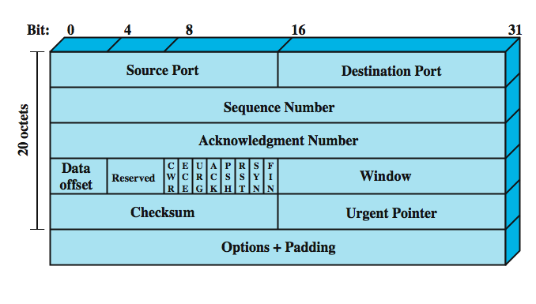
TCP Header
3
Notes:
TCP uses only a single type of protocol data unit, a TCP segment. The header is shown in Stallings DCC8e Figure 20.10. This header performs all protocol mechanisms, and is large, with a min length of 20 octets. The fields are:
• Source Port (16 bits): Source TCP user. eg. Telnet = 23; HTTP = 80.
• Destination Port (16 bits): Destination TCP user.
• Sequence Number (32 bits): of first data octet in this segment except when the SYN flag is set. when it contains the initial sequence number (ISN) and the first data octet in this segment has sequence number ISN + 1.
• Acknowledgment Number (32 bits): Contains the sequence number of the next data octet that the TCP entity expects to receive.
• Data Offset (4 bits): Number of 32-bit words in the header (size of header)
• Reserved (4 bits): Reserved for future use.
• Flags (6 bits):
• Window (16 bits): Flow control credit allocation, in octets.
• Checksum (16 bits): The ones complement of the ones complement sum of all the 16-bit words in the segment plus a pseudoheader.
• Urgent Pointer (16 bits): This value, when added to the segment sequence number, contains the sequence number of the last octet in a sequence of urgent data. This allows the receiver to know how much urgent data is coming.
• Options (Variable): eg. option that specifies the maximum segment size.

Slide 4
Issues to Consider
  ordered delivery
  flow control
  connection establishment
  connection termination
  retransmission strategy
  duplication detection
  failure recovery
4

Slide 5
Ordered Delivery
segments may arrive out of order.
hence we number segments sequentially.
TCP numbers each octet sequentially.
each segment is numbered by the first octet number in the segment.
5
Notes:
With an unreliable network service, it is possible that segments, even if they are all delivered, may arrive out of order. The required solution to this problem is to number segments sequentially. We have seen that for data link control protocols, such as HDLC, and for X.25, each data unit (frame, packet) is numbered sequentially with each successive sequence number being one more than the previous sequence number. This scheme is used in some transport protocols, such as the ISO transport protocols. However, TCP uses a somewhat different scheme in which each data octet that is transmitted is implicitly numbered. Thus, the first segment may have a sequence number of 1. If that segment has 200 octets of data, then the second segment would have the sequence number 201, and so on. For simplicity in the discussions of this section, we will continue to assume that each successive segment's sequence number is 200 more than that of the previous segment; that is, each segment contains exactly 200 octets of data.

Slide 6
TCP Flow Control
uses a credit scheme
each octet has a sequence number
each transport segment has in header
  sequence number (SN)
  ACK number (AN)
  window size (W)
sends sequence number of first octet in segment
ACK includes (AN=i, W=j) which means
  all octets through SN=i-1 acknowledged, want i next
  permission to send additional window of W=j octets
6
Notes:
The credit scheme decouples acknowledgment from flow control. In a credit scheme, a segment may be acknowledged without granting new credit, and vice versa. For the credit scheme, each individual octet of data that is transmitted is considered to have a unique sequence number. In addition to data, each transmitted segment includes in its header three fields related to flow control: sequence number (SN), acknowledgment number (AN), and window (W). When a transport entity sends a segment, it includes the sequence number of the first octet in the segment data field. Implicitly, the remaining data octets are numbered sequentially following the first data octet. A transport entity acknowledges an incoming segment with a return segment that includes (AN = i, W = j), with the following interpretation:
• All octets through sequence number SN = i – 1 are acknowledged; the next expected octet has sequence number i.
• Permission is granted to send an additional window of W = j octets of data; that is, the j octets corresponding to sequence numbers i through i + j – 1.

Slide 7
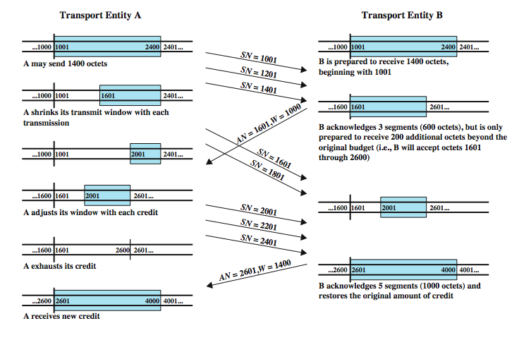
Credit Allocation
7
Notes:
Stallings DCC8e Figure 20.1 illustrates the mechanism (compare Figure 7.4). For simplicity, we show data flow in one direction only and assume that 200 octets of data are sent in each segment. Initially, through the connection establishment process, the sending and receiving sequence numbers are synchronized and A is granted an initial credit allocation of 1400 octets, beginning with octet number 1001. The first segment transmitted by A contains data octets numbered 1001 through 1200. After sending 600 octets in three segments, A has shrunk its window to a size of 800 octets (numbers 1601 through 2400). After B receives these three segments, 600 octets out of its original 1400 octets of credit are accounted for, and 800 octets of credit are outstanding. Now suppose that, at this point, B is capable of absorbing 1000 octets of incoming data on this connection. Accordingly, B acknowledges receipt of all octets through 1600 and issues a credit of 1000 octets. This means that A can send octets 1601 through 2600 (5 segments). However, by the time that B's message has arrived at A, A has already sent two segments, containing octets 1601 through 2000 (which was permissible under the initial allocation). Thus, A's remaining credit upon receipt of B's credit allocation is only 600 octets (3 segments). As the exchange proceeds, A advances the trailing edge of its window each time that it transmits and advances the leading edge only when it is granted credit.

Slide 8
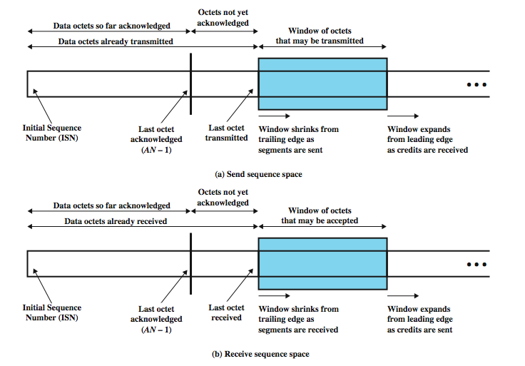
Sending and Receiving Perspectives
8
Notes:
Stallings DCC8e Figure 20.2 shows the view of this mechanism from the sending and receiving sides (compare Figure 7.3). Typically, both sides take both views because data may be exchanged in both directions. Note that the receiver is not required to immediately acknowledge incoming segments but may wait and issue a cumulative acknowledgment for a number of segments. The receiver needs to adopt some policy concerning the amount of data it permits the sender to transmit. The conservative approach is to only allow new segments up to the limit of available buffer space. If this policy were in effect in Figure 20.1, the first credit message implies that B has 1000 available octets in its buffer, and the second message that B has 1400 available octets. A conservative flow control scheme may limit the throughput of the transport connection in long-delay situations. The receiver could potentially increase throughput by optimistically granting credit for space it does not have. For example, if a receiver's buffer is full but it anticipates that it can release space for 1000 octets within a round-trip propagation time, it could immediately send a credit of 1000. If the receiver can keep up with the sender, this scheme may increase throughput and can do no harm. If the sender is faster than the receiver, however, some segments may be discarded, necessitating a retransmission. Because retransmissions are not otherwise necessary with a reliable network service (in the absence of internet congestion), an optimistic flow control scheme will complicate the protocol.

Slide 9
Issues to Consider
  ordered delivery
  flow control
  connection establishment
  connection termination
  retransmission strategy
  duplication detection
  failure recovery
9

Slide 10
Connection Establishment and Termination
required by connection-oriented transport protocols like TCP
need connection establishment and termination procedures to
  allow each end to know the other exists
  allow negotiation of optional parameters
  trigger allocation of transport entity resources
10
Notes:
Even with a reliable network service, there is a need for connection establishment and termination procedures to support connection-oriented service. Connection establishment serves three main purposes:
• It allows each end to assure that the other exists.
• It allows exchange or negotiation of optional parameters (e.g., maximum segment size, maximum window size, quality of service).
• It triggers allocation of transport entity resources (e.g., buffer space, entry in connection table).

Slide 11
TCP Connection Establishment
three way handshake
  SYN, SYN-ACK, ACK
connection determined by source and destination sockets
can only have a single connection between any unique pairs of ports
but one port can connect to multiple ports
Notes:
Connection establishment in TCP always uses a three-way handshake. When the SYN flag is set, the segment is essentially a request for connection and functions as explained in Stallings DCC8e Section 20.1. To initiate a connection, an entity sends a SYN, SN = X, where X is the initial sequence number. The receiver responds with SYN, SN = Y, AN = X + 1 by setting both the SYN and ACK flags. Note that the acknowledgment indicates that the receiver is now expecting to receive a segment beginning with data octet X + 1, acknowledging the SYN, which occupies SN = X. Finally, the initiator responds with AN = Y + 1. If the two sides issue crossing SYNs, no problem results: Both sides respond with SYN/ACKs (Stallings DCC8e Figure 20.4).
A connection is uniquely determined by the source and destination sockets (host, port). Thus, at any one time, there can only be a single TCP connection between a unique pair of ports. However, a given port can support multiple connections, each with a different partner port.

Slide 12
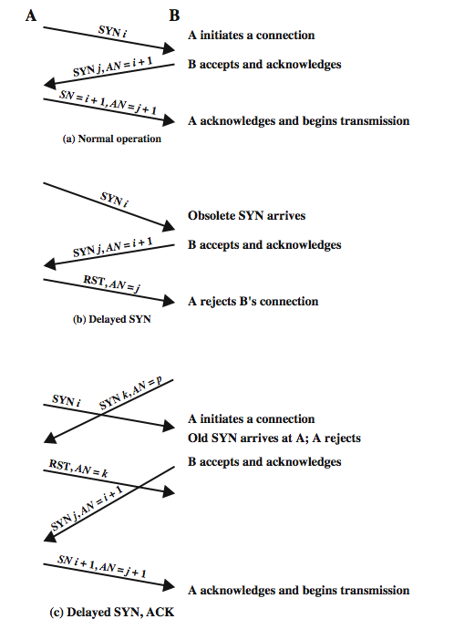
TCP Three Way
Handshake:
Examples
12
Notes:
Stallings DCC8e Figure 20.9 illustrates typical three-way handshake operations. In Figure 20.9a, transport entity A initiates the connection, with a SYN including the sending sequence number, i. The value i is referred to as the initial sequence number (ISN) and is associated with the SYN; the first data octet to be transmitted will have sequence number i + 1. The responding SYN acknowledges the ISN with (AN = i + 1) and includes its ISN. A acknowledges B's SYN/ACK in its first data segment, which begins with sequence number i + 1. Figure 20.9b shows a situation in which an old SYN i arrives at B after the close of the relevant connection. B assumes that this is a fresh request and responds with SYN j, AN = i + 1. When A receives this message, it realizes that it has not requested a connection and therefore sends an RST, AN = j. Note that the AN = j portion of the RST message is essential so that an old duplicate RST does not abort a legitimate connection establishment. Figure 20.9c shows a case in which an old SYN/ACK arrives in the middle of a new connection establishment. Because of the use of sequence numbers in the acknowledgments, this event causes no mischief.

Slide 13
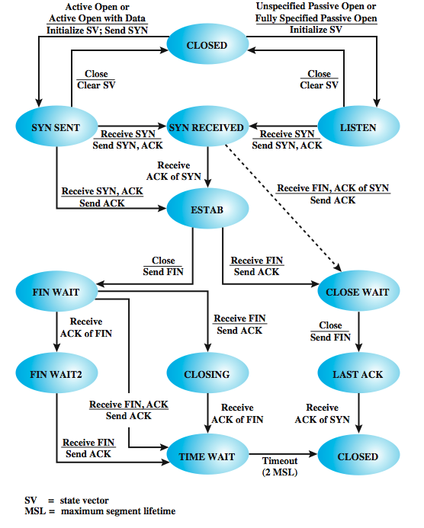
TCP Three Way
Handshake:
State
Diagram
13
Notes:
The way out of this problem is for each side to acknowledge explicitly the other's SYN and sequence number. The procedure is known as a three-way handshake. The revised connection state diagram, which is the one employed by TCP, is shown in the upper part of Stallings DCC8e Figure 20.8. A new state (SYN RECEIVED) is added. In this state, the transport entity hesitates during connection opening to assure that the SYN segments sent by the two sides have both been acknowledged before the connection is declared established. In addition to the new state, there is a control segment (RST) to reset the other side when a duplicate SYN is detected.
For simplicity, the upper part of Figure 20.8 does not include transitions in which RST is sent. The basic rule is as follows: Send an RST if the connection state is not yet OPEN and an invalid ACK (one that does not reference something that was sent) is received. The reader should try various combinations of events to see that this connection establishment procedure works in spite of any combination of old and lost segments.

Slide 14
Issues to Consider
  ordered delivery
  flow control
  connection establishment
  connection termination
  retransmission strategy
  duplication detection
  failure recovery
14

Slide 15
Connection Termination
also needs handshaking
misordered segments could cause the following:
  entity in CLOSE WAIT state sends the last data segment, followed by a FIN
  but the FIN arrives before the last data segment
  receiver accepts FIN, closes connection, loses data
need to associate sequence number with FIN
receiver waits for all segments before FIN sequence number
15
Notes:
The state diagram of Figure 20.3 defines the use of a simple two-way handshake for connection establishment, which was found to be unsatisfactory in the face of an unreliable network service. Similarly, the two-way handshake defined in that diagram for connection termination is inadequate for an unreliable network service. Misordering of segments could cause the following scenario. A transport entity in the CLOSE WAIT state sends its last data segment, followed by a FIN segment, but the FIN segment arrives at the other side before the last data segment. The receiving transport entity will accept that FIN, close the connection, and lose the last segment of data. To avoid this problem, a sequence number can be associated with the FIN, which can be assigned the next sequence number after the last octet of transmitted data. With this refinement, the receiving transport entity, upon receiving a FIN, will wait if necessary for the late-arriving data before closing the connection.

Slide 16
Connection Termination:
Graceful Close
also have problems with loss of segments and obsolete segments
need graceful close which will:
  send FIN i (send last segment with FIN flag set to 1) and receive AN i+1
  receive FIN j and send AN j+1
  wait twice maximum expected segment lifetime before “closed”.
16
Notes:
A more serious problem is the potential loss of segments and the potential presence of obsolete segments. Figure 20.8 shows that the termination procedure adopts a similar solution to that used for connection establishment. Each side must explicitly acknowledge the FIN of the other, using an ACK with the sequence number of the FIN to be acknowledged. For a graceful close, a transport entity requires the following:
• It must send a FIN i and receive AN = i + 1.
• It must receive a FIN j and send AN = j + 1.
• It must wait an interval equal to twice the maximum expected segment lifetime.

Slide 17
Issues to Consider
  ordered delivery
  flow control
  connection establishment
  connection termination
  retransmission strategy
  duplication detection
  failure recovery
17

Slide 18
Retransmission Strategy
retransmission of segments needed because
  segments may be damaged in transit
  segments fail to arrive
transmitter does not know of failure
receiver must acknowledge successful receipt
  can use cumulative acknowledgement for efficiency
If a segment does not arrive successfully, no ACK will be issued ➔ retransmission.
There is a timer associated with each segment sent.
Timer expires before ACK arrives ➔ retransmit.
18
Notes:
Two events necessitate the retransmission of a segment. First, a segment may be damaged in transit but nevertheless arrive at its destination. If a checksum is included with the segment, the receiving transport entity can detect the error and discard the segment. The second contingency is that a segment fails to arrive. In either case, the sending transport entity does not know that the segment transmission was unsuccessful. To cover this contingency, a positive acknowledgment scheme is used: The receiver must acknowledge each successfully received segment by returning a segment containing an acknowledgment number. For efficiency, we do not require one acknowledgment per segment. Rather, a cumulative acknowledgment can be used, as we have seen many times in this book. Thus, the receiver may receive segments numbered 1, 201, and 401, but only send AN = 601 back. The sender must interpret AN = 601 to mean that the segment with SN = 401 and all previous segments have been successfully received.
If a segment does not arrive successfully, no acknowledgment will be issued and a retransmission is in order. To cope with this situation, there must be a timer associated with each segment as it is sent. If the timer expires before the segment is acknowledged, the sender must retransmit.

Slide 19
Accept Policy
segments may arrive out of order
accept in order
  only accept segments in order
  discard out of order segments
  simple implementation, but burdens network
accept in window
  accept all segments within receive window
  reduce transmissions
  more complex implementation with buffering
Notes:
19
When all data segments arrive in order over a TCP connection, TCP places the data in a receive buffer for delivery to the user. It is possible, however, for segments to arrive out of order. In this case, the receiving TCP entity has two options:
• In-order: Accept only segments that arrive in order; any segment that arrives out of order is discarded. The in-order policy makes for a simple implementation but places a burden on the networking facility, as the sending TCP must time out and retransmit segments that were successfully received but discarded because of misordering. Furthermore, if a single segment is lost in transit, then all subsequent segments must be retransmitted once the sending TCP times out on the lost segment.
• In-window: Accept all segments that are within the receive window (see Stallings DCC8e Figure 20.2b). The in-window policy may reduce transmissions but requires a more complex acceptance test and a more sophisticated data storage scheme to buffer and keep track of data accepted out of order.

Slide 20
Retransmit Policy
TCP sender has a queue of segments transmitted but not acknowledged
Sender will retransmit if it does not receive an ACK within a given time
  first only - single timer, send the front segment when timer expires; efficient for traffic, considerable delays
  batch - single timer, send all segments when timer expires; has unnecessary retransmissions
  individual - timer for each segment; lower delay, more efficient for traffic, but complex
Notes:
20
TCP maintains a queue of segments that have been sent but not yet acknowledged. The TCP specification states that TCP will retransmit a segment if it fails to receive an acknowledgment within a given time. A TCP implementation may employ one of three retransmission strategies:
• First-only: Maintain one retransmission timer for the entire queue. If an acknowledgment is received, remove the appropriate segment or segments from the queue and reset the timer. If the timer expires, retransmit the segment at the front of the queue and reset the timer. The first-only policy is efficient in terms of traffic. Because timer for second segment in the queue is not set until the first segment is acknowledged, however, there can be considerable delays.
• Batch: Maintain one retransmission timer for the entire queue. if an acknowledgment is received, remove the appropriate segment or segments from the queue and reset the timer. If the timer expires, retransmit all segments in the queue and reset the timer. The batch policy also reduces the likelihood of long delays but may result in unnecessary retransmissions.
• Individual: Maintain one timer for each segment in the queue. If an acknowledgment is received, remove the appropriate segment or segments from the queue and destroy the corresponding timer or timers. If any timer expires, retransmit the corresponding segment individually and reset its timer. The individual policy solves the delay problem at the expense of a more complex implementation.
The actual effectiveness of the retransmit policy depends in part on the accept policy of the receiver.

Slide 21
Retransmit Policy (2)
effectiveness depends in part on receiver’s accept policy
  accept in order: batch
  accept in window: first-only or individual

Slide 22
Acknowledgement Policy
immediate
  send empty ACK (no data) for each accepted segment
  simple, at cost of extra transmissions
cumulative
  piggyback ACK on suitable outbound data segments unless persist timer expires
  if persist timer expires, send empty ACK
  typically used in practice
  more complex (processing, estimating RTT)
  but fewer transmissions
Notes:
22
When a data segment arrives that is in sequence, the receiving TCP entity has two options concerning the timing of acknowledgment:
• Immediate: When data are accepted, immediately transmit an empty (no data) segment containing the appropriate acknowledgment number.
• Cumulative: When data are accepted, record the need for acknowledgment, but wait for an outbound segment with data on which to piggyback the acknowledgment. To avoid long delay, set a persist timer (Table 20.1); if the timer expires before an acknowledgment is sent, transmit an empty segment containing the appropriate acknowledgment number.
The immediate policy is simple and keeps the remote TCP entity fully informed, which limits unnecessary retransmissions. However, this policy results in extra segment transmissions, namely, empty segments used only to ACK. Furthermore, the policy can cause a further load on the network. Consider that a TCP entity receives a segment and immediately sends an ACK. Then the data in the segment are released to the application, which expands the receive window, triggering another empty TCP segment to provide additional credit to the sending TCP entity.
Because of the potential overhead of the immediate policy, the cumulative policy is typically used. Recognize, however, that the use of this policy requires more processing at the receiving end and complicates the task of estimating round-trip time by the sending TCP entity.

Slide 23
Issues to Consider
  ordered delivery
  flow control
  connection establishment
  connection termination
  retransmission strategy
  duplication detection
  failure recovery
23

Slide 24
Duplication Detection
if an ACK is lost, the segment is duplicated and re-transmitted
receiver must recognize duplicates
if duplicate received prior to closing connection
  receiver assumes previous ACK lost and sends a new ACK for the duplicate
  sender must not get confused by multiple ACKs
  need a sequence number space large enough to not recycle sequence numbers within the maximum lifetime of a segment
24
Notes:
If a segment is lost and then retransmitted, no confusion will result. If, however, one or more segments in sequence are successfully delivered, but the corresponding ACK is lost, then the sending transport entity will time out and one or more segments will be retransmitted. If these retransmitted segments arrive successfully, they will be duplicates of previously received segments. Thus, the receiver must be able to recognize duplicates. The fact that each segment carries a sequence number helps, but, nevertheless, duplicate detection and handling is not simple. There are two cases: a duplicate is received prior to the close of the connection, or a duplicate is received after the close of the connection (discussed in the subsection on connection establishment). Notice that we say "a" duplicate rather than "the" duplicate. From the sender's point of view, the retransmitted segment is the duplicate. However, the retransmitted segment may arrive before the original segment, in which case the receiver views the original segment as the duplicate. In any case, two tactics are needed to cope with a duplicate received prior to the close of a connection:
• The receiver must assume that its acknowledgment was lost and therefore must acknowledge the duplicate.
• Consequently, the sender must not get confused if it receives multiple acknowledgments to the same segment.
• The sequence number space must be long enough so as not to "cycle" in less than the maximum possible segment lifetime (time it takes segment to transit network).

Slide 25
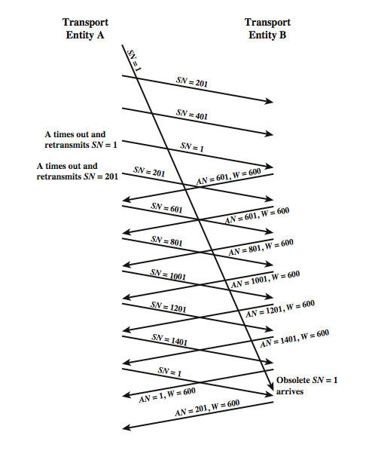
Incorrect
Duplicate
Detection
25
Notes:
Stallings DCC8e Figure 20.5 illustrates the reason for the latter requirement. In this example, the sequence space is of length 1600; that is, after SN = 1600, the sequence numbers cycle back and begin with SN = 1. For simplicity, we assume the receiving transport entity maintains a credit window size of 600. Suppose that A has transmitted data segments with SN = 1, 201, and 401. B has received the two segments with SN = 201 and SN = 401, but the segment with SN = 1 is delayed in transit. Thus, B does not send any acknowledgments. Eventually, A times out and retransmits segment SN = 1. When the duplicate segment SN = 1 arrives, B acknowledges 1, 201, and 401 with AN = 601. Meanwhile, A has timed out again and retransmits SN = 201, which B acknowledges with another AN = 601. Things now seem to have sorted themselves out and data transfer continues. When the sequence space is exhausted, A cycles back to SN = 1 and continues. Alas, the old segment SN = 1 makes a belated appearance and is accepted by B before the new segment SN = 1 arrives. When the new segment SN = 1 does arrive, it is treated as a duplicate and discarded.
It should be clear that the untimely emergence of the old segment would have caused no difficulty if the sequence numbers had not yet wrapped around. The larger the sequence number space (number of bits used to represent the sequence number), the longer the wraparound is avoided. How big must the sequence space be? This depends on, among other things, whether the network enforces a maximum packet lifetime, and the rate at which segments are being transmitted. Fortunately, each addition of a single bit to the sequence number field doubles the sequence space, so it is rather easy to select a safe size.

Slide 26
Issues to Consider
  ordered delivery
  flow control
  connection establishment
  connection termination
  retransmission strategy
  duplication detection
  failure recovery
26

Slide 27
Failure Recovery
The still active side can close the connection using a keep-alive timer.
  Timer expires: closes the connection, and signals an abnormal close to the upper layer.
The failed side restarts quickly:
  The failed side returns an RST i to every segment i that it receives.
  The other side performs an abnormal termination.
Notes:
Failure Recovery When the system upon which a transport entity is running
fails and subsequently restarts, the state information of all active connections is lost.
The affected connections become half open because the side that did not fail does
not yet realize the problem.
The still active side of a half-open connection can close the connection using a
keepalive timer. This timer measures the time the transport machine will continue to
await an acknowledgment (or other appropriate reply) of a transmitted segment after
the segment has been retransmitted the maximum number of times.When the timer
expires, the transport entity assumes that the other transport entity or the intervening
network has failed, closes the connection, and signals an abnormal close to the TS user.
In the event that a transport entity fails and quickly restarts, half-open connections
can be terminated more quickly by the use of the RST segment.The failed side
returns an RST i to every segment i that it receives.When the RST i reaches the
other side, it must be checked for validity based on the sequence number i, because
the RST could be in response to an old segment. If the reset is valid, the transport
entity performs an abnormal termination.
These measures clean up the situation at the transport level. The decision as
to whether to reopen the connection is up to the TS users. The problem is one of
synchronization. At the time of failure, there may have been one or more outstanding
segments in either direction. The TS user on the side that did not fail knows
how much data it has received, but the other user may not, if state information
were lost. Thus, there is the danger that some user data will be lost or duplicated.

Slide 28
TCP Congestion Control
28

Slide 29
TCP Congestion Control
flow control also used for congestion control
  recognize increased transit times and dropped packets
  react by reducing flow of data
RFC 1122 and 2581 detail extensions
  Tahoe, Reno and New Reno implementations
two categories of extensions:
  retransmission timer management
  window management
29
Notes:
The credit-based flow control mechanism of TCP was designed to enable a destination to restrict the flow of segments from a source to avoid buffer overflow at the destination. This same flow control mechanism is now used in ingenious ways to provide congestion control over the Internet between the source and destination. As congestion begins to occur, the transit time across a network or internetwork increases, and network or internet nodes drop packets. The TCP flow control mechanism can be used to recognize the onset of congestion (by recognizing increased delay times and dropped segments) and to react by reducing the flow of data. If many of the TCP entities operating across a network exercise this sort of restraint, internet congestion is relieved.
Since the publication of RFC 793, a number of techniques have been implemented that are intended to improve TCP congestion control characteristics. None of these extend or violate the original TCP standard; rather they represent implementation policies that are within the scope of the TCP specification. Many of these techniques are mandated for use with TCP in RFC 1122 (Requirements for Internet Hosts) while some of them are specified in RFC 2581. The techniques fall roughly into two categories: retransmission timer management and window management. In this section, we look at some of the most important and most widely implemented of these techniques.

Slide 30
Retransmission Timer Management
static timer likely too long or too short
hence estimate round trip delay by observing pattern of delay for recent segments
set retransmission timer to a value a bit greater than estimated RTT: RTO(k) = RTT(k) + Δ
to estimate RTT:
  simple average over a number of segments
  exponential average using time series (RFC 793)
assume no loss, the RTT of each segment is used in the following calculations
Notes:
As network or internet conditions change, a static retransmission timer is likely to be either too long or too short. Accordingly, virtually all TCP implementations attempt to estimate the current round-trip time by observing the pattern of delay for recent segments, and then set the timer to a value somewhat greater than the estimated round-trip time.
A simple approach is to take the average of observed round-trip times over a number of segments. If the average accurately predicts future round-trip times, then the resulting retransmission timer will yield good performance.
Note that each term in the simple average is given equal weight. Typically, we would like to give greater weight to more recent instances because they are more likely to reflect future behavior. A common technique for predicting the next value on the basis of a time series of past values, and the one specified in RFC 793, is exponential averaging.

Slide 31
Computing RTT
Simple average
Exponential average
31
Notes:
The second equation is used to avoid calculating the entire summation each time (for each segment).

Slide 32
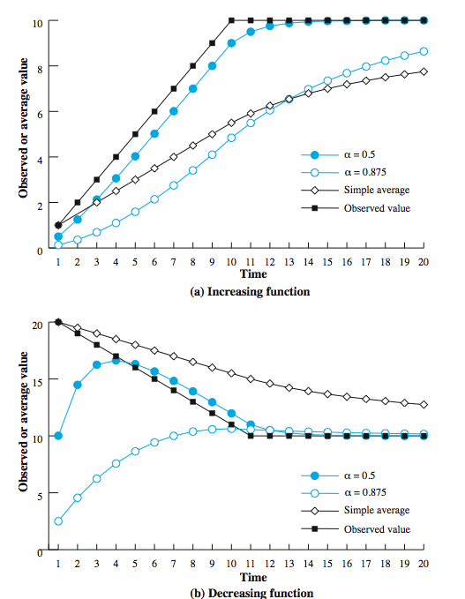
Use of
Exponential
Averaging
Notes:
Stallings DCC8e Figure 20.11 compares simple averaging with exponential averaging (for two different values of α). In part (a) of the figure, the observed value begins at 1, grows gradually to a value of 10, and then stays there. In part (b) of the figure, the observed value begins at 20, declines gradually to 10, and then stays there. Note that exponential averaging tracks changes in RTT faster than does simple averaging and that the smaller value of α results in a more rapid reaction to the change in the observed value.
As was mentioned, the retransmission timer should be set at a value somewhat greater than the estimated round-trip time. One possibility is to use a constant value. The disadvantage of this is that Δ is not proportional to SRTT. For large values of SRTT, it is relatively small and fluctuations in the actual RTT will result in unnecessary retransmissions. For small values of SRTT, it is relatively large and causes unnecessary delays in retransmitting lost segments. Accordingly, RFC 793 specifies the use of a timer whose value is proportional to SRTT, within limits.

Slide 33
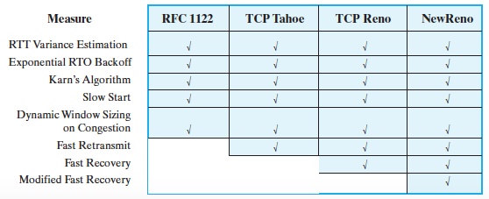
Implementation of TCP Congestion Control Measures

Slide 34
RTT Variance Estimation
Jacobson’s algorithm
To “smooth out” high variance in RTTs caused by
  dynamic network traffic
  receiver using cumulative acknowledgements
Then calculates RTT and RTO

Slide 35
Implementation of TCP Congestion Control Measures

Slide 36
Why Karn’s Algorithm?
Scenario: a segment C1 times out and is retransmitted as C2.
Sender receives an ACK: 2 possibilities
  case 1: to acknowledge C1
  case 2: to acknowledge C2
Sender cannot distinguish between the 2 cases.
If case 2 is true, and RTT = t_{C1} – t_{ACK} then RTT would be too long.
If case 1 is true, and RTT = t_{C2} – t_{ACK} then RTT would be too short.

Slide 37
Karn’s Algorithm
Do not use the measured RTT of a retransmitted segment to update r(K+1).
Calculate the backoff RTO using binary exponential backoff when a retransmission occurs.
Use the backoff RTO value for succeeding segments until an ACK arrives for a segment that has not been retransmitted,
  at which point use Jacobson’s algorithm (averaging formula) to compute new RTT and future RTO values.

Slide 38
Exponential RTO Backoff
timeout probably due to congestion
  dropped packet or long round trip time
hence maintaining same retransmission timeout (RTO) timer is not good idea
better to increase RTO each time a segment is
re-transmitted
  RTO = q × RTO
  commonly q = 2 (binary exponential backoff)
  as in Ethernet CSMA/CD
Notes:
When a TCP sender times out on a segment, it must retransmit that segment. RFC 793 assumes that the same RTO value will be used for this retransmitted segment. However, because the timeout is probably due to network congestion, manifested as a dropped packet or a long delay in round-trip time, maintaining the same RTO value is ill advised. A more sensible policy dictates that a sending TCP entity increase its RTO each time a segment is retransmitted; this is referred to as a backoff process. If a second retransmission is required, each sending TCP entity will wait an even longer time before timing out for a third retransmission, giving the internet an even longer period to recover. A simple technique for implementing RTO backoff is to multiply the RTO for a segment by a constant value for each retransmission, which causes RTO to grow exponentially with each retransmission. The most commonly used value of q is 2. With this value, the technique is referred to as binary exponential backoff. This is the same technique used in the Ethernet CSMA/CD protocol.

Slide 39
Implementation of TCP Congestion Control Measures

Slide 40
Window Management: Slow Start
awnd = min( credit, cwnd )
larger windows allow connections to send more data
at start, limit TCP to 1 segment: cwnd = 1
assume no loss, for every ACK, slide window forward by 1 and also increase cwnd by 1, doubling window size in the next “round”
exponential growth during “slow start”
when does “slow start” stop?
Notes:
In addition to the previous, a number of approaches to managing the send window have been examined.
The larger the send window used in TCP, the more segments that a sending TCP entity can send before it must wait for an acknowledgment. This can create a problem when a TCP connection is first established, because the TCP entity is free to dump the entire window of data onto the internet. A means is needed of gradually expanding the window until acknowledgments are received. This is the purpose of the slow start mechanism. When a new connection is opened, TCP is only allowed to send 1 segment and then must wait for an acknowledgment before transmitting a second segment. Each time an acknowledgment to new data is received, the window value is increased by 1, up to some maximum value. In effect, the slow-start mechanism probes the internet to make sure that the TCP entity is not sending too many segments into an already congested environment. As acknowledgments arrive, TCP is able to open up its window until the flow is controlled by the incoming ACKs rather than by the window. The term slow start is a bit of a misnomer, because it actually grows exponentially.
The slow-start algorithm has been found to work effectively for initializing a connection. It enables the TCP sender to determine quickly a reasonable window size for the connection. But once congestion occurs, it may take a long time for the congestion to clear. So Jacobson proposed the use of slow start to begin with, followed by a linear growth of the window, as described.

Slide 41
Dynamic Window Sizing on Congestion
when a timeout occurs, assume congestion
set slow start threshold to half current congestion window: ssthresh = cwnd / 2
set window size to 1 and slow start until reaching threshold
beyond threshold, increase window size by 1 for each RTT with no loss (congestion avoidance)
Note: threshold can become quite small for successive packet losses.

Slide 42
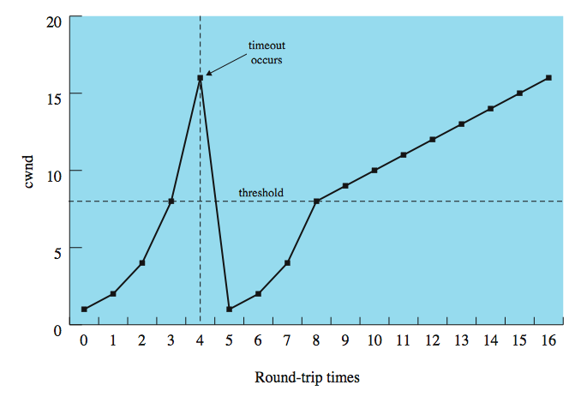
Window Management
Notes:
Stallings DCC8e Figure 20.13 illustrates slow-start and dynamic window resizing on congestion. Note that it takes 11 round-trip times to recover to the window level that initially took 4 round-trip times to achieve.

Slide 43
Implementation of TCP Congestion Control Measures

Slide 44
Fast Retransmit
retransmit timer RTO rather longer than RTT
if a segment is lost TCP slow to retransmit
  accept in order: many segments may be lost
  accept in window: first segment lost may cause buffer overflow at receiver
fast retransmit
  receiver: if receive a segment out of order, issue an ACK for the last in-order segment correctly received. Repeat this until the missing segment arrives.
  sender: if receive 4 ACKs for the same segment then immediately retransmit (without waiting for timer to expire), since it is likely to have been lost,
Notes:
The retransmission timer (RTO) that is used by a sending TCP entity to determine when to retransmit a segment will generally be noticeably longer than the actual round-trip time (RTT) that the ACK for that segment will take to reach the sender. Both the original RFC 793 algorithm and the Jacobson algorithm set the value of RTO at somewhat greater than the estimated round-trip time SRTT. A consequence of these factors is that if a segment is lost, TCP may be slow to retransmit. Jacobson proposed two procedures, called fast retransmit and fast recovery, that under some circumstances improve on the performance provided by RTO.
Fast retransmit takes advantage of the rule if a TCP entity receives a segment out of order, it must immediately issue an ACK for the last in-order segment that was received. When a source TCP receives a duplicate ACK, it means that either (1) the segment following the ACKed segment was delayed so that it ultimately arrived out of order, or (2) that segment was lost. To make sure that TCP that a segment has been lost and must be retransmitted, Jacobson recommends that a TCP sender wait until it receives three duplicate ACKs to the same segment (that is, a total of four ACKs to the same segment).
When a TCP entity retransmits a segment using fast retransmit, it knows (or rather assumes) that a segment was lost, even though it has not yet timed out on that segment. Accordingly, the TCP entity should take congestion avoidance measures. Jacobson proposes a fast recovery technique: retransmit the lost segment, cut window in half, and then proceed with the linear increase of it. This technique avoids the initial exponential slow-start process.

Slide 45
Fast Recovery
Setting cwnd = 1 upon a loss is unnecessarily conservative (low throughput).
Avoid slow start.
Fast recovery:
  retransmit the lost segment
  cut cwnd in half
  then increase cwnd linearly

Slide 46
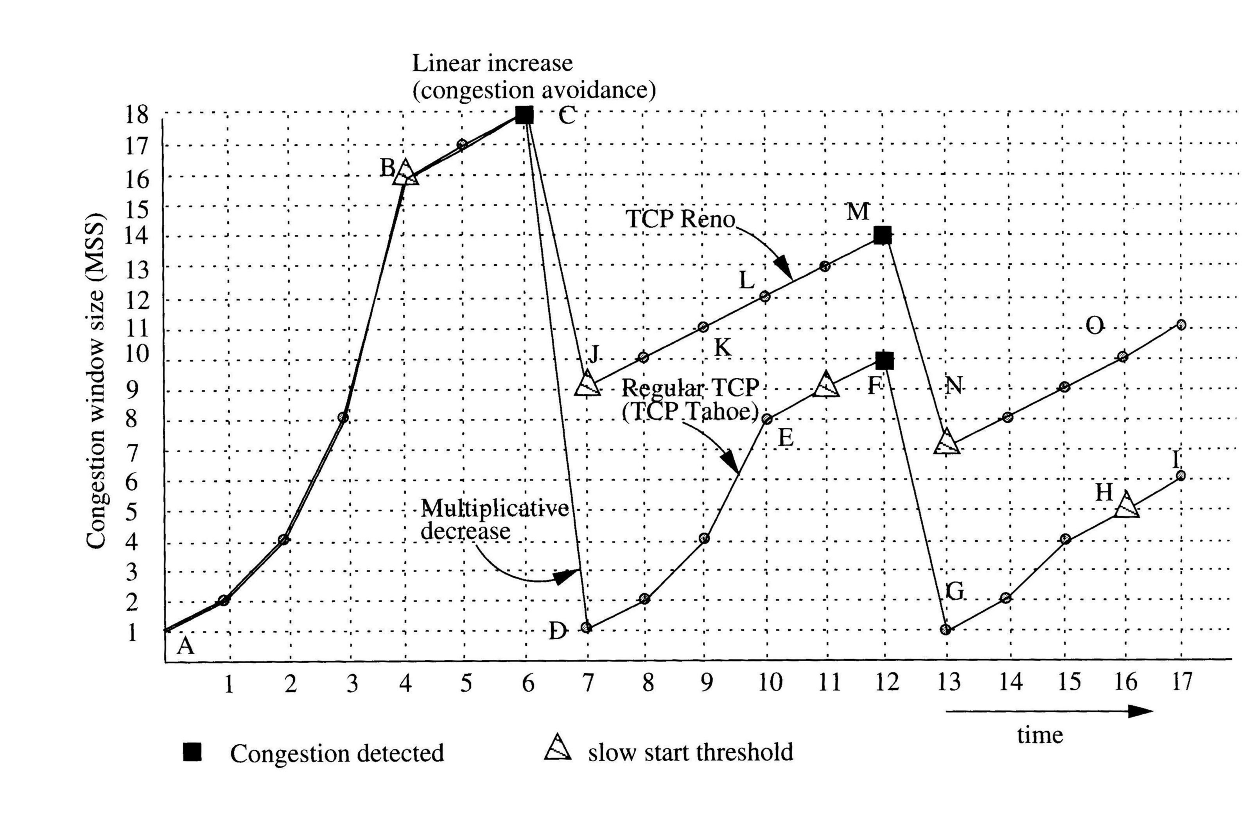
Window Management Examples
46

Slide 47
When does “slow start” stop?
awnd = min( credit, cwnd )
when reaching credit
when a time out occurs
when reaching ssthresh (if one exists)
when receiving triple duplicate ACKs

Slide 48
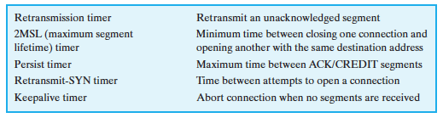
Transport Protocol Timers

Slide 49
TCP Header
49
Notes:
TCP uses only a single type of protocol data unit, a TCP segment. The header is shown in Stallings DCC8e Figure 20.10. This header performs all protocol mechanisms, and is large, with a min length of 20 octets. The fields are:
• Source Port (16 bits): Source TCP user. eg. Telnet = 23; HTTP = 80.
• Destination Port (16 bits): Destination TCP user.
• Sequence Number (32 bits): of first data octet in this segment except when the SYN flag is set. when it contains the initial sequence number (ISN) and the first data octet in this segment has sequence number ISN + 1.
• Acknowledgment Number (32 bits): Contains the sequence number of the next data octet that the TCP entity expects to receive.
• Data Offset (4 bits): Number of 32-bit words in the header (size of header)
• Reserved (4 bits): Reserved for future use.
• Flags (6 bits):
• Window (16 bits): Flow control credit allocation, in octets.
• Checksum (16 bits): The ones complement of the ones complement sum of all the 16-bit words in the segment plus a pseudoheader.
• Urgent Pointer (16 bits): This value, when added to the segment sequence number, contains the sequence number of the last octet in a sequence of urgent data. This allows the receiver to know how much urgent data is coming.
• Options (Variable): eg. option that specifies the maximum segment size.

Slide 50
Reading
Chapter “Transport Protocols”, William Stallings’ book
50

