Slide 1
Recursion
notes Chapter 8

Slide 2
Recursively Move Smallest to Front
recall that we developed a method that moves the smallest element in a list to the front of the list

Slide 3
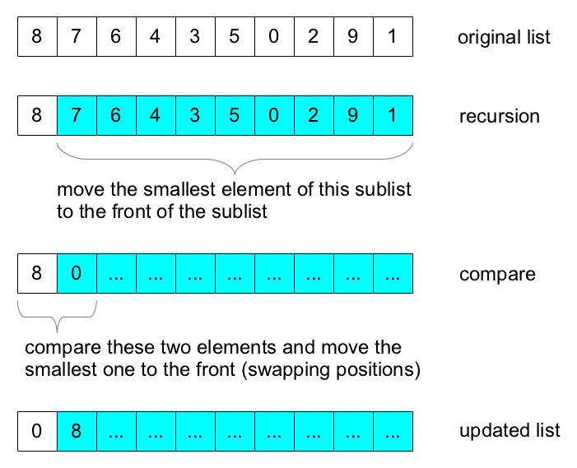
Recursively Move Smallest to Front

Slide 4
Recursively Move Smallest to Front
public class Sort {
public static void minToFront(List<Integer> t) {
if (t.size() < 2) {
return;
}
Sort.minToFront(t.subList(1, t.size()));
int first = t.get(0);
int second = t.get(1);
if (second < first) {
t.set(0, second);
t.set(1, first);
}
}
}

Slide 5
Sorting the List
observe what happens if you repeat the process with the sublist made up of the second through last elements:
0 | 8 | 7 | 6 | 4 | 3 | 5 | 1 | 2 | 9
minToFront
0 | 1 | 8 | 7 | 6 | 4 | 3 | 5 | 2 | 9

Slide 6
Sorting the List
observe what happens if you repeat the process with the sublist made up of the third through last elements:
0 | 1 | 8 | 7 | 6 | 4 | 3 | 5 | 2 | 9
minToFront
0 | 1 | 2 | 8 | 7 | 6 | 4 | 3 | 5 | 9

Slide 7
Sorting the List
observe what happens if you repeat the process with the sublist made up of the fourth through last elements:
0 | 1 | 2 | 8 | 7 | 6 | 4 | 3 | 5 | 9
minToFront
0 | 1 | 2 | 3 | 8 | 7 | 6 | 4 | 5 | 9

Slide 8
Sorting the List
if you keep calling minToFront until you reach a sublist of size two, you will sort the original list:
this is the selection sort algorithm
0 | 1 | 2 | 3 | 4 | 5 | 6 | 7 | 8 | 9
minToFront
0 | 1 | 2 | 3 | 4 | 5 | 6 | 7 | 8 | 9

Slide 9
Selection Sort
public class Sort {
// minToFront not shown
public static void selectionSort(List<Integer> t) {
if (t.size() > 1) {
Sort.minToFront(t);
Sort.selectionSort(t.subList(1, t.size()));
}
}
}

Slide 10
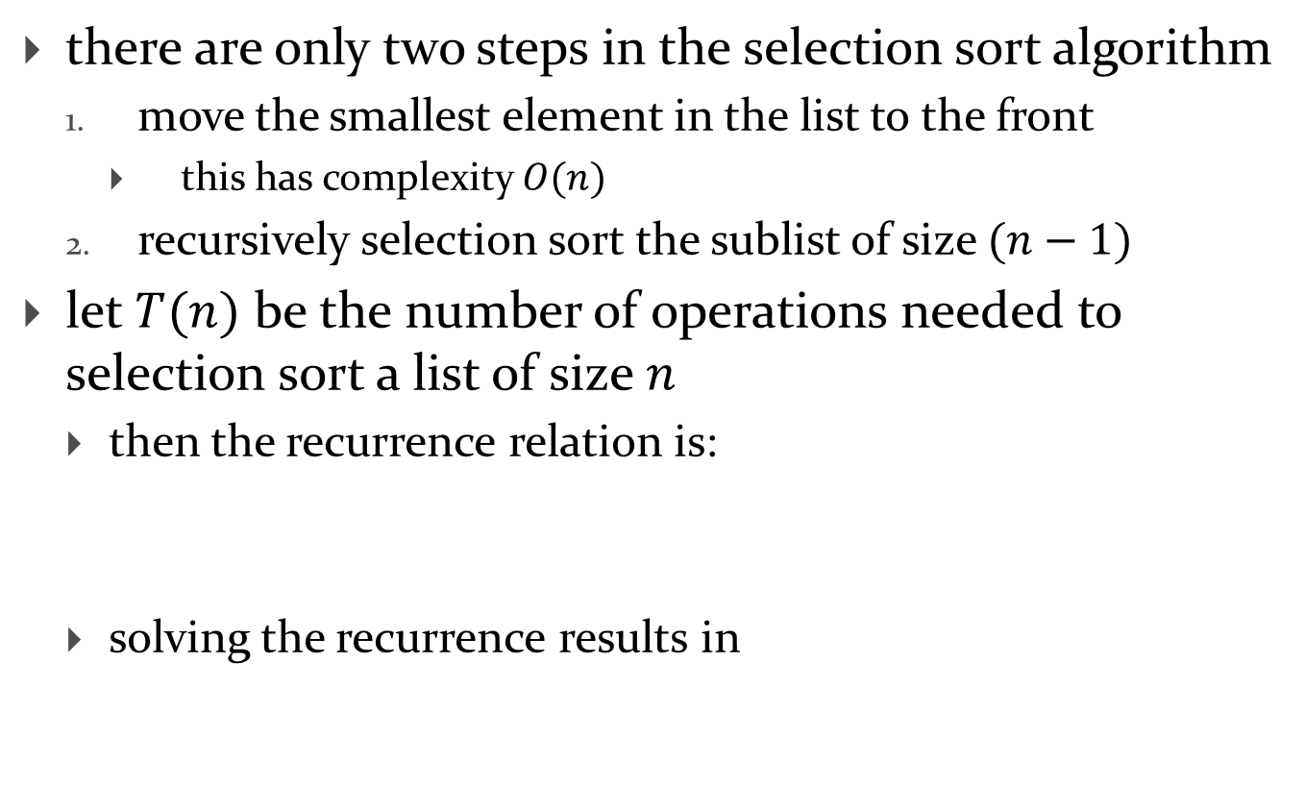
Selection Sort
there are only two steps in the selection sort algorithm
move the smallest element in the list to the front
this has complexity $O(n)$
recursively selection sort the sublist of size $(n−1)$
let $T(n)$ be the number of operations needed to selection sort a list of size $n$
then the recurrence relation is:
solving the recurrence results in
$$T\left(n\right)=T\left(n−1\right)+O(n)$$
$$T\left(n\right)=O(n^{2})$$

Slide 11
Quicksort
quicksort, like mergesort, is a divide and conquer algorithm for sorting a list or array
it can be described recursively as follows:
choose an element, called the pivot, from the list
reorder the list so that:
values less than the pivot are located before the pivot
values greater than the pivot are located after the pivot
quicksort the sublist of elements before the pivot
quicksort the sublist of elements after the pivot

Slide 12
Quicksort
step 2 is called the partition step
consider the following list of unique elements
assume that the pivot is 6
0 | 8 | 7 | 6 | 4 | 3 | 5 | 1 | 2 | 9

Slide 13
Quicksort
the partition step reorders the list so that:
values less than the pivot are located before the pivot
we need to move the cyan elements before the pivot
values greater than the pivot are located after the pivot
we need to move the red elements after the pivot
0 | 8 | 7 | 6 | 4 | 3 | 5 | 1 | 2 | 9
0 | 8 | 7 | 6 | 4 | 3 | 5 | 1 | 2 | 9

Slide 14
Quicksort
after partitioning the list looks like:
partioning has 3 results:
the pivot is in its correct final sorted location
the left sublist contains only elements less than the pivot
the right sublist contains only elements greater than the pivot
0 | 4 | 3 | 5 | 1 | 2 | 6 | 8 | 7 | 9

Slide 15
Quicksort
after partitioning we recursively quicksort the left sublist
for the left sublist, let's assume that we choose 4 as the pivot
after partitioning the left sublist we get:
we then recursively quicksort the left and right sublists
and so on...
0 | 1 | 3 | 2 | 4 | 5 | 6 | 8 | 7 | 9

Slide 16
Quicksort
eventually, the left sublist from the first pivoting operation will be sorted; we then recursively quicksort the right sublist:
if we choose 8 as the pivot and partition we get:
the left and right sublists have size 1 so there is nothing left to do
0 | 1 | 2 | 3 | 4 | 5 | 6 | 8 | 7 | 9
0 | 1 | 2 | 3 | 4 | 5 | 6 | 7 | 8 | 9

Slide 17
Quicksort
the computational complexity of quicksort depends on:
the computational complexity of the partition operation
without proof I claim that this is $O(n)$ for a list of size $n$
how the pivot is chosen

Slide 18
Quicksort
let's assume that when we choose a pivot we always choose the smallest (or largest) value in the sublist
yields a sublist of size $(n−1)$ which we recursively quicksort
let $T(n)$ be the number of operations needed to quicksort a list of size $n$ when choosing a pivot as described above
then the recurrence relation is:
solving the recurrence results in
$$T\left(n\right)=T\left(n−1\right)+O(n)$$
same as selection sort
$$T\left(n\right)=O(n^{2})$$

Slide 19
Quicksort
let's assume that when we choose a pivot we always choose the median value in the sublist
yields 2 sublists of size $\left(\frac{n}{2}\right)$ which we recursively quicksort
let $T(n)$ be the number of operations needed to quicksort a list of size $n$ when choosing a pivot as described above
then the recurrence relation is:
solving the recurrence results in
$$T\left(n\right)=2T\left(\frac{n}{2}\right)+O(n)$$
same as merge sort
$$T\left(n\right)=O(n\log_{2}{n})$$

Slide 20
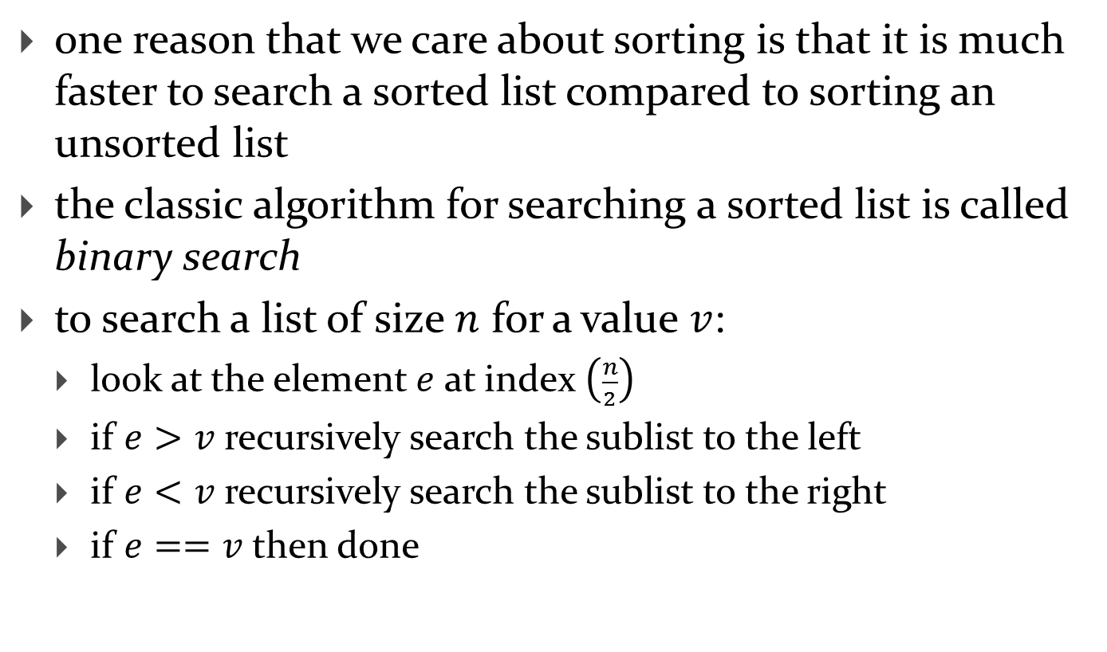
Binary Search
one reason that we care about sorting is that it is much faster to search a sorted list compared to sorting an unsorted list
the classic algorithm for searching a sorted list is called binary search
to search a list of size $n$ for a value $v$:
look at the element $e$ at index $\left(\frac{n}{2}\right)$
if $e>v$ recursively search the sublist to the left
if $e<v$ recursively search the sublist to the right
if $e==v$ then done

Slide 21

Binary Search
consider the sorted list of size $n=9$
 | 1 | 3 | 4 | 5 | 6 | 7 | 8 | 9 | 10
sublistindex | 0 | 1 | 2 | 3 | 4 | 5 | 6 | 7 | 8

Slide 22

Binary Search
search for $v=3$
 | 1 | 3 | 4 | 5 | 6 | 7 | 8 | 9 | 10
index | 0 | 1 | 2 | 3 | 4 | 5 | 6 | 7 | 8
$$mid=\frac{9}{2}=4$$
$$e=6$$
$v<e,$ recursively search the left sublist

Slide 23

Binary Search
search for $v=3$
no longer considered
 | 1 | 3 | 4 | 5 | 6 | 7 | 8 | 9 | 10
sublistindex | 0 | 1 | 2 | 3
$$mid=\frac{4}{2}=2$$
$$e=4$$
$v<e,$ recursively search the left sublist

Slide 24

Binary Search
search for $v=3$
no longer considered
 | 1 | 3 | 4 | 5 | 6 | 7 | 8 | 9 | 10
sublistindex | 0 | 1
$$mid=\frac{2}{2}=1$$
$$e=3$$
$v==e,$ done

Slide 25
Binary Search
search for $v=2$
 | 1 | 3 | 4 | 5 | 6 | 7 | 8 | 9 | 10
sublistindex | 0 | 1 | 2 | 3 | 4 | 5 | 6 | 7 | 8
$$mid=\frac{9}{2}=4$$
$$e=6$$
$v<e,$ recursively search the left sublist

Slide 26
Binary Search
search for $v=2$
no longer considered
 | 1 | 3 | 4 | 5 | 6 | 7 | 8 | 9 | 10
sublistindex | 0 | 1 | 2 | 3
$$mid=\frac{4}{2}=2$$
$$e=4$$
$v<e,$ recursively search the left sublist

Slide 27
Binary Search
search for $v=2$
no longer considered
 | 1 | 3 | 4 | 5 | 6 | 7 | 8 | 9 | 10
sublistindex | 0 | 1
$$mid=\frac{2}{2}=1$$
$$e=3$$
$v<e,$ recursively search the left sublist

Slide 28

Binary Search
search for $v=2$
no longer considered
 | 1 | 3 | 4 | 5 | 6 | 7 | 8 | 9 | 10
sublistindex | 0
$$mid=\frac{1}{2}=0$$
$$e=1$$
$v>e,$ recursively search the right sublist; right sublist is empty, done

Slide 29
Binary Search
search for $v=$9
 | 1 | 3 | 4 | 5 | 6 | 7 | 8 | 9 | 10
sublistindex | 0 | 1 | 2 | 3 | 4 | 5 | 6 | 7 | 8
$$mid=\frac{9}{2}=4$$
$$e=6$$
$v>e,$ recursively search the right sublist

Slide 30

Binary Search
search for $v=$9
 | 1 | 3 | 4 | 5 | 6 | 7 | 8 | 9 | 10
sublistindex |  |  |  |  |  | 0 | 1 | 2 | 3
$$mid=\frac{4}{2}=2$$
$$e=9$$
$v==e,$ done

Slide 31
/**
* Searches a sorted list of integers for a given value using binary search.
*
* @param v the value to search for
* @param t the list to search
* @return true if v is in t, false otherwise
*/
public static boolean contains(int v, List<Integer> t) {
if (t.isEmpty()) {
return false;
}
int mid = t.size() / 2;
int e = t.get(mid);
if (e == v) {
return true;
}
else if (v < e) {
return Sort.contains(v, t.subList(0, mid));
}
else {
return Sort.contains(v, t.subList(mid + 1, t.size()));
}
}

Slide 32
Binary Search
what is the recurrence relation?
what is the big-O complexity?

