Slide 1
Wireless LAN Security
CSE 6590
Fall 2010

Slide 2
Outline
Wired Equivalent Privacy (WEP)
first security protocol defined in 802.11
Wi-Fi Protected Access (WPA)
defined by Wi-Fi Alliance
WPA2
802.11i

Slide 3
History
In the early 1980s, the IEEE began work on developing computer network architecture standards
This work was called Project 802
In 1990, the IEEE formed a committee to develop a standard for WLANs (Wireless Local Area Networks)
At that time WLANs operated at a speed of 1 to 2 million bits per second (Mbps)

Slide 4
IEEE 802.11 WLAN Standard
In 1997, the IEEE approved the IEEE 802.11 WLAN standard
Revisions
IEEE 802.11a
IEEE 802.11b
IEEE 802.11g
IEEE 802.11n

Slide 5
Controlling Access to a WLAN
Access is controlled by limiting a device’s access to the access point (AP)
Only devices that are authorized can connect to the AP
One way: Media Access Control (MAC) address filtering
CCSF uses this technique (unfortunately)
See www.ccsf.edu/wifi

Slide 6
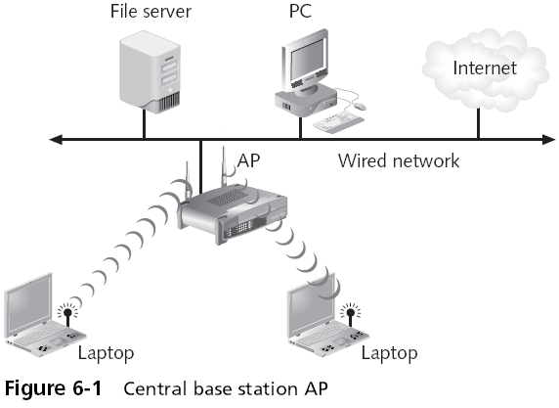
Controlling Access

Slide 7
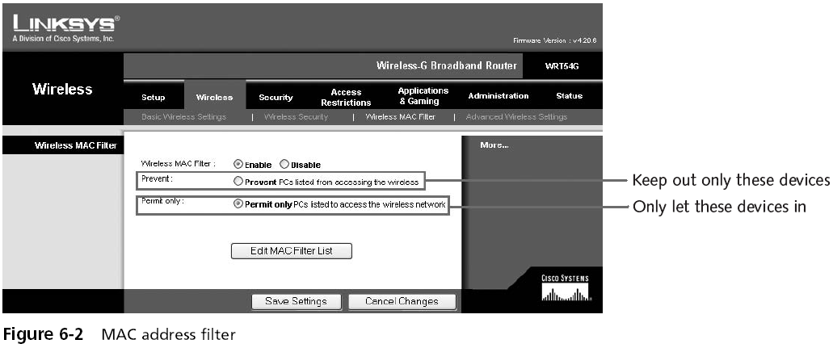
MAC Address Filtering

Slide 8
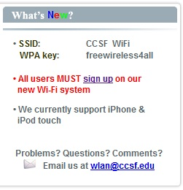
MAC Address Filtering
Usually implemented by permitting instead of preventing
CCSF does this
www.ccsf.edu/wifi

Slide 9
MAC Address Filtering Weaknesses
MAC addresses are transmitted in the clear
An attacker can just sniff for MACs
Managing a large number of MAC addresses is difficult
MAC address filtering does not provide a means to temporarily allow a guest user to access the network
Other than manually entering the user’s MAC address into the access point

Slide 10
Wired Equivalent Privacy (WEP)
Designed to ensure that only authorized parties can view transmitted wireless information
Uses encryption to protect traffic
WEP was designed to be:
Efficient and reasonably strong
10
Notes:
10

Slide 11
WEP Keys
WEP secret keys can be 64 or 128 bits long
The AP and devices can hold up to four shared secret keys
One of which must be designated as the default key

Slide 12
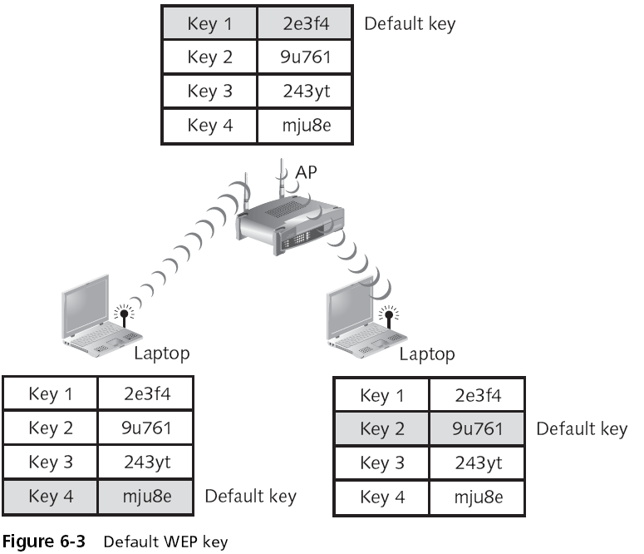

Slide 13
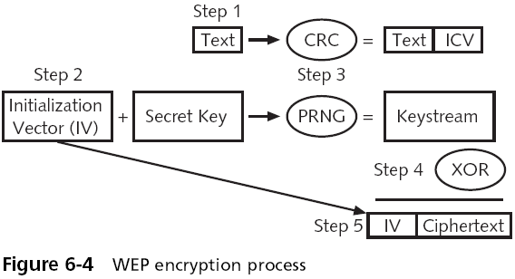
WEP Encryption Process

Slide 14
WEP Encryption Process (2)
When a node has a packet to send, it first generates CRC for this packet as an integrity check value (ICV).
Generates an IV; concatenates it with the secret key; applies RC4 to create RC4 key stream.
Performs XOR operation on the above two streams, byte by byte, to produce ciphertext.
Appends the IV to the ciphertext and transmits to the receiver.

Slide 15
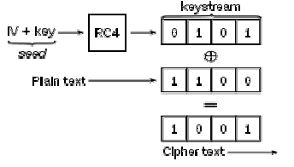
WEP Encryption Process (3)

Slide 16
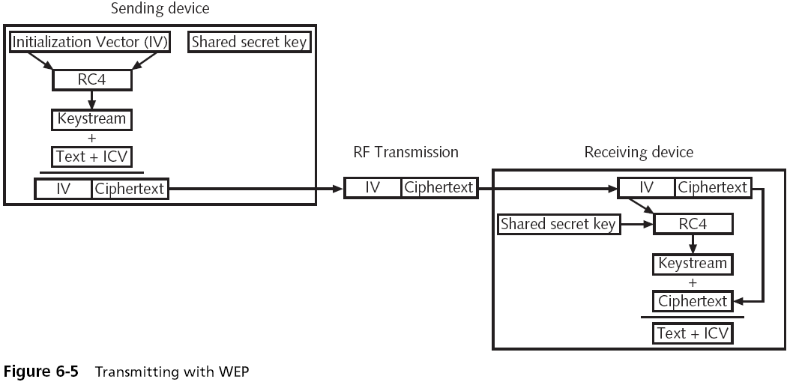
Transmitting with WEP

Slide 17
Analysis of WEP Encryption
IV is 24-bit long ⇒ 2²⁴ choices.
The probability of choosing the same IV value is more than 99% after only 12,00 frames.
Only a few seconds elapse with 11Mbps and 1KByte frame size.
IV values are sent in plain text ⇒ attackers can detect a duplicate value and re-use past keys.

Slide 18
Device Authentication
Before a computer can connect to a WLAN, it must be authenticated
Types of authentication in 802.11
Open system authentication
Lets everyone in
Shared key authentication
Only lets computers in if they know the shared key

Slide 19
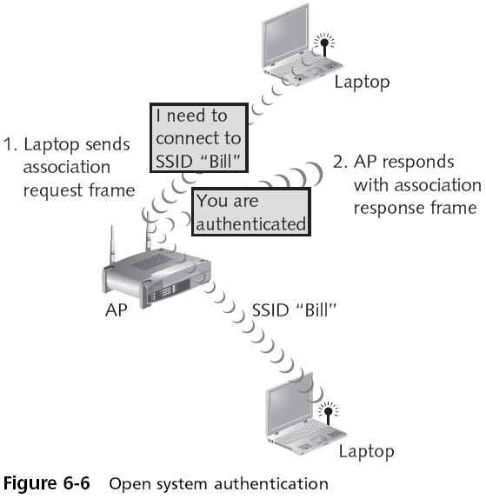

Slide 20
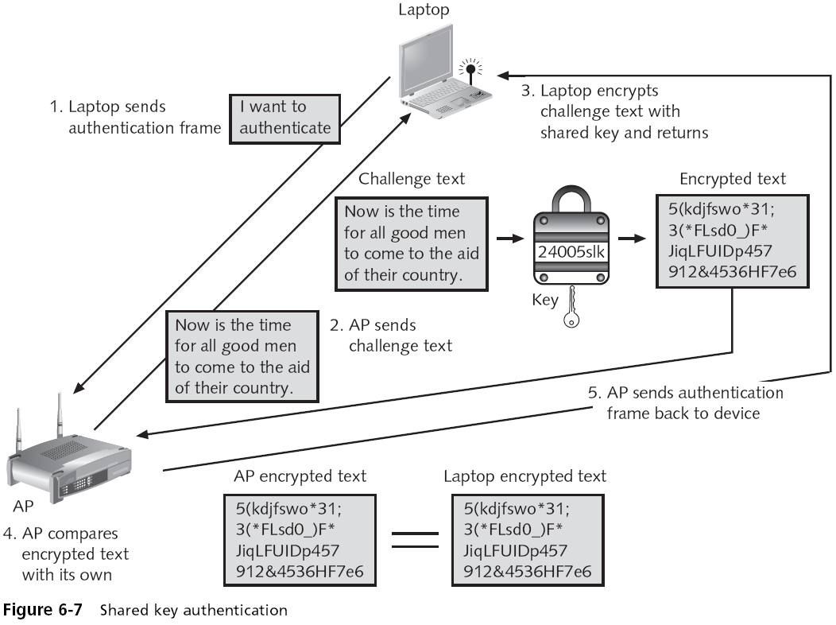

Slide 21
WEP Summary
Authentication is first carried out via
open system authentication, or
shared key authentication
Data packets are then encrypted using the WEP encryption process described above. Each packet requires a new IV.

Slide 22
WEP Weaknesses
Static WEP keys (no periodic updates)
High frequency of repeating the same IV
IVs are only 24-bit long
Packets can be replayed to force the access point to pump out IVs.
CRC is weak in integrity check.
An attacker can flip a bit in the encrypted data and then change the CRC as well.
Authentication is too simple.

Slide 23
WPA

Slide 24
WPA History
Wireless Ethernet Compatibility Alliance (WECA)
A consortium of wireless equipment manufacturers and software providers
WECA goals:
To encourage wireless manufacturers to use the IEEE 802.11 technologies
To promote and market these technologies
To test and certify that wireless products adhere to the IEEE 802.11 standards to ensure product interoperability

Slide 25
WPA History (2)
In 2002, the WECA organization changed its name to Wi-Fi (Wireless Fidelity) Alliance
In October 2003 the Wi-Fi Alliance introduced Wi-Fi Protected Access (WPA)
WPA had the design goal to protect both present and future wireless devices, addresses both wireless authentication and encryption
PSK or 802.11X addresses authentication and TKIP addresses encryption

Slide 26
WPA: Improving WEP Encryption
Key size increased to 128 bits
Larger IVs: 48-bit long
Changing security keys through Temporary Key Integrity Protocol (TKIP)
Encryption keys are changed (based on a master key) after a certain number of packets have been sent.
An IV is mixed with data (not concatenate).
Ciphering scheme is the same as WEP
compatible with old wireless LAN cards

Slide 27
WPA: Improving Integrity Check
WPA uses a new message integrity check scheme called Michael, replacing the CRC function in WEP.
A frame counter is added to Michael to avoid replay or forgery attack.

Slide 30
WPA Authentication
Two options:
PSK (inexpensive, home/personal networking)
802.11X (expensive, enterprise networking)

Slide 31
WPA Personal Security
Pre-shared key (PSK) authentication
Uses a passphrase to generate the encryption key
Key must be entered into both the access point and all wireless devices
Prior to the devices communicating with the AP
The PSK is not used for encryption
Instead, it serves as the starting point (seed) for mathematically generating the encryption keys
Results in a pair-wise master key (PMK)
Followed by a 4-way handshake to handle key management and distribution, which uses the PMK to generate a pair-wise transient key (PTK).

Slide 32
WPA Personal Security (2)

Slide 33
Pre-Shared Key Weakness
A PSK is a 64-bit hexadecimal number
Usually generated from a passphrase
Consisting of letters, digits, punctuation, etc. that is between 8 and 63 characters in length
If the passphrase is a common word, it can be found with a dictionary attack

Slide 34
PSK Key Management Weaknesses
People may send the key by e-mail or another insecure method
Changing the PSK key is difficult
Must type new key on every wireless device and on all access points
In order to allow a guest user to have access to a PSK WLAN, the key must be given to that guest

Slide 35
WPA Authentication via 802.11X
Three components:
Remote authentication dial-in user service (RADIUS)
authenticator (access point)
supplicant (client)
Uses EAP authentication framework
EAP-PSK, EAP-TLS, EAP-TTLS, EAP-MD5
Results in a pair-wise master key (PMK)
Followed by a 4-way handshake to handle key management and distribution, which uses the PMK to generate a pair-wise transient key (PTK).

Slide 36
EAP-TLS
AS verifies client’s digital signature using client’s public key got from client’s certificate Cert_{client}
Get random number p by decrypting with its private key
Client calculates H(c,s,p), compares it with the value sent by As

Slide 37
4-way Handshake

Slide 38
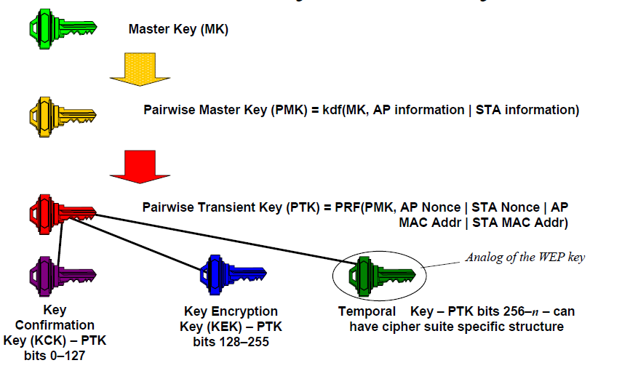
Key Hierarchy

Slide 40
WPA2

Slide 41
WPA2 Personal Security
Wi-Fi Protected Access 2 (WPA2)
Introduced by the Wi-Fi Alliance in September 2004
The second generation of WPA security
Still uses PSK (Pre-Shared Key) authentication
But instead of TKIP encryption it uses a stronger data encryption method called AES-CCMP
AES: Advanced Encryption Standard
CCMP: Counter Mode with Cipher Block Chaining Message Authentication Code Protocol

Slide 42
WPA2 Personal Security (2)
PSK Authentication
Intended for personal and small office home office users who do not have advanced server capabilities
PSK keys are automatically changed and authenticated between devices after a specified period of time known as the rekey interval

Slide 43
WPA2 Personal Security (3)
AES-CCMP Encryption
Encryption under the WPA2 personal security model is accomplished by AES-CCMP
This encryption is so complex that it requires special hardware to be added to the access points to perform it

Slide 44
WPA and WPA2 Compared

Slide 45
WPA2 Enterprise Security
The most secure method
Authentication uses IEEE 802.1x
Encryption is AES-CCMP

Slide 46
Wireless Security Models

Slide 47
802.11i
A superset of all WLAN security mechanisms including WEP, WPA and WPA2.
PSK (personal) or 802.11X (enterprise) is used for authentication and key management.

Slide 48
Reference
Section 6.3.1, Wireless Mesh Networks, by I. F. Akyildiz and X. Wang

