Slide 1
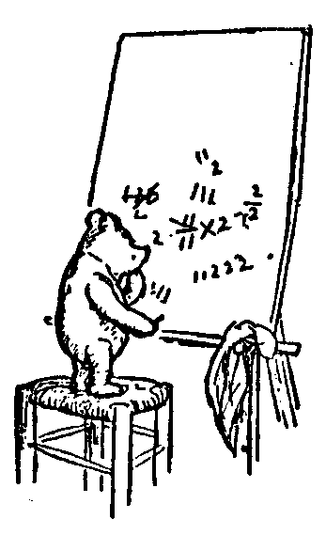
Logic for Computer Science
(Representing Numbers)
Calculous Epsilon/Delta Proofs
Vector Spaces
Graphs
Induction
Fields
Constructing Integers
Finite Fields
Proofs for Integers
Finite, Countable, and Uncountable
Jeff Edmonds
York University
Lecture 7

Slide 2
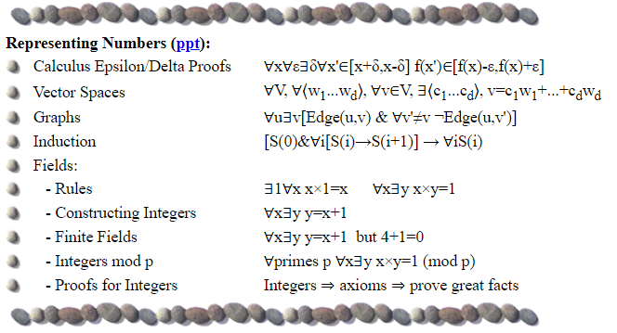
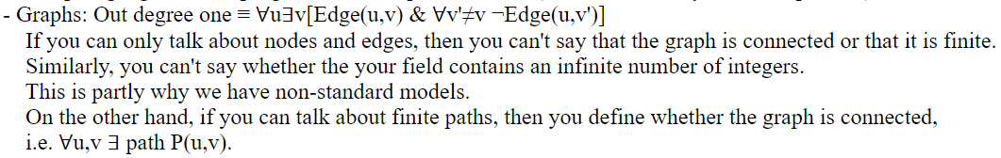
Representing Numbers

Slide 3
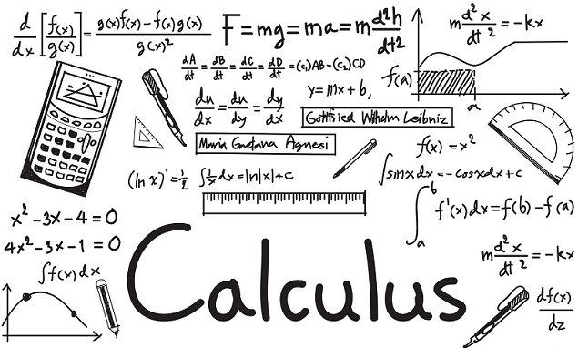
Continuous & Converging
Epsilon Delta Proofs: Key to calculus, analysis, and set theory.

Slide 4
Continuous & Converging
Continuous:
Let the function f(x) be from reals to reals.
f is said to be continuous everywhere
iff ∀x, f is continuous at x
iff ∀x, for an arbitrary definition of closeness,
as x' approaches x
f(x') stays close to f(x).
iff ∀x, ∀ε>0, within a sufficiently small range near x,
f does not vary by more than ε
iff ∀x, ∀ε>0, ∃δ>0, ∀x'∈[x−δ,x+δ], |f(x')-f(x)|<ε
f(x')
ε
f(x)
ε
f(x)
δ
δ
x'
x

Slide 5
Continuous & Converging
Converge: Consider the infinite sequence.
It is said to converge to the value a
iff for an arbitrary definition of closeness,
the sequence eventually gets and stays close to a
iff ∀ε>0, ∃i, ∀i'≥i, |a_{i'}-a_{i}|<ε.
ε
a
ε
a₁, a₂, a₃, a₄, a₅, a₆, a₇, a₈, a₉, a₁₀, ….
i'
i

Slide 6
Continuous & Converging
Try to prove the follow:
Assume that f(x) is continuous everywhere.
As 1, 2, 3, 4, 5, … goes to infinity,
¹/₁, ¹/₂, ¹/₃, ¹/₄, ¹/₅, … converges to
f(¹/₁), f(¹/₂), f(¹/₃), f(¹/₄), f(¹/₅), … converges to
The proof follows our intuition
but is completely mechanical symbol manipulation
like done in Logic 1090
0
f(0)
ε
f(0)
ε
a
a₁, a₂, a₃, a₄, a₅, a₆, a₇, a₈, a₉, a₁₀, ….
i
i'

Slide 7
Continuous & Converging
Intermediate Value Theorem:
∀f where f(x) is a continuous function from the reals to the reals
∀a,b with f(a)<0 and f(b)>0,
∃r∈[a,b] for which
Binary search gets you closer and closer but not there.
The proof follows our intuition
but is completely mechanical symbol manipulation
like done in Logic 1090
f(r)=0.
0
f(x)
a
r
b
Actually, Predicate logic only allows quantification over simple objects.
Here f is a function, so ∀f is technically second order logic.

Slide 8
Vector Spaces
A basis of a vector space:
  A tuple [w₁,w₂,…,w_{d}] of “vectors”
  Linearly independent (none is sum of the others)
  Spans the space uniquely
  ∀ vectors v in the entire space
  ∃ real coeficients [a₁,a₂,…,a_{d}]
  so that v is this linear combination of the basis vectors,
  v = a₁w₁+a₂w₂ +… + a_{d}w_{d}
Basis = [w₁,w₂,…,w_{d}] = [ , ]
v =
[a₁,a₂,…,a_{d}] =
[3,-1]
Notes:
8

Slide 9
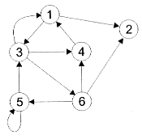
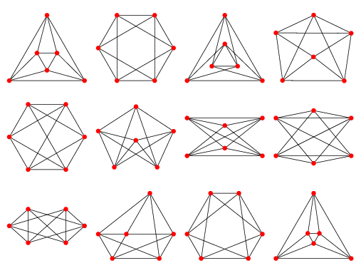
Graphs
Graph: Edges between the nodes (Directed or undirected)

Slide 10
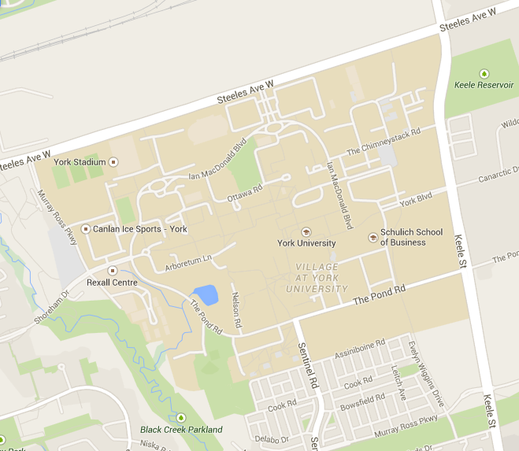
Graphs
Graph: Edges between the nodes (Directed or undirected)
Eg: Cities and roads

Slide 11

Graphs
Graph: Edges between the nodes (Directed or undirected)
Eg: Computers and networks

Slide 12
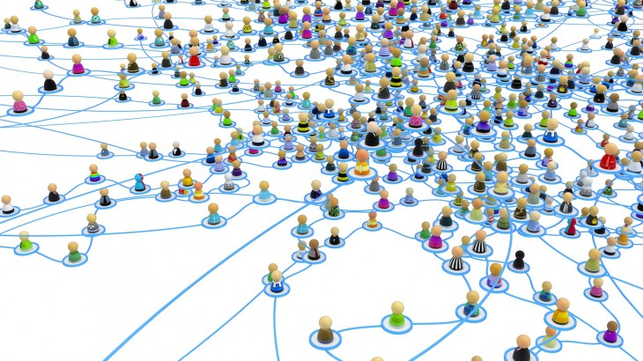
Graphs
Graph: Edges between the nodes (Directed or undirected)
Eg: Social Networks

Slide 13

Graphs
Every
node u is in a triangle
∀u,
∃v&w, edge(u,v)∧edge(u,w)∧edge(v,w)
u
v
w
Any finite graph structure can be expressed
by a Predicate logic statement
whose length ≅ size of structure.

Slide 14
Graphs
Every
node v has in an out degree 1
∀v,
∃u, [edge(u,v)
& ∃w, [edge(v,w)
& ∀u′, u≠u′ → ¬edge(u′,v) ]
& ∀w′, w≠w′ → ¬edge(v,w′) ]
u′
u
v
w
u′′
Does the graph need to be infinite?
Is this it?

Slide 15
Graphs
Graph G has an finite/infinite number of nodes.
G is connected.
No fixed length Predicate logic statement Φ can say these.
Proof:
To talk about k nodes of the graph, we need |Φ| ≥ k
∀Φ,
∃G
with |G| >> |Φ|,
Φ is to short to say
G is connected.
Not completely true. I can say:
∀ nodes uv ∃ Path P connecting u to v.
∀ nodes uv ∃ integer P encoding a path connecting u to v.
I meant where Φ quantifies only over nodes.

Slide 16
Proofs with Implications
Induction
Α ⇒ Β
If A is true then B is true.
This may because A causes B.
The counter positive is ¬B ⇒ ¬A
because if B is not true, then A can’t be true
because otherwise B would be true.
Hence ¬B may cause ¬A.
Or C may cause both A and B.
Or maybe cause and eﬀect is not involved at all.
A ⇒ B formally means ¬(A and ¬B)
Bring the negation in gives ¬A or B
If A is false, then the statement A ⇒ B follows.
If B is true, then A ⇒ B again follows.
Notes:
16

Slide 17
Induction
Let S(i) be a statement that for each i maybe true or false.
Goal: Prove that ∀i S(i).
Proof:
Prove S(0) is true.
Prove: ∀i S(i) ⇒ S(i+1)
  Let i be arbitrary.
  Assume that S(i) is true.
  Prove that it follows that S(i+1) is true.
By way of induction, ∀i S(i) is true.
S(0)
⇒ S(1)
⇒ S(2)
⇒ S(3)
⇒ S(4)
⇒ …
Predicate logic statement:
[S(0) & ∀i S(i)⇒S(i+1)] ⇒ ∀i S(i)

Slide 18
Induction
Predicate logic statement:
[S(0) & ∀i S(i)⇒S(i+1)] ⇒ ∀i S(i)
Do we KNOW this is true in our universe?
0
i
i+1
…
Do we KNOW that this process reaches all i?
S(0)
⇒ S(1)
⇒ S(2)
⇒ S(3)
⇒ S(4)
⇒ …
Induction is an axiom that we must define to be true.
It says something about the nature of the integers.

Slide 19
Induction
Predicate logic statement:
[S(0) & ∀i S(i)⇒S(i+1)] ⇒ ∀i S(i)
A⇒B iff ¬B⇒¬A
¬[∀i S(i)] ⇒ ¬[S(0) & ∀i S(i)⇒S(i+1)]
⇒ ¬S(0) or
∃i ¬[S(i)⇒S(i+1)]
∃i S(i) & ¬S(i+1)]
or
S(0)
⇒ S(1)
⇒ S(2)
⇒ S(3)
⇒ S(4)
⇒ …

Slide 20
Induction
Claim: Every positive integer is special.
Proof:
Clearly 0 is special.
By way of contradiction assume they are not all special.
Let i be the smallest integer that is not special.
Well having that distinction would make i very special.
This contradicts i not being special.
Hence, every positive integer must be special.
or
special
special
special
special
special
not special
S(0)
⇒ S(1)
⇒ S(2)
⇒ S(3)
⇒ S(4)
⇒ …

Slide 21

Induction
Claim: Every positive integer is special.
Proof:
Clearly 0 is special.
By way of contradiction assume they are not all special.
Let i be the smallest integer that is not special.
Well having that distinction would make i very special.
This contradicts i not being special.
Hence, every positive integer must be special.
or
special
special
special
special
special
not special
S(0)
⇒ S(1)
⇒ S(2)
⇒ S(3)
⇒ S(4)
⇒ …

Slide 22
Fields
A Field has:
  A universe U of values
  Two operations: + and ×
  + Identity: ∃0 ∀a a+0 = a
  × Identity: ∃1 ∀a a×1 = a
  ∀a,b,c
  Associative: a+(b+c) = (a+b)+c & a×(b×c) = (a×b)×c
  Commutative: a+b = b+a & a×b = b×a
  Distributive: a×(b+c) = (a×b) + (a×c)
  + Inverse: ∀a ∃b a+b=0, i.e. b=-a
  × Inverse: ∀a≠0 ∃b a×b=1, i.e. b=a⁻¹
Examples:
  Reals, Rationals, & Complex Numbers
  Integers
  Invertible Matrices
No
Differentiates
between
+ and ×
No
?
?
Notes:
22

Slide 23
Fields
A Field has:
  A universe U of values
  Two operations: + and ×
  + Identity: ∃0 ∀a a+0 = a
  × Identity: ∃1 ∀a a×1 = a
  ∀a,b,c
  Associative: a+(b+c) = (a+b)+c & a×(b×c) = (a×b)×c
  Commutative: a+b = b+a & a×b = b×a
  Distributive: a×(b+c) = (a×b) + (a×c)
  + Inverse: ∀a ∃b a+b=0, i.e. b=-a
  × Inverse: ∀a≠0 ∃b a×b=1, i.e. b=a⁻¹
Does a×0 = 0 ?
Proof: a×0
(& a×0 = 0)
= (a×0)+0
= (a×0) + (a+(-a))
= ((a×0)+a) + (-a)
= ((a×0)+(a×1)) + (-a)
= (a×(0+1)) + (-a)
= (a×1) + (-a)
= a + (-a)
= 0
Notes:
23

Slide 24
Constructing Integers
I want to prove everything about the integers
If you start assuming you know nothing about them,
then you can’t start.
If you start assuming you know lots,
then there is nothing left to do.
Ok, I will assume (axioms) as little as I can get away with.

Slide 25
Constructing Integers
Lets start by building the objects: 0,1,2,3,…
In Predicate logic, we can have an infinite number of objects in your universe.
You can make global statements about them with ∀i.
You can have a few constants.
Your axioms need to be finite.
Ok, lets start with the constant 0.
In Predicate logic, we have functions like x+y
producing an objects from a pair of objects.
Ok, lets have the function s(i) that given i
returns the successor i+1

Slide 26
Constructing Integers
My integers are
0 = 0
1 = s(0)
2 = s(s(0))
3 = s(s(s(0)))
4 = s(s(s(s(0))))
….
Remember what happened to the line of nodes.
That’s as good as we can do.
0
s(0)
s(s(0))
s(s(s(0)))
We can say s(s(s(s(0)))) ≠ 0,
but we can only say of few of these.

Slide 27
Constructing Integers
To prove everything about the integers,
I need to know something about addition.

Slide 28

Constructing Integers
I have x and y
and must compute sum(x,y)
Recursion
You can have as many
friends as you want.
You give each a sub instance.
  Meets the precondition
  Smaller
Trust them to give you
the output for their instances.
I give my friend
(x-1) and (y+1).
Size = x-1
I return sum(x-1,y+1)
I return sum(x-1,y+1) = sum(x,y)

Slide 29
Constructing Integers
I have 0 and y′
and must compute sum(0,y′)
Recursion
If your input has size zero,
you must solve it yourself.
I return y′

Slide 30
Constructing Integers
x = 4
y = 5
x+y =
My responsibility is to ensure that my algorithm works
under the assumption
that my friends do
their job correctly.
Stack Frame:
A particular execution
of one routine
on one particular input instance.
Lets trace out the execution
on a computer.

Slide 31
Constructing Integers
x = 4
y = 5
x+y =
x = 3
y = 6
x+y =
My responsibility is to ensure that my algorithm works
Our friend is
a separate execution
with separate stack frame
with its own local variables.
under the assumption
that my friends do
their job correctly.
Lets trace out the execution
on a computer.

Slide 32
Constructing Integers
x = 4
y = 5
x+y =
9
x = 3
y = 6
x+y =
9
x = 2
y = 7
x+y =
9
x = 1
y = 8
x+y =
9
Lets trace out the execution
on a computer.
x = 0
y = 9
x+y =
9

Slide 33
Constructing Integers
To prove everything about the integers,
I need to know something about addition.
This tells me that what x+y does can be captured by
∀y, sum(0,y) = y
∀x&y, sum(s(x),y) = sum(x,s(y))
Similarly for x×y,
∀y, mult(0,y) = 0
∀x&y, mult(s(x),y) = sum( mult(x,y), y )
Similarly for y^{x},
∀y, exp(y,0) = 1
∀x&y, exp(y,s(x)) = mult( exp(y,x), y )

Slide 34
Constructing Integers
To prove everything about the integers,
I need to know something about addition.
This tells me that what x-y does can be captured by
∀x&y, ∃z, y+z=x
Similarly for ^{x}/_{y},
∀x&y, ∃z, y×z= x
Similarly for log_{y}(x),
∀x&y, ∃z, y^{z} = x

Slide 35
Constructing Integers
Actually we only consider positive integers.
This tells me that what x-y does can be captured by
∀x&y, ∃z, y+z=x
or (y>x and z=0)
max(x-y,0)
Similarly for ^{x}/_{y},
∀x&y, ∃z, y×z= x
and y×(z+1)>x
⎣^{x}/_{y} ⎦
≤
Similarly for log_{y}(x),
∀x&y, ∃z, y^{z} = x
and y^{(z+1)} >x
⎣log_{y}(x) ⎦
≤

Slide 36
Constructing Integers
There. If we insist on all of these things,
then we must get the integers!
I’m afraid not.
No fixed length Predicate logic statement Φ say:
“The universe only has an finite/infinite number of ints.”
Proof:
To talk about k integers, we need |Φ| ≥ k
But here k=∞. No finite Φ is long enough.

Slide 37
Finite Fields
+
0
1
2
3
4
Integers mod 5 (Z/5)
  Universe U = {0,1,2,3,4}
  Two operations + and ×
    3+4 = 7 =_{mod 5} 2
    3×4 = 12 =_{mod 5} 2
0
0
1
2
3
4
1
1
2
3
4
0
2
2
3
4
0
1
3
3
4
0
1
2
4
4
0
1
2
3
Don’t think of mod 5
as a function mod₅(7) = 2.
Think of it as equivalence classes
… -8 =_{mod 5} -3 =_{mod 5} 2 =_{mod 5} 7 …
Must prove + & × are well defined
[a]_{modp} × [b]_{modp} = [a+ip]×[b+jp]
= a×b + (aj+bi+ijp)p
= [a×b]_{modp}
×
0
1
2
3
4
0
0
0
0
0
0
1
0
1
2
3
4
2
0
2
4
1
3
3
0
3
1
4
2
4
0
4
3
2
1
Notes:
37

Slide 38
Finite Fields
+
0
1
2
3
4
My integer construction is not violated.
0, s(0), s(s(0)), s(s(s(0))), s(s(s(s(0))))
0
0
1
2
3
4
1
1
2
3
4
0
5 = 0 _{mod 5}
s(s(s(s(s(0))))) = 0
2
2
3
4
0
1
3
3
4
0
1
2
4
4
0
1
2
3
∀y, sum(0,y) = y
∀x&y, sum(s(x),y) = sum(x,s(y))
×
0
1
2
3
4
0
0
0
0
0
0
Similarly for x×y,
∀y, mult(0,y) = 0
∀x&y,
mult(s(x),y) = sum( mult(x,y), y )
1
0
1
2
3
4
2
0
2
4
1
3
3
0
3
1
4
2
4
0
4
3
2
1
Notes:
38

Slide 39
Finite Fields
+
0
1
2
3
4
  Special value 0
    a+0 = a
    a×0 = 0
  Special value 1
    a×1 = a
0
0
1
2
3
4
1
1
2
3
4
0
2
2
3
4
0
1
3
3
4
0
1
2
4
4
0
1
2
3
×
0
1
2
3
4
0
0
0
0
0
0
1
0
1
2
3
4
2
0
2
4
1
3
3
0
3
1
4
2
4
0
4
3
2
1
Notes:
39

Slide 40
Finite Fields
+
0
1
2
3
4
0
0
1
2
3
4
Associative:
  a+(b+c) = (a+b)+c
  a×(b×c) = (a×b)×c
Commutative:
  a+b = b+a
  a×b = b×a
Distributive:
  a×(b+c) = a×b + a×c
1
1
2
3
4
0
2
2
3
4
0
1
3
3
4
0
1
2
4
4
0
1
2
3
×
0
1
2
3
4
0
0
0
0
0
0
1
0
1
2
3
4
2
0
2
4
1
3
3
0
3
1
4
2
4
0
4
3
2
1
Notes:
40

Slide 41
Finite Fields
+
0
1
2
3
4
  Inverses:
    ∀a ∃b a+b=0, i.e. b=-a
      2+(-2) =_{mod 5} 0
      2 + 3 = 5 =_{mod 5} 0
    ∀a≠0 ∃b a×b=1, i.e. b=a⁻¹
      2×(½) =_{mod 5} 1
      2×3 = 6 =_{mod 5} 1
0
0
1
2
3
4
?
1
1
2
3
4
0
2
2
3
4
0
1
3
3
4
0
1
2
?
4
4
0
1
2
3
×
0
1
2
3
4
Such inverse always exist
iff
mod prime p
0
0
0
0
0
0
1
0
1
2
3
4
2
0
2
4
1
3
  Integers mod prime p ➔ field:
    ∀prime p ∀a ∃b a×b=_{mod p}1
3
0
3
1
4
2
4
0
4
3
2
1
Notes:
41

Slide 42
Fields
Finite
Problems for computers:
  Reals
    Too much space
    Lack of precision
  Integers
    Lack of inverses
    Grow too big
Better field?
  Finite field, eg integers mod a prime
Notes:
42

Slide 43
Proofs for Integers
I still want to prove everything about the integers
Prove:
{All these assumptions/axioms }
⇒ some great fact you want to prove about the integers.
Then you get for free:
Integers
⇒{All these assumptions/axioms }
⇒ some great fact you want to prove about the integers.

Slide 44
2001: Countable
and Uncountable Infinite
Description Length and Carnality
Countable
Countable via a List
Countable via Finite Descriptions
Uncountable
Hierarchy of Infinities
Some Uncomputable Problem
Not covered
Jeff Edmonds
York University
Lecture 6.0
COSC 2001

Slide 45
Finite
S = { a | a is a planck size quantum in the universe }
Planck’s length = 10⁻³⁵ m.
Width of universe = 100 billion light years
= 10²⁷ m.
= 10⁶² planck’s lengths.
|S| = volume = (width)³ = 10¹⁸⁶ planck size quantum
= finite
Anything bigger is not really of this reality.

Slide 46
Countably Infinite
S₀ = { α | α is a 0/1 string of length 5 }
|S₀| =
2⁵
2 choices × 2 choices × … × 2 choices
S₁ = { α | α is a 0/1 string of length arbitrarily long but finite }
interpret α as the description of an integer in binary eg 101₂=5
= { n | n is an integer }
interpret α as an ascii string eg “cat”
= { s | s is a finite string in ascii }
interpret α as the description of a fraction eg “3/4”
= { x | x is a fraction/rational }
interpret α as the description of a Turing Machine / Alg
= { M | M is a TM }
|S₁| =
2^{arbitrarily long but finite}
= |Integers|
= countable

Slide 47
Uncountable
S₀ = { α | α is a 0/1 string of length 5 }
|S₀| =
2⁵
2 choices × 2 choices × … × 2 choices
S₂ = { α | α is a 0/1 string of length infinite }
interpret α as the description of a real in binary eg 0.10010…₂
= { r | r is a real in (0..1) }
interpret α as a function from ints to {0,1}
eg f(0) = 1, f(1) = 0, f(2) = 0, f(3) = 1, f(4) = 0, …
= { f | f:ints→{0,1} }
interpret α as a function from finite strings to {N,Y}
eg L(0) = Y, L(1) = N, L(10) = N, L(11) = Y, L(100) = N, …
ie L is a language.
= { L | L:strings→{0,1} } = { L | L is a language }
= { P | P is a computational problem }
|S₂| =
0 1 2 3 4 …
2^{infinite}
= |Reals|
= uncountable

Slide 48
Description Length vs Cardnality
 | |”α”| = length of description of each item | |{α}| = cardnality of set containing all such items
Finite | 5 | 2⁵
Integers | Arbitrarily long but finite | Countably Infinite
Reals | Infinite (countable) | Uncountable

Slide 49
Some Uncomputable Problem
|Integers|
=
|Fractions|
<<
|Reals|
Each defined by
a finite string
Each defined by
a finite string
Most defined by
an infinite string
<<
Set of TM/Algorithms
Each defined by
a finite string
Countable in size
Set of Comp. Problems
For each input I,
must define what P does.
Most defined by
an infinite string
Uncountable in size
Most problems
do not have
an algorithm!!!
∃P ∀M ∃ I M(I)≠P(I)

Slide 50
End

Slide 51
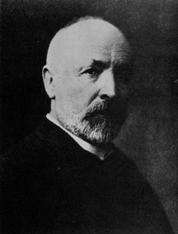
Countable Infinity
A finite set contains some integer number of elements.
{ , 4, }
The size of an infinite set is bigger than any integer.
The set of natural numbers N = {1,2,3,4,… }
The set of fractions Q = {¹/₂, ²/₃, ... }
The set of reals R = {2.34323…, 34.2233…, π, e, …}
Are these infinite sets the same “size”?
Two sets have the same size
if there is a bijection between them.
|{ , 4, }|
= |{ 1, 2, 3 }|
= 3
Cantor (1874)

Slide 52
Do N and E have the same cardinality?
Countable Infinity
N = { 0, 1, 2, 3, 4, 5, 6, 7, …. }
E = The even, natural numbers.

Slide 53
Countable Infinity
E and N do not have the same cardinality!
E is a proper subset of N with plenty left over.
0, 1, 2, 3, 4, 5, 6, 7, 8,….
0, 2, 4, 6, 8,….
f(x)=x is not a bijection.

Slide 54
Countable Infinity
E and N do have the same cardinality!
0, 1, 2, 3, 4, 5, ….…
0, 2, 4, 6, 8,10, ….
f(x) = 2x is a bijection

Slide 55
Countable Infinity
Lesson:
Cantor’s definition only requires that bijection between the two sets.
Not that all 1-1 correspondences
are onto.
This distinction never arises when the sets are finite.

Slide 56
Countable Infinity
If this makes you feel uncomfortable…..
TOUGH! It is the price that you must pay to reason about infinity

Slide 57
Countable Infinity
The set of integers N = {1,2,3,4,… }
The set of fractions Q = {¹/₂, ²/₃, ... }
Are these infinite sets the same “size”?
Two sets have the same size
if there is a mapping between them.
|{ , 4, }|
= |{ 1, 2, 3 }|
= 3

Slide 58
Countable Infinity
The set of integers N = {1,2,3,4,… }
The set of fractions Q = {¹/₂, ²/₃, ...
Are these infinite sets the same “size”?
Two sets have the same size
if there is a mapping between them.
1,2,3,4,… }
Q looks bigger.
|{ , 4, }|
= |{ 1, 2, 3 }|
= 3

Slide 59
Countable Infinity
No way!
The rationals are dense: between any two there is a third. You can’t list them one by one without leaving out an infinite number of them.

Slide 60
Countable Infinity
Don’t jump to conclusions!
There is a clever way to list the rationals, one at a time, without missing a single one!

Slide 61
Countable Infinity
...
...
6
⁶/₁
⁶/₂
⁶/₃
⁶/₄
⁶/₅
⁶/₆
⁶/₇
⁶/₈
All positive
fractions
5
⁵/₁
⁵/₂
⁵/₃
⁵/₄
⁵/₅
⁵/₆
⁵/₇
⁵/₈
4
⁴/₁
⁴/₂
⁴/₃
⁴/₄
⁴/₅
⁴/₆
⁴/₇
⁴/₈
3
³/₁
³/₂
³/₃
³/₄
³/₅
³/₆
³/₇
³/₈
2
²/₁
²/₂
²/₃
²/₄
²/₅
²/₆
²/₇
²/₈
...
Count them
by mapping.
1
¹/₁
¹/₂
¹/₃
¹/₄
¹/₅
¹/₆
¹/₇
¹/₈
1 2 3 4 5 6 7 8
Oops we never
get to ²/₁!
{ 1, 2, 3, 4, 5, 6, …. }
All positive integers

Slide 62
Countable Infinity
...
...
6
⁶/₁
⁶/₂
⁶/₃
⁶/₄
⁶/₅
⁶/₆
⁶/₇
⁶/₈
All positive
fractions
5
⁵/₁
⁵/₂
⁵/₃
⁵/₄
⁵/₅
⁵/₆
⁵/₇
⁵/₈
4
⁴/₁
⁴/₂
⁴/₃
⁴/₄
⁴/₅
⁴/₆
⁴/₇
⁴/₈
Over counting just
means we proved
|N|≥|Q|
3
³/₁
³/₂
³/₃
³/₄
³/₅
³/₆
³/₇
³/₈
2
²/₁
²/₂
²/₃
²/₄
²/₅
²/₆
²/₇
²/₈
...
Count them
by mapping.
1
¹/₁
¹/₂
¹/₃
¹/₄
¹/₅
¹/₆
¹/₇
¹/₈
1 2 3 4 5 6 7 8
Every rational gets
mapped to some integer!
|N|=|Q|
Q is “Countable”
{ 1, 2, 3, 4, 5, 6, …. }
All positive integers

Slide 63
Countable Infinity
How is it that we can loop over all tuples ⟨a,b,c⟩
ensuring that we eventually get to each?
loop a,b,c ≥ 0
  print(a,b,c);
end loop
loop a ≥ 0
loop b ≥ 0
loop c ≥ 0
print(a,b,c);
No, this inner loop will never exit.
We will never get to b=1

Slide 64
Countable Infinity
How is it that we can loop over all tuples ⟨a,b,c⟩
ensuring that we eventually get to each?
loop a,b,c ≥ 0
  print(a,b,c);
end loop
Though this will never list them all.
Each ⟨a,b,c⟩ will eventually be listed.
loop sum = 0,1,2,…..
loop a = 0,…,sum
loop b = 0,…,sum-a
c = sum-a-b
print(a,b,c);
Eg: ⟨3,7,5⟩ gets printed
when sum = 15, a=3,
and b=7.
The set of tuples {⟨a,b,c⟩} is countable.

Slide 65
Countable Infinity
A set S is called countable if |S| ≤ |N|
|S| = |{ , 4, , ….. }|
≤ |{ 1, 2, 3, 4, 5, … }| = |N|
Note a finite set is countable.
If also |S| ≥ |N|, then S is called countably infinite.

Slide 66
Countable Infinity
A set S is called countable if |S| ≤ |N|
|S| = |{ , 4, , ….. }|
≤ |{ 1, 2, 3, 4, 5, … }| = |N|
There is a list containing each object
∃List, ∀xϵS, ∃ iϵN List(i) = x
Each integer (index in list)
lists at most one object xϵS
i x = List(i)
1:
2:
3:
4:
5:
Each object xϵS
appears some where in the list
4

Slide 67
Countable Infinity
A set S is called countable if |S| ≤ |N|
|S| = |{ , 4, , ….. }|
Give each object a
finite description.
“apple” “four” “chair”
≤ |{ 1, 2, 3, 4, 5, … }| = |N|
Two equivalent definitions of a set S being “Countable”
There is a list containing each object
∃List, ∀xϵS, ∃ iϵN List(i) = x
Each object xϵS has (at least one) finite description
such that each description uniquely identifies that object.
My name is
Herr Dr Professor Wizard the great great great ….
Just because you have an infinite name does not mean the set { } is not countable!
I call you
Bob

Slide 68
Countable Infinity
A set S is called countable if |S| ≤ |N|
|S| = |{ , 4, , ….. }|
Give each object a
finite description.
“apple” “four” “chair”
≤ |{ 1, 2, 3, 4, 5, … }| = |N|
Two equivalent definitions of a set S being “Countable”
There is a list containing each object
∃List, ∀xϵS, ∃ iϵN List(i) = x
Each object xϵS has (at least one) finite description
such that each description uniquely identifies that object.
∃Language, ∀xϵS, ∃ nameϵASCII* Language(name) = x
|S| ≤ |ASCII*| ≤ |N|

Slide 69
Countable Infinity
A set S is called countable if |S| ≤ |N|
|S| = |{ , 4, , ….. }|
Give each object a
finite description.
“apple” “four” “chair”
‘a’ ‘p’ ‘p’ ‘l’ ‘e’
‘c’ ‘h’ ‘a’ ‘i’ ‘r’
Break each description
into a string of characters.
‘f’ ‘o’ ‘u’ ‘r’
61 70 70 6C 65
63 68 61 69 72
Convert each character
to Hex-Ascii.
66 6F 75 72
Concatenate the Hex
into one Hex integer.
≤ |{ 6170706C65, 666F7572, 6368616972, … }|
≤ |{ 1, 2, 3, 4, 5, … }| = |N|
The number of such
integers is at most the
number of integers.
Hence, this set of
objects is countable.

Slide 70
Countable Infinity
A set S is called countable if |S| ≤ |N|
The set of fractions
|Q| = |{¹/₂, ²/₃, ¹¹/₈ ,... }|
Give each object a
finite description.
“¹/₂ ” “²/₃” “¹¹/₈”
Break each description
into a string of characters.
‘1’ ‘/’ ‘2
‘2’ ‘/’ ‘3’
‘1’ ‘1’ ‘/’ ‘8’
Convert each character
to Hex-Ascii.
31 2F 32
32 2F 32
31 31 2F 38
Concatenate the Hex
into one Hex integer.
≤ |{312F32, 322F32, 31312F38, … }|
The number of such
integers is at most the
number of integers.
≤ |{ 1, 2, 3, 4, 5, … }| = |N|
Hence, this set of
objects is countable.

Slide 71
Countable Infinity
A set S is called countable if |S| ≤ |N|
The set of finite sets of integers
|S| = |{ {3,23,…,98}. ... }|
Give each object a
finite description.
“{3,23,…,98}”
Break each description
into a string of characters.
‘{’ ‘3’ ‘,’ ‘2’ ‘3’ ‘,’ …. ‘,’ ‘9’ ‘8’ ‘3’ ‘7’ ‘}’
7B 33 2C 32 32 2C … 2C 39 38 33 37 7D
Convert each character
to Hex-Ascii.
7B332C32322C…2C393833377D
Concatenate the Hex
into one Hex integer.
≤ |{ 1, 2, 3, 4, 5, … }| = |N|
The number of such
integers is at most the
number of integers.
Hence, this set of
objects is countable.

Slide 72
Countable Infinity
A set S is called countable if |S| ≤ |N|
The set of finite sets of integers
|S| = |{ {3,23,…,98}. ... }|
Give each object a
finite description.
“{3,23,…,98}”
“{23,3,…,98}”
It is ok if an object
is given more than
one description.
‘{’ ‘3’ ‘,’ ‘2’ ‘3’ ‘,’ …. ‘,’ ‘9’ ‘8’ ‘3’ ‘7’ ‘}’
7B 33 2C 32 32 2C … 2C 39 38 33 37 7D
As long as each
description
uniquely identifies
an object.
7B332C32322C…2C393833377D
≤ |{ 1, 2, 3, 4, 5, … }| = |N|

Slide 73
Countable Infinity
A set S is called countable if |S| ≤ |N|
The set of reals
|R| = |{2.34323…, 34.2233…, π, e, …}|
Give each object a
finite description.
Does π or e require and infinite description?
No. π, e describe them just fine.
Does 0.101001000100001000001…. needs an infinite description.
0
1
2
3
4
5
No. I just describe it just fine.

Slide 74
Countable Infinity
A set S is called countable if |S| ≤ |N|
The set of reals
|R| = |{2.34323…, 34.2233…, π, e, …}|
Give each object a
finite description.
We say that a real number x repeats if the
pattern of digits repeats after a finite number
0.345 123 123 123 123 123…
Is the set of all repeating real numbers countable.
Yes. Each has a distinguishing finite description, namely
0.345123
x = 0.345 123 123 123 123 123…
1000x = 345. 123 123 123 123 123…
999x = 345
x = ³⁴⁵/₉₉₉

Slide 75
Countable Infinity
A set S is called countable if |S| ≤ |N|
The set of reals
|R| = |{2.34323…, 34.2233…, π, e, …}|
Give each object a
finite description.
We say that a real number x is computable
if there exists a TM M that on no input will print out each of its digits in decimal notation, 3.4642946….
Given that a real number has an infinite number of digits, at no point will it have printed out all of its digits. But for every integer i, at some point in time, M will have printed out the first i digits of x.
Is the set of all computable real numbers countable.
Yes. Each computable number has a distinguishing finite description, namely
this TM M.

Slide 76
Countable Infinity
A set S is called countable if |S| ≤ |N|
The set of reals
|R| = |{2.34323…, 34.2233…, π, e, …}|
Give each object a
finite description.
Tell me a real number that needs an infinite description.
Impossible. If you can tell it to me,
then it has a finite description.
We say that a real number x is random if it is produced by flipping a 10 sided dice for each of its infinite number of digits.
Is the set of all random real numbers countable.
No. Each random number does need an
infinite amount of information to specify it.

Slide 77
Countable Infinity
A set S is called countable if |S| ≤ |N|
The set of reals
|R| = |{2.34323…, 34.2233…, π, e, …}|
Give each object a
finite description.
Most real seems to require an infinite description.
>>
|R| |{ 1, 2, 3, … }| = |N|
loop reals r
  print(r)
end loop
Can we loop over all reals
ensuring that we eventually get to each?
No!

Slide 78
Uncountable Infinity
A set S is called countable if |S| ≤ |N|
|S| = |{ , 4, , ….. }|
≤ |{ 1, 2, 3, 4, 5, … }| = |N|
∃List, ∀xϵS, ∃ iϵN List(i) = x
Each integer i is able to hit at most one element List(i)=xϵS.
If this can hit every element of element xϵS,
then |S| ≤ |N|.

Slide 79
Uncountable Infinity
A set S is called countable if |S| ≤ |N|
|S| = |{ , 4, , ….. }|
≤ |{ 1, 2, 3, 4, 5, … }| = |N|
∃List, ∀xϵS, ∃ iϵN List(i) = x
A set S is called uncountable if |S| > |N|
∀List, ∃xϵS, ∀iϵN List(i)≠x
i.e. find an x is not mapped to any natural number.
Proof by game:
Let List be an arbitrary mapping from N likely to S.
I construct a value xϵS.
Let i be an arbitrary natural number.
I prove that List(i)≠x

Slide 80
Uncountable Infinity
Proof that |R| > |N|
i.e. ∀List, ∃xϵR, ∀iϵN List(i)≠x
Let List be an arbitrary mapping from N to R.
i x=List(i)
12.34323834749308477599304 …
8.50949039988484877588487 …
930.93994885783998573895002 …
34.39498837792008948859069 …
0.00343988348757590125473 …
…..
Proof by
Diagonalization
We find a real number x_{diagonal} that is not in the list.
The i^{th} digit will be the i^{th} digit of the i^{th} number List(i)
increased by one (mod 10).
Let i be arbitrary in N.
I prove that List(i)≠x_{diagonal}
They differ in the i^{th} digit
x_{diagonal} = 0.41004 …

Slide 81
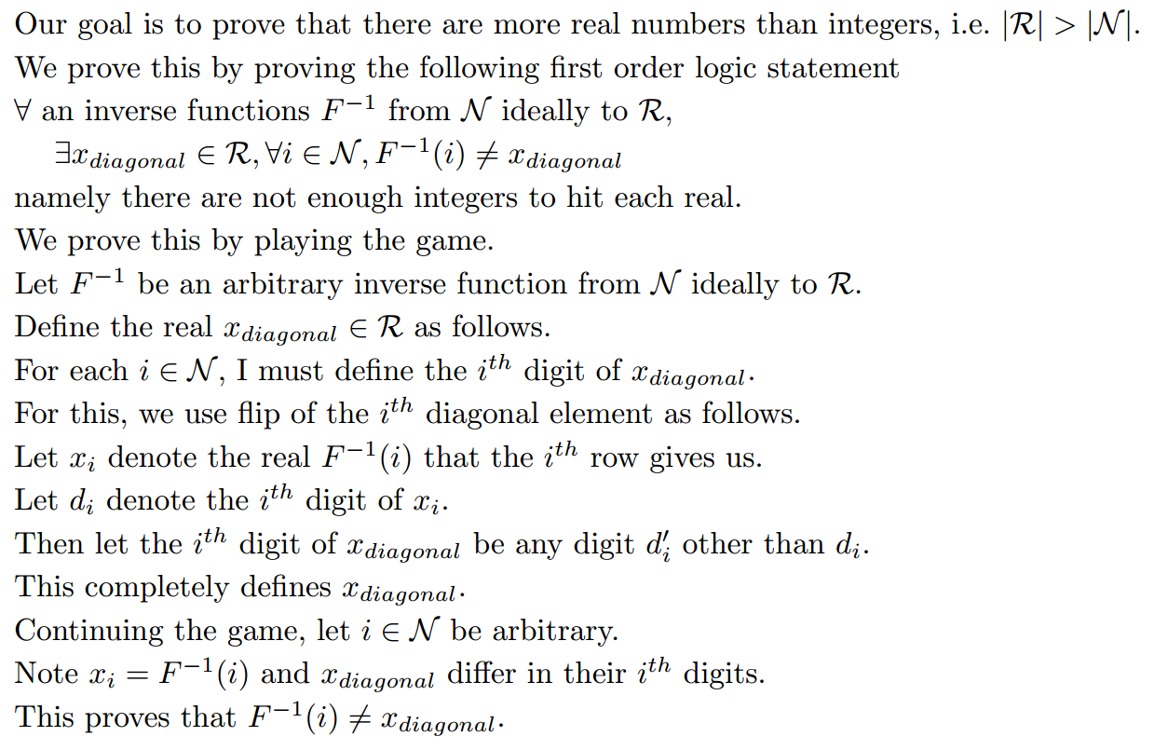
Uncountable Infinity
Proof that |R| > |N|
i.e. ∀List, ∃xϵR, ∀iϵN List(i)≠x
List
List
List
List
List
List

Slide 82
Hierarchy of Infinities
|Integers|
=
|Fractions|
<<
|Reals|
Each defined by
a finite string
Each defined by
a finite string
Most defined by
an infinite string
Set of finite subsets of the integers
{{2,3},{1,3,5,6}, … }
Each defined by a finite string
The set is countable in size
Set of possibly infinite subsets of the integers
{{2,3,…},{1,3,…}, … }
Most defined by a infinite string
The set is uncountable in size

Slide 83
Hierarchy of Infinities
<<
|Reals|
Most defined by
an infinite string
Set of finite subsets of the reals
{{2.394..,3.3563..},{1.982..,3.345..,5.32..}, … }
Each defined by a string of countably infinite length.
The set is same size as the reals
Set of possibly infinite subsets of the reals
{{2.394..,3.3563..,…},{1.982..,3.345..,…}, … }
Each defined by a string of uncountably infinite length.
The set is much bigger than the reals!
There is an infinite hierarchy of infinities!

Slide 84
Some Uncomputable Problem
∃P ∀M ∃ I M(I)≠P(I)
|Integers|
=
|Fractions|
<<
|Reals|
Each defined by
a finite string
Each defined by
a finite string
Most defined by
an infinite string
<<
Set of TM/Algorithms
Each defined by
a finite string
Countable in size
Set of Comp. Problems
For each input I,
must define what P does.
Most defined by
an infinite string
Uncountable in size
Most problems
do not have
an algorithm!!!

Slide 85
Some Uncomputable Problem
∃P ∀M ∃ I M(I)≠P(I)
Some problem
Computable
Known
GCD

Slide 86
End

